Slide 1
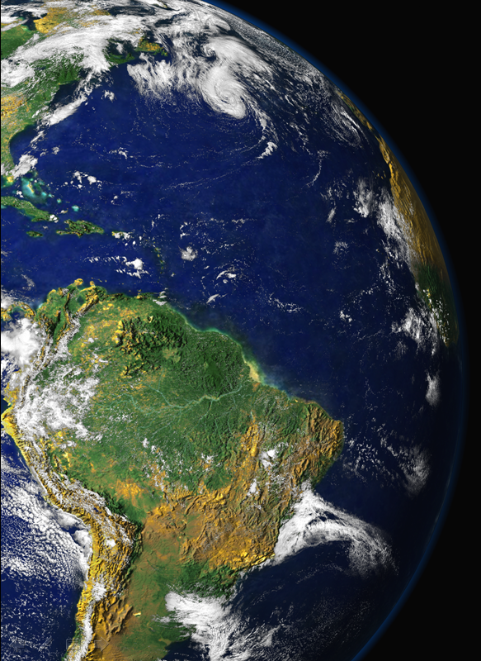
Conferência CONCLIMA 12 de Setembro de 2013
Projeto Temático FAPESP 2008/58100-2
AEROCLIMA - Efeitos diretos e indiretos de aerossóis no clima da Amazônia e Pantanal
Coordenadores: Paulo Artaxo e Maria Assunção F. Silva Dias,
Universidade de São Paulo
Equipe: Henrique Barbosa (IFUSP), Joel Ferreira de Brito (IFUSP), Luciana Rizzo (UNIFESP-Diadema), Theotônio Pauliquevis (UNIFESP-Diadema), Karla Longo (INPE), Saulo Freitas (INPE), David Adams (UEA), Rodrigo Souza (UEA), Wanderley Bastos (UNIR-Porto Velho), Sandra Hacon (FIOCRUZ), Fernando Morais (IFUSP), Alcides Ribeiro (IFUSP), Ana Loureiro (IFUSP), Fábio Jorge (IFUSP), Lívia Oliveira (INPA), Joiada Silva (UNIR-Porto Velho), Rodrigo Marques (UFMT) e José Nogueira (UFMT) , Scot Martin (Harvard), Meinrat Andreae (Max Planck) e muitos outros.

Slide 2
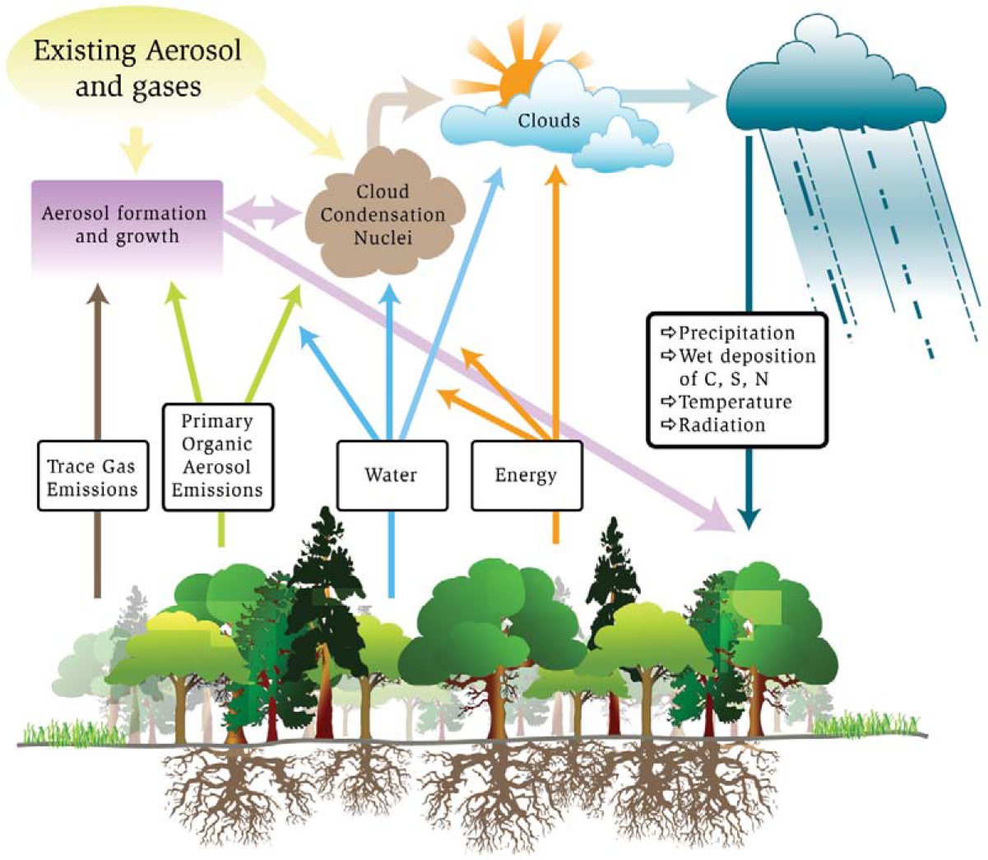
Amazon Basin has strong coupling between terrestrial ecosystem and the hydrologic cycle: The linkages among carbon cycle, aerosol life cycle, and cloud life cycle need to be understood and quantified.
Susceptibility and expected reaction to stresses of global climate change as well as pollution introduced by future regional economic development are not known or quantified at present time.
Source: Barth et al., “Coupling between Land Ecosystems and the Atmospheric Hydrologic Cycle through Biogenic Aerosol Particles,” BAMS, 86, 1738-1742, 2005.

Slide 3
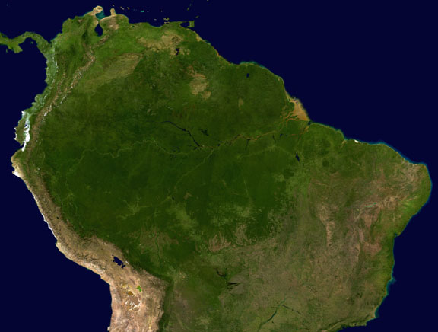
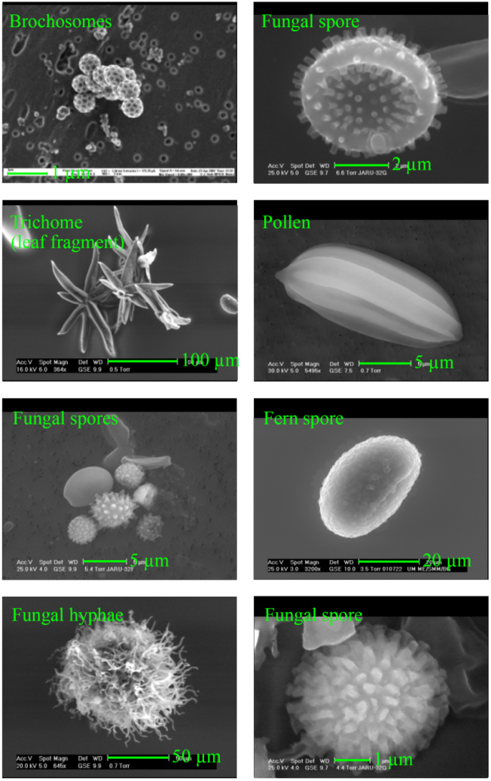
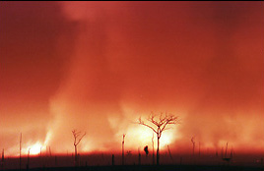
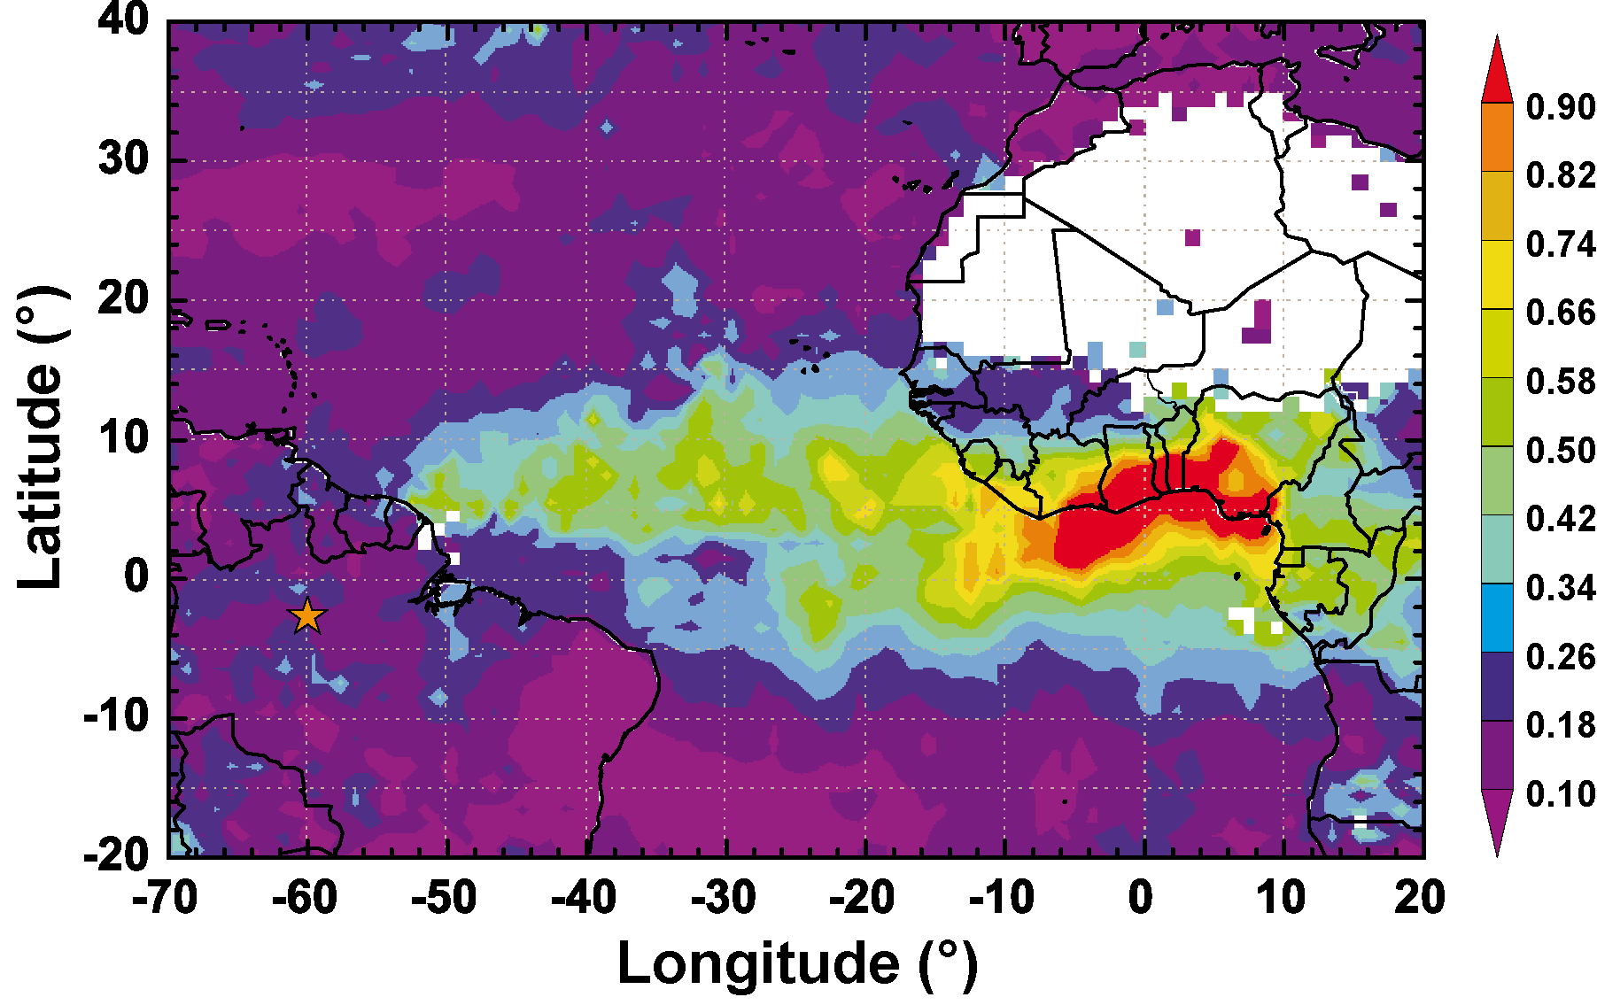
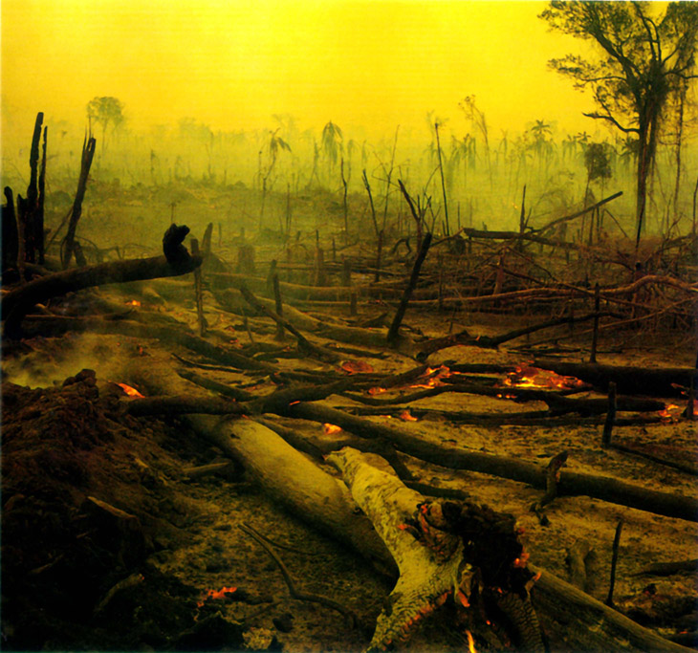
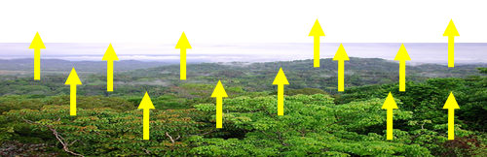
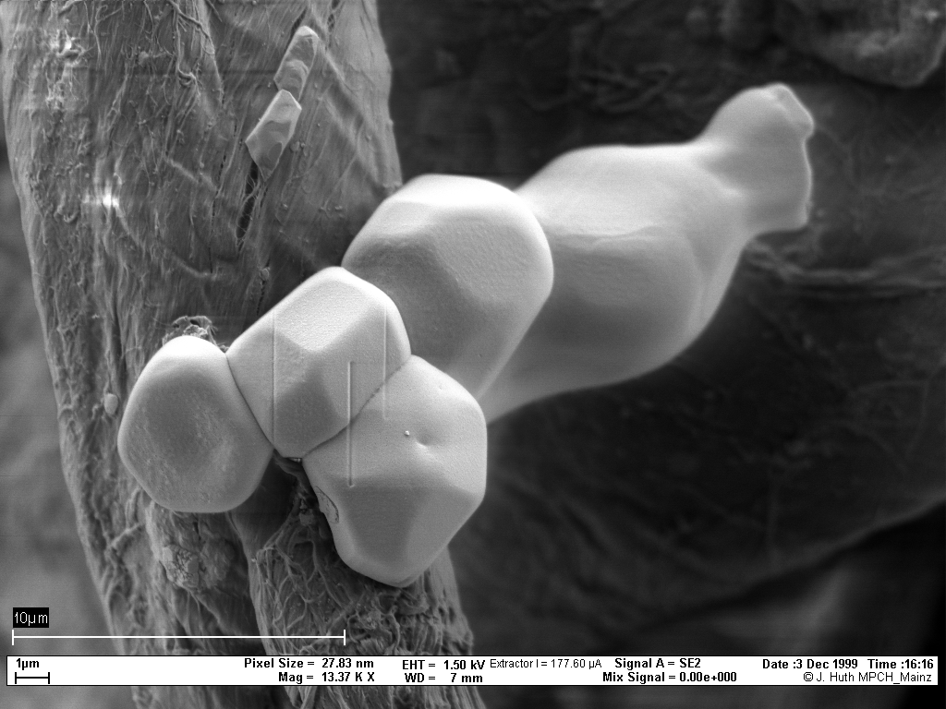
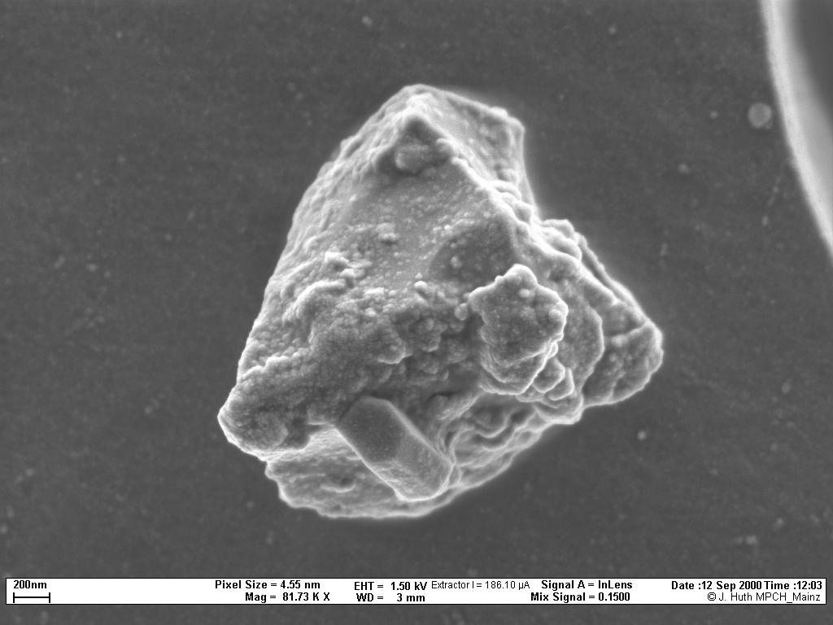
Amazonia: 3 different types of aerosols
Biogenic (primary and SOA)
Biomass Burning
Dust from Sahara
Each with VERY different properties and impacts

Slide 4
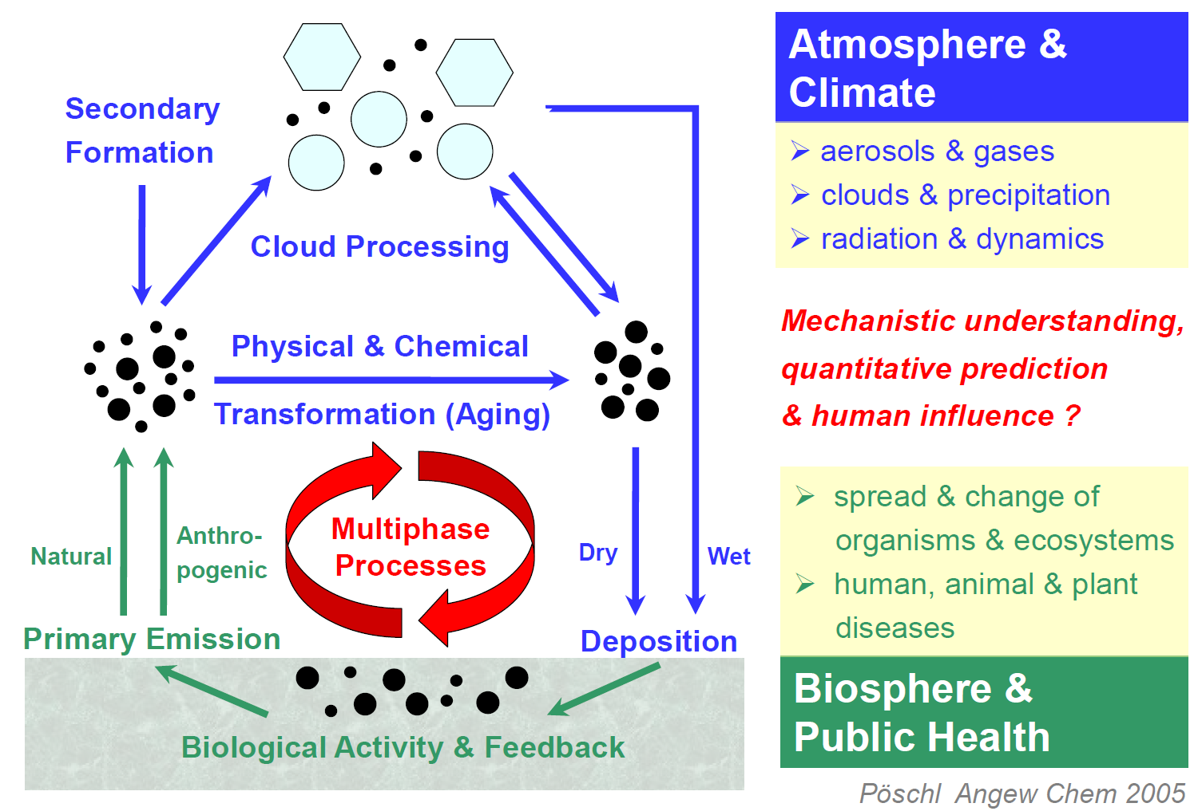
Aerosol Cycling in Amazonia

Slide 5
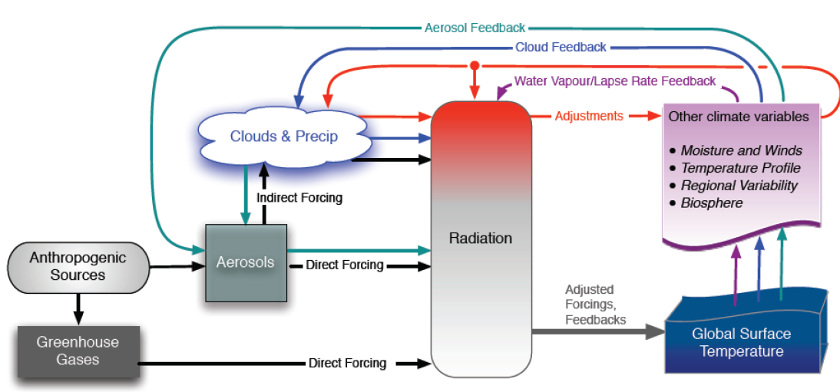
Aerosols, radiation, clouds and greenhouse gases in the global climate system
The major uncertainties in the climate system

Slide 6
Aerosol and cloud lifecycles

Slide 7
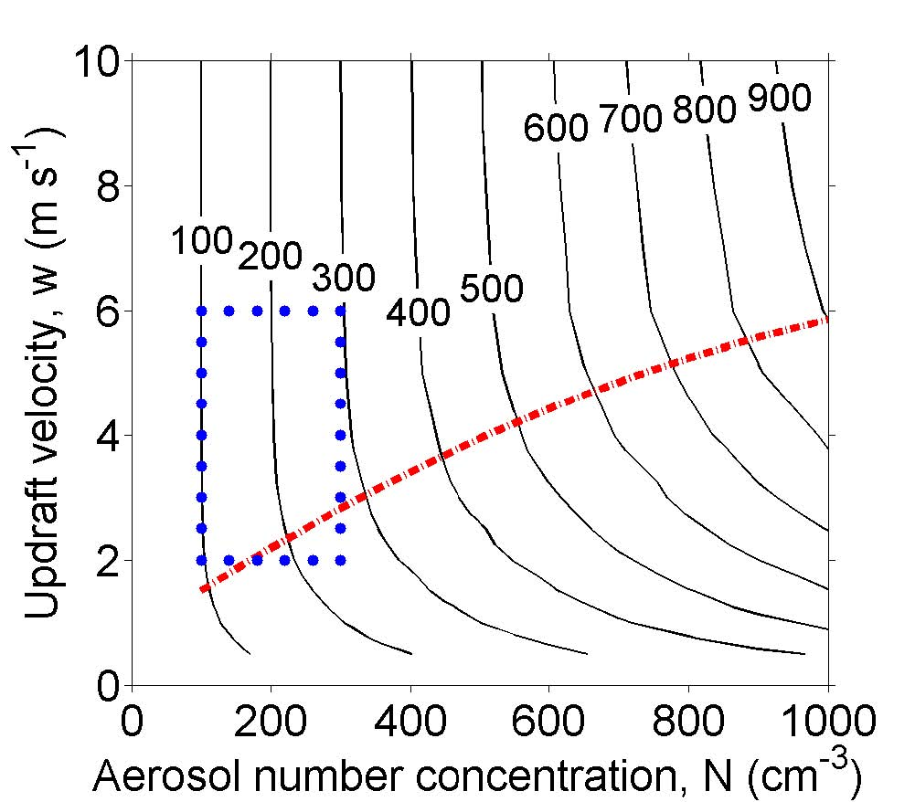
High sensitivity to Pollution in Pristine Regions
Amazon Basin:
Low aerosol number concentrations +
High water vapor concentration =
Especially susceptible.
Possibility of large changes in energy flows and rainfall patterns
Particle-Limited Regime
Amazon
Basin
Anthropogenically affected continents
Pöschl et al., “Rainforest aerosols as biogenic nuclei of clouds and precipitation in the Amazon,” Science, 2010, 329, 1513-1516.

Slide 8
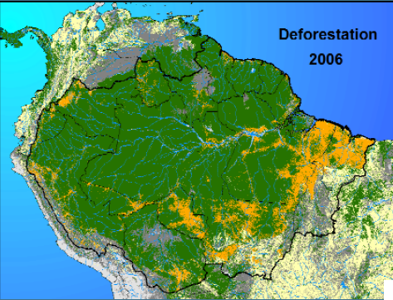
Deforestation was reduced from 27,700 Km² in 2004 to 4,571 Km² in 2012.
A very dynamical system, and we need to know what effects on the ecosystem these changes have produced
4.571 Km²
in 2012
What public policies are needed to sustain this reduction?

Slide 9
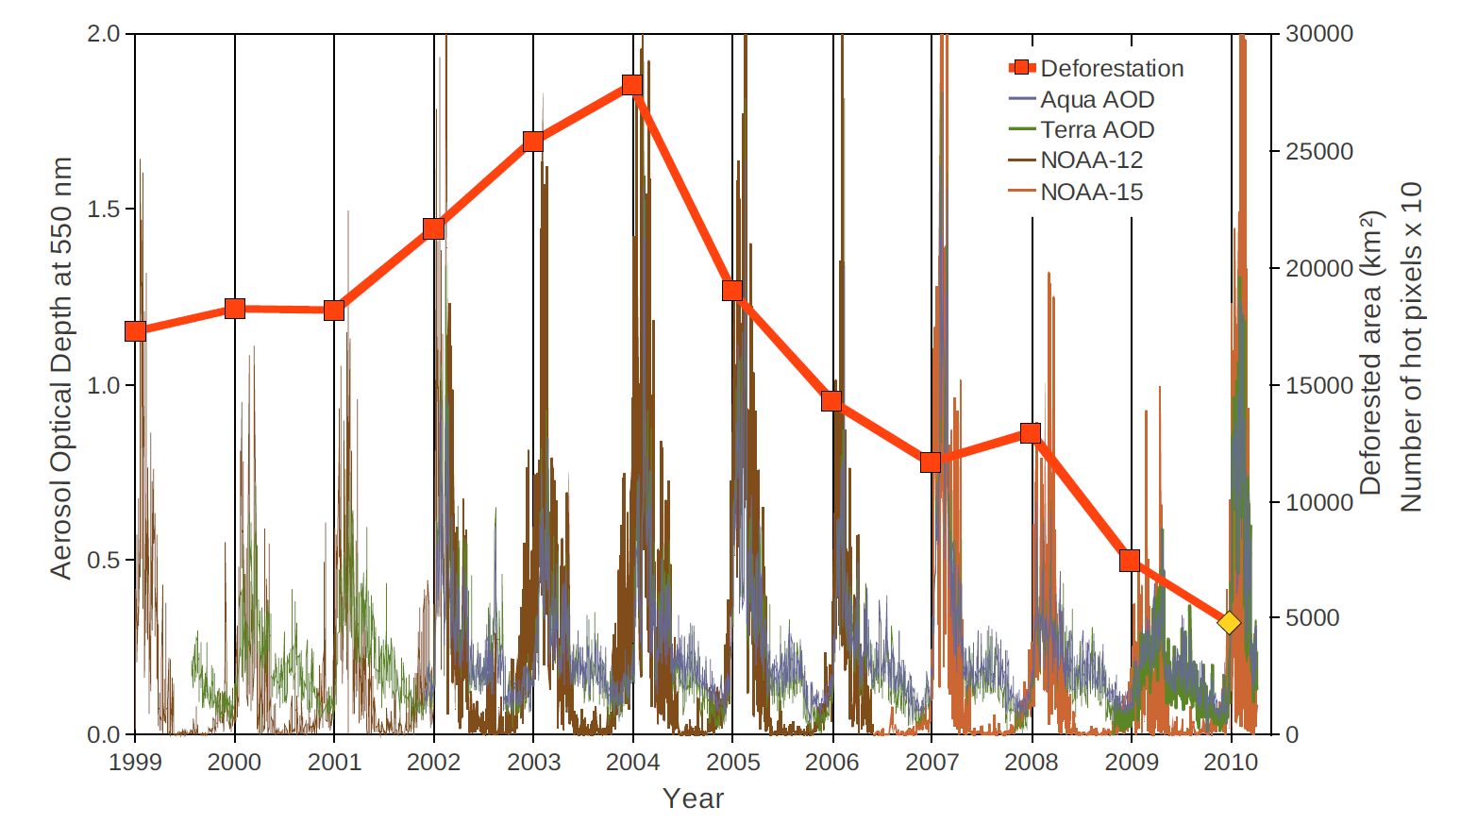
Yearly deforestation and MODIS AOD and hot pixels from NOAA-12/15
Yearly deforestation over the Brazilian Amazon region (INPE, 2010) compared to MODIS daily smoke optical depth and the daily number of hot pixels from NOAA-12 and NOAA-15. The results are shown according to the hydrological year, from August 1st of the previous year to July 31st of the years shown in the graph. The vertical lines indicate August 1st , which correspond to the onset of the burning season.

Slide 10
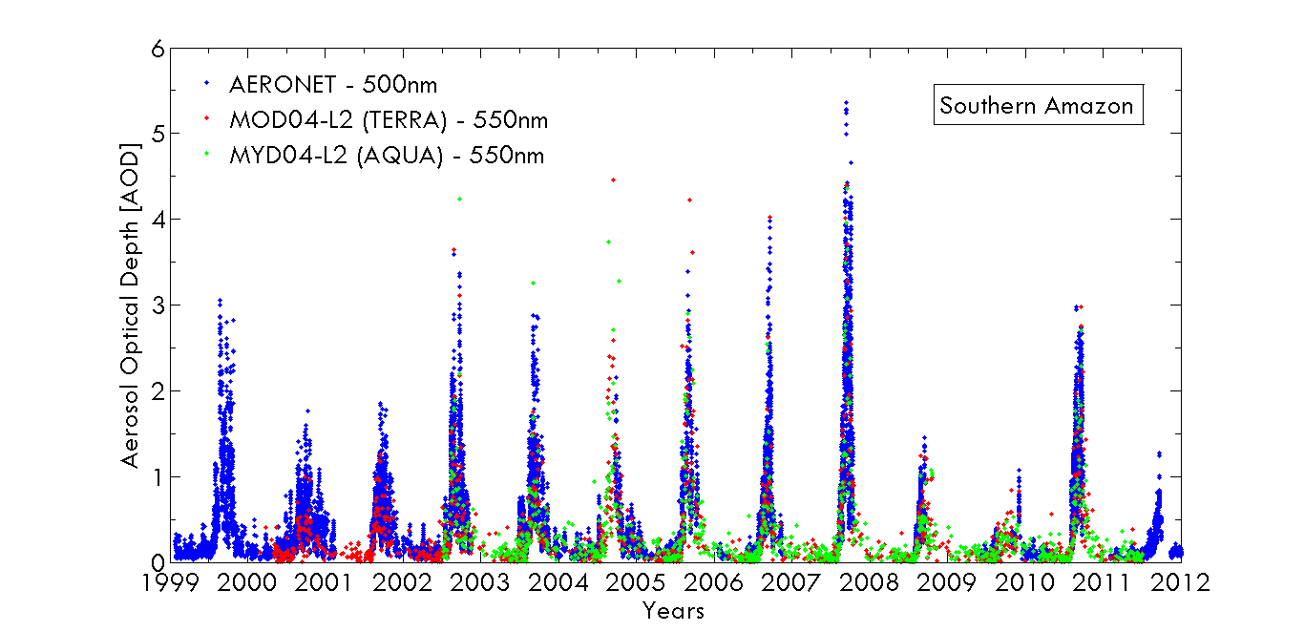
AOD 550 nm 1999-2012 in Porto Velho, Rondonia

Slide 11
Aerosol composition in wet-season Amazonia
Fine Fraction
1.7 µg m⁻³
Coarse Fraction
5.7 µg m⁻³
Martin et al., 2010

Slide 12
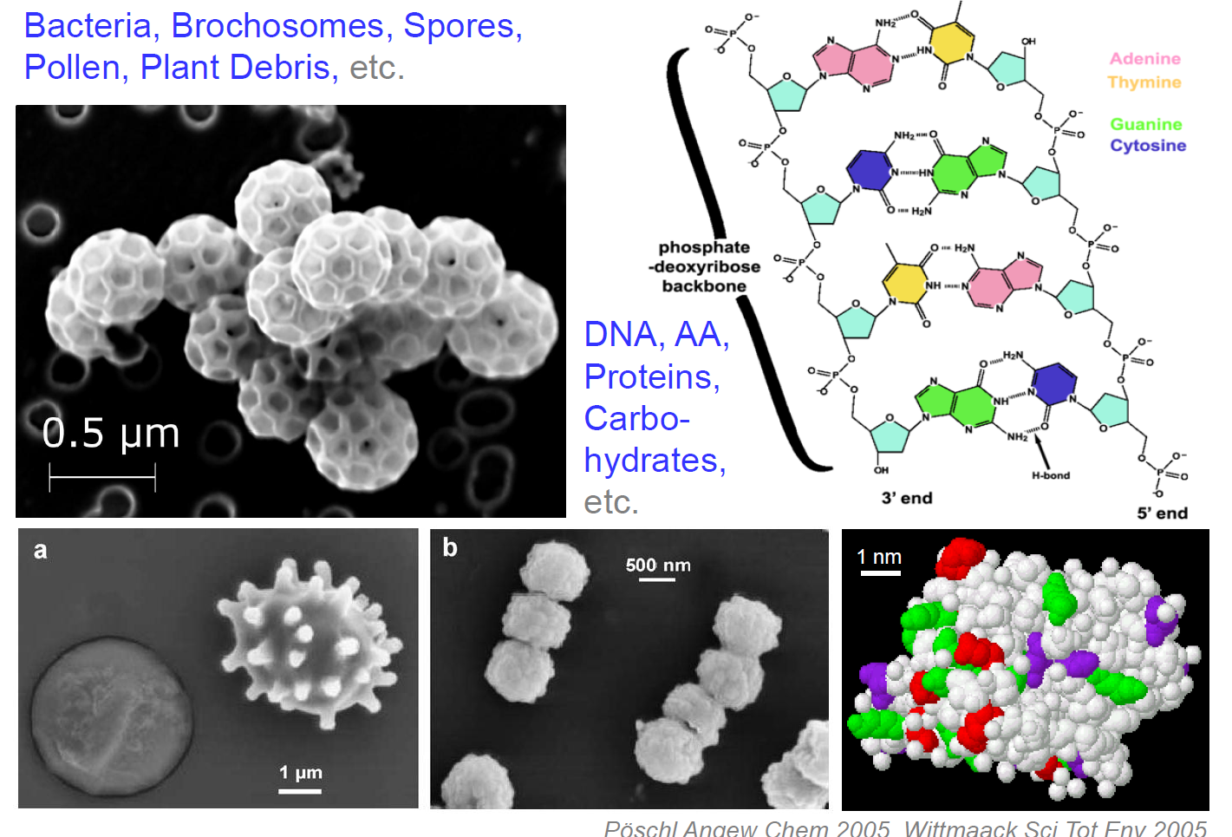
Biological Particles & Molecules

Slide 13
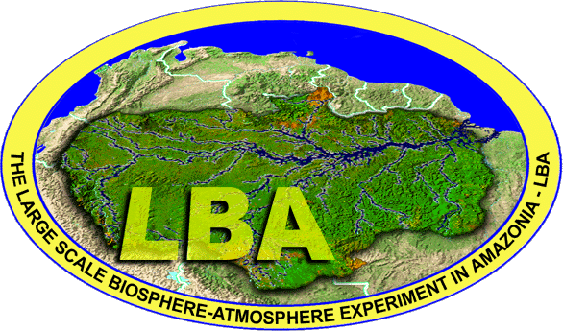
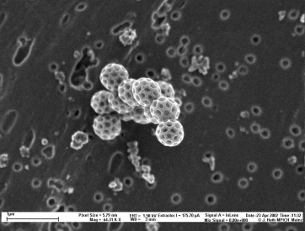
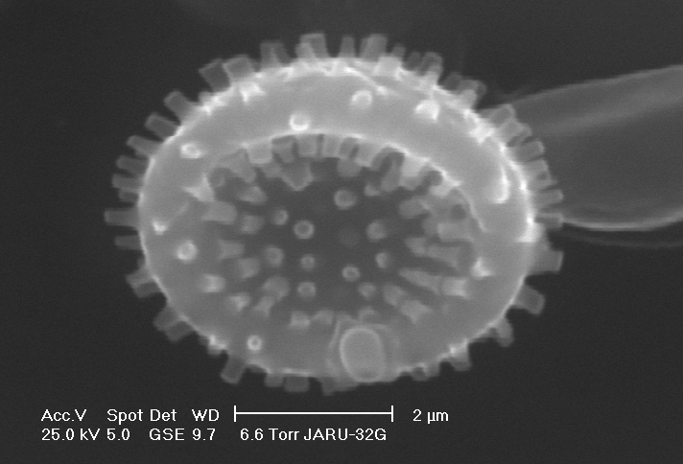
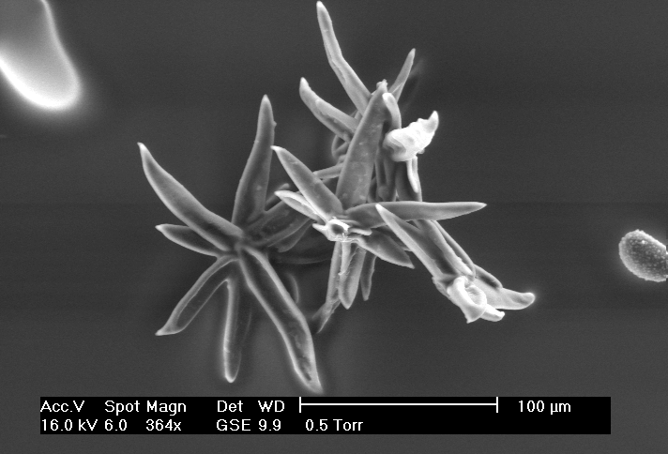
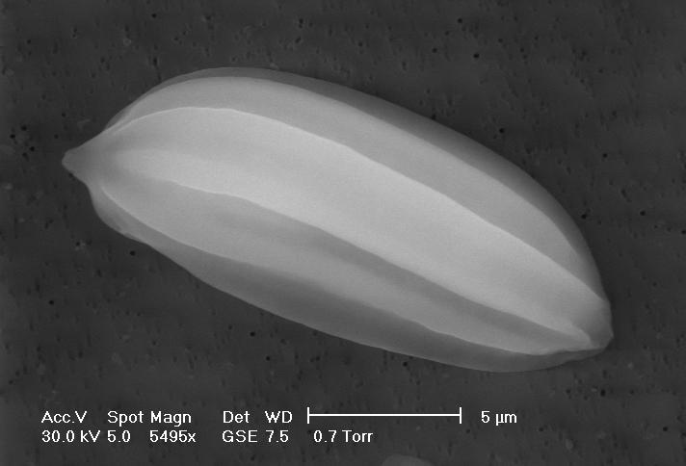
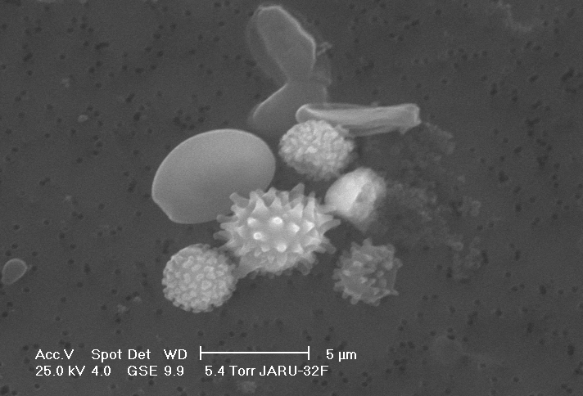
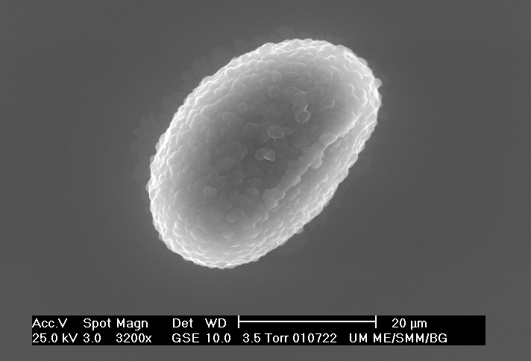
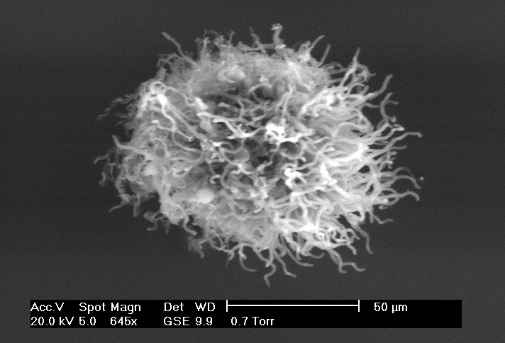
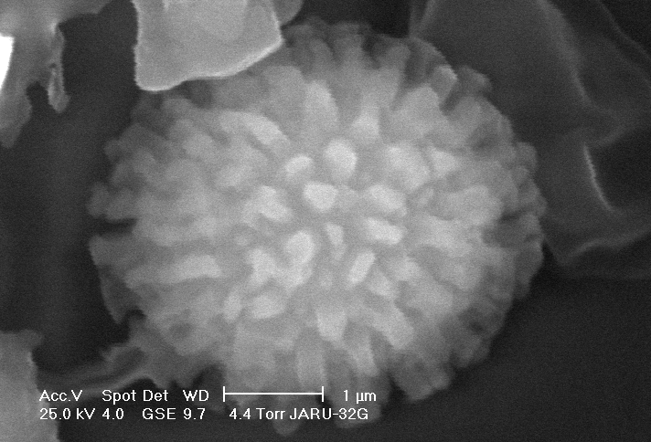
  POLLEN/SPORE D_{p} DAY NIGHT
  (μm) (m⁻³) (m⁻³)
  Fungal spores:
  Alternaria longissima 12-60 190 10
  Ascospores 2-22 2,064 7,416
  Aspergillus/
  Penicillium 2-6 2,470 0
  Basidiospores 12 95 5
  Cladosporium 2-12 3,040 3,090
  Dreschlera/
  Exserohium 10-70 152 412
  Myxomycete 8 10 2,060
  Other 5-350 1,348 1,462
  Periconia 10 57 309
  Powdery Mildew 7-13 76 1,648
  Rust 8-12 1,710 3,605
  Smut 5-7 10 9,167
  Yeast 2-10 12,255 203,528
  TOTAL FUNGAL 23,462 234,154
  Algae (unknown type) 8 20 0
  TOTAL ALGAE 20 0
Natural biogenic particles
Brochosomes
Fungal spore
Trichome
(leaf fragment)
Pollen
Fungal spores
Fern spore
Fungal hyphae
Fungal spore
Source: MPIC, Mainz
10 times higher at night !!!

Slide 14
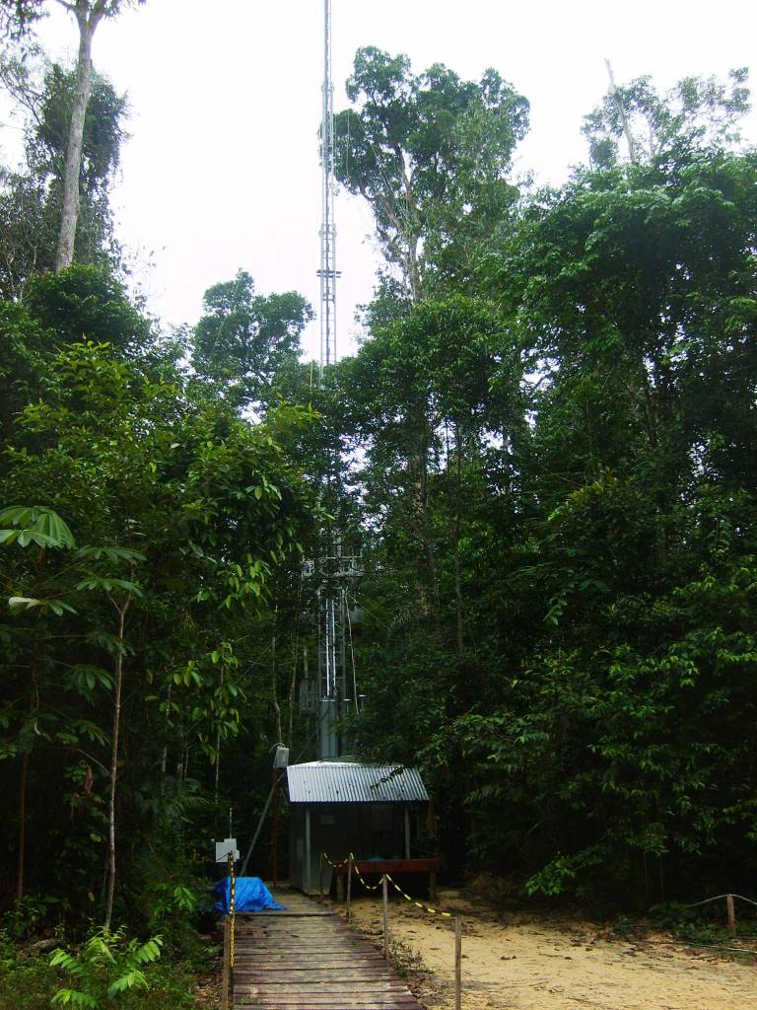
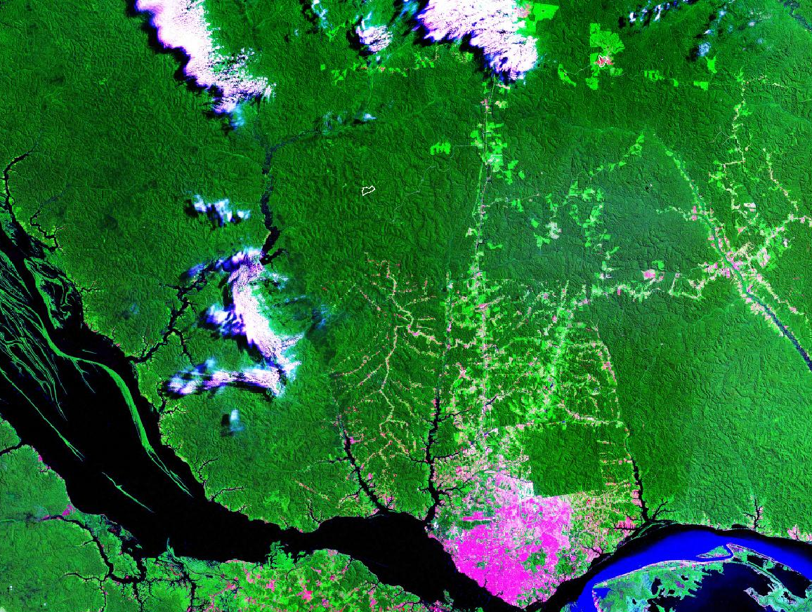
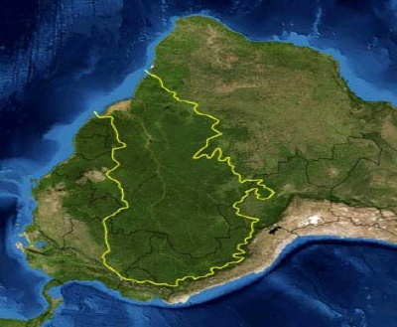
Long term monitoring stations in Amazonia
Rbio Cuieiras
Manaus
Dry aerosol (RH<40%)
Site continuously operational since Feb 2008.
Manaus and Porto Velho

Slide 15
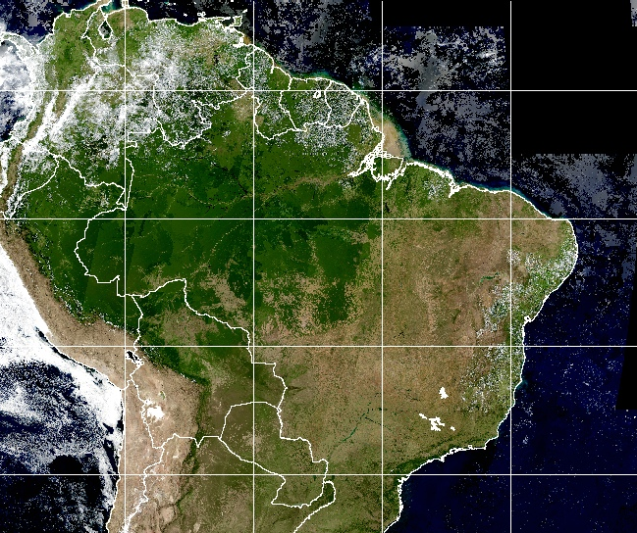
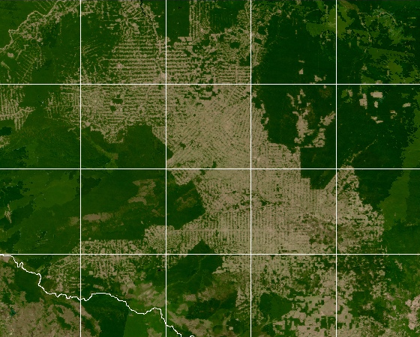
Porto Velho aerosol and trace gases sampling location
-80
-70
-60
-50
Porto Velho
-40
-30
5
-10
-11
-12
-5
-64
-63
-62
-61
-15
-15
-25
-25
-80
-70
-60
-50
-40
-30

Slide 16
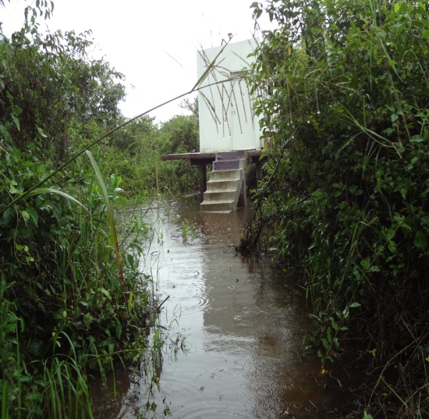
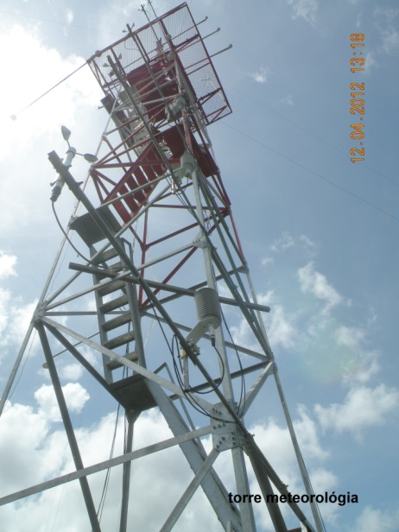
Centro de Pesquisas do Pantanal (CPP-SESC), Universidade Federal do Mato Grosso

Slide 17
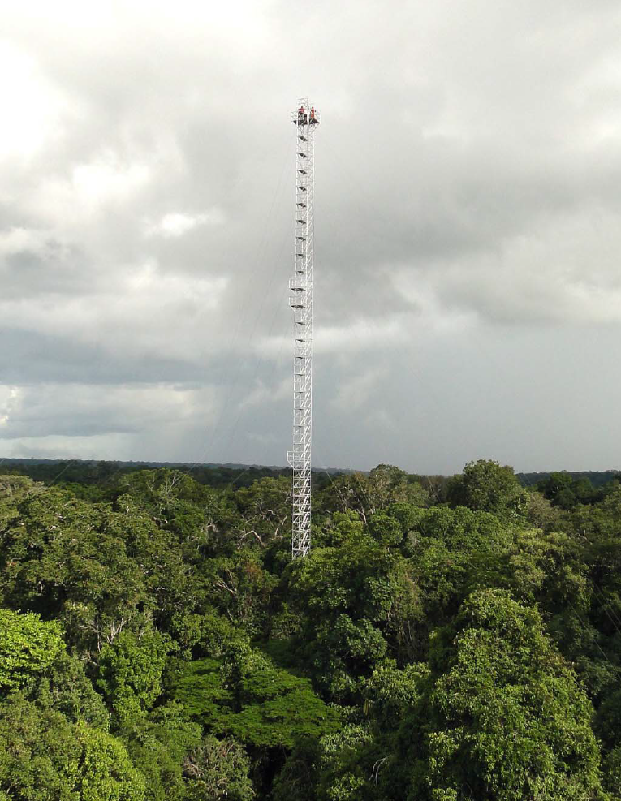
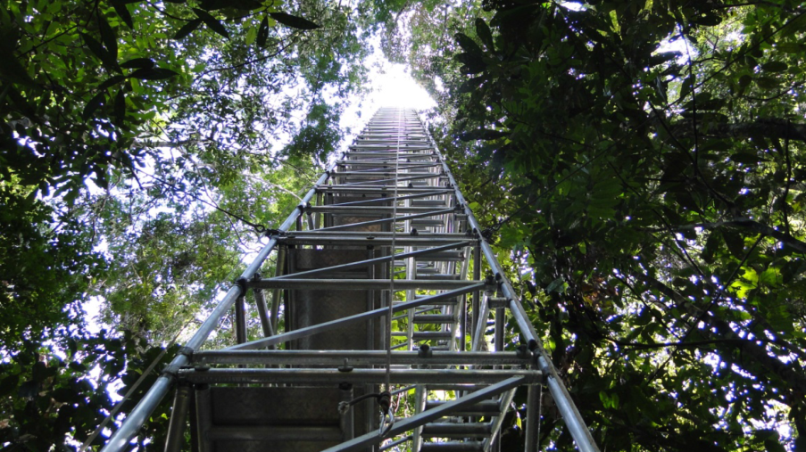
Four flux towers with 85 meters already in operation at the ATTO site
Measurements at 6 levels for
Ozone, CO, VOCs (PTR-MS), aerosol number size distribution, composition with ACSM, Light scattering (TSI Neph), light absorption using MAAP, Aethalometer, SP2), CO2, CH4, water vapor and others.

Slide 18
Instrumentation operational since February 2008
MAAP - Multiangle Absorption Photometer: aerosol absorption at 637 nm
Aethalometer absorption at 7 wavelengths.
TSI Nephelometer: aerosol scattering at 450, 550, 700 nm
CPC 3772: aerosol number concentration
TSI SMPS: aerosol size distribution (10-500 nm)
Stacked filter units: fine and coarse mode aerosol composition – trace elements by XRF and PIXE, BC, ions
Quartz filter for EC/OC analysis (Sunset analyzer)
Ozone monitor (Thermo Environment 42C)
Picarro CO₂, CO.
Raymetrics Raman Lidar with 3 wavelengths
AERONET Cimel Sunphotometer and MFR radiometers
Recently ACSM (Aerodyne Aerosol Chemical Speciation Monitor)

Slide 19
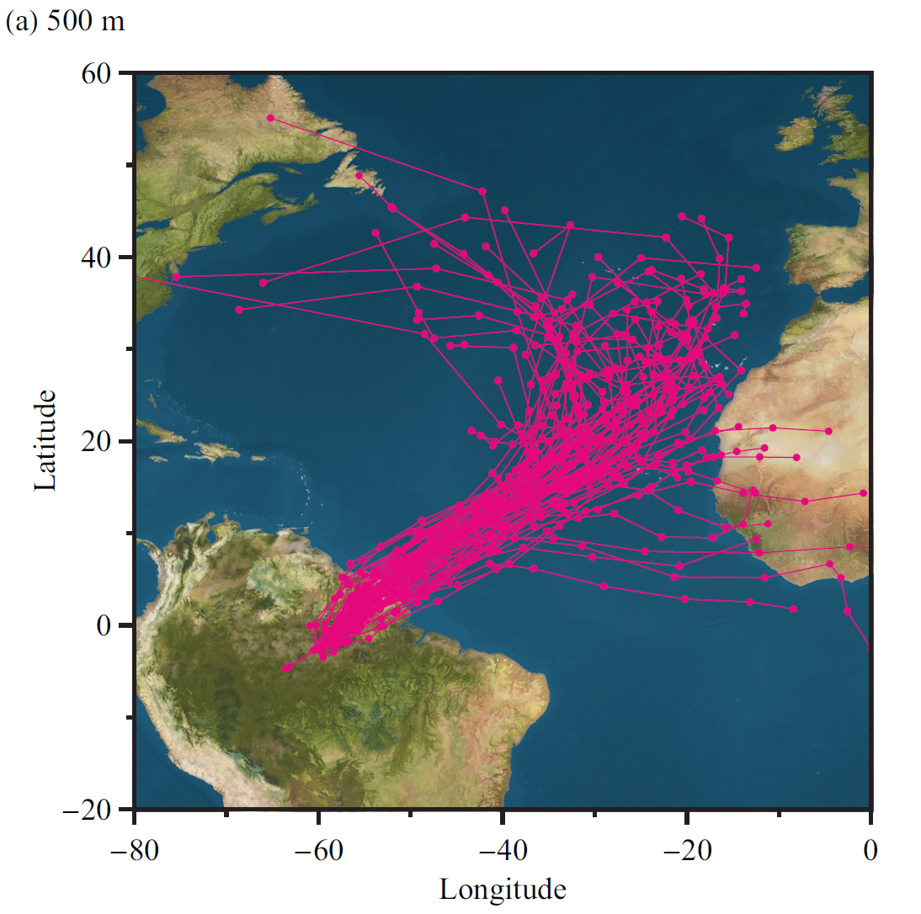
HYSPLIT air mass trajectories wet season 2008

Slide 21
Porto Velho aerosol mass concentration and black carbon from 1999 to 2012

Slide 22
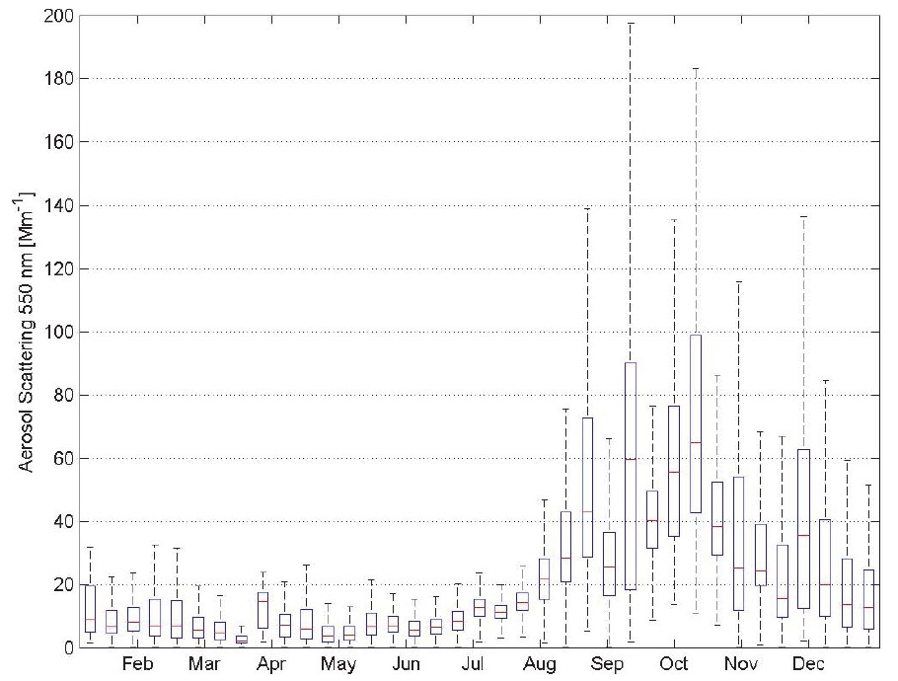
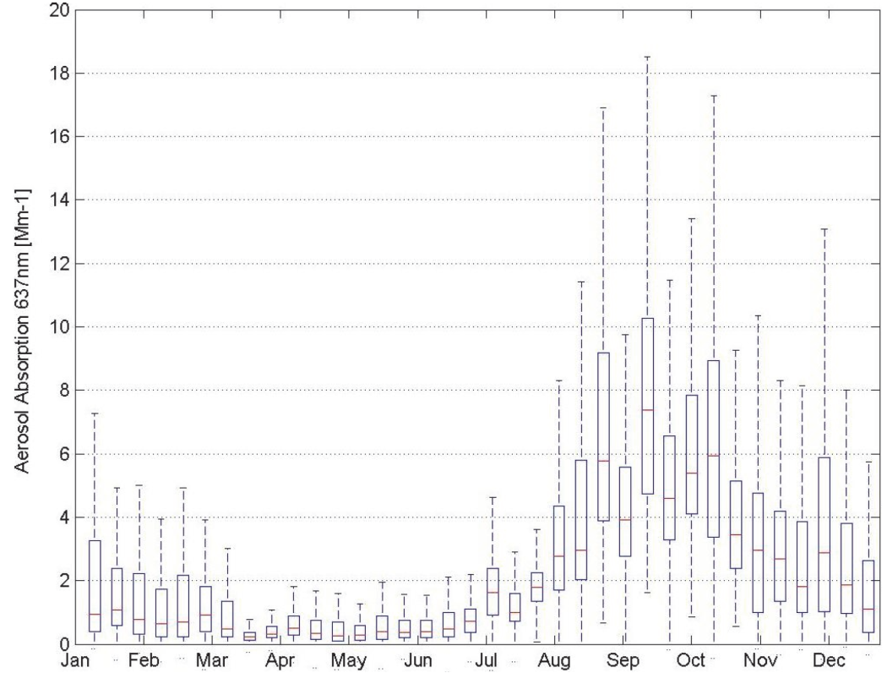
Seasonality of scattering and absorption
particle scattering coefficients at 550nm
aerosol absorption coefficients at 637nm
Particle scattering coefficients at 550nm between February 2008 and May 2011. Statistics were calculated for each 10 Julian days
Aerosol particle absorption coefficients at 637nm between February 2008 and May 2011. Statistics were calculated for each 10 Julian days

Slide 23
Scattering, absorption and SSA in Manaus and Porto Velho
Monthly statistics (2009 – 2012) for light scattering coefficient σ_{s} at 637 nm and light absorption coefficient σ_{a} at 637 nm in Mm⁻¹ for Porto Velho (PVH, in black) and central Amazonia (TT34, in red).
Single Scattering Albedo Lower at the pristine site
Artaxo et al., 2013

Slide 24
Manaus organic aerosol wet season measurements
Brito et al., 2013

Slide 25
Organic aerosol measurements in Rondonia
Brito et al., 2013

Slide 26
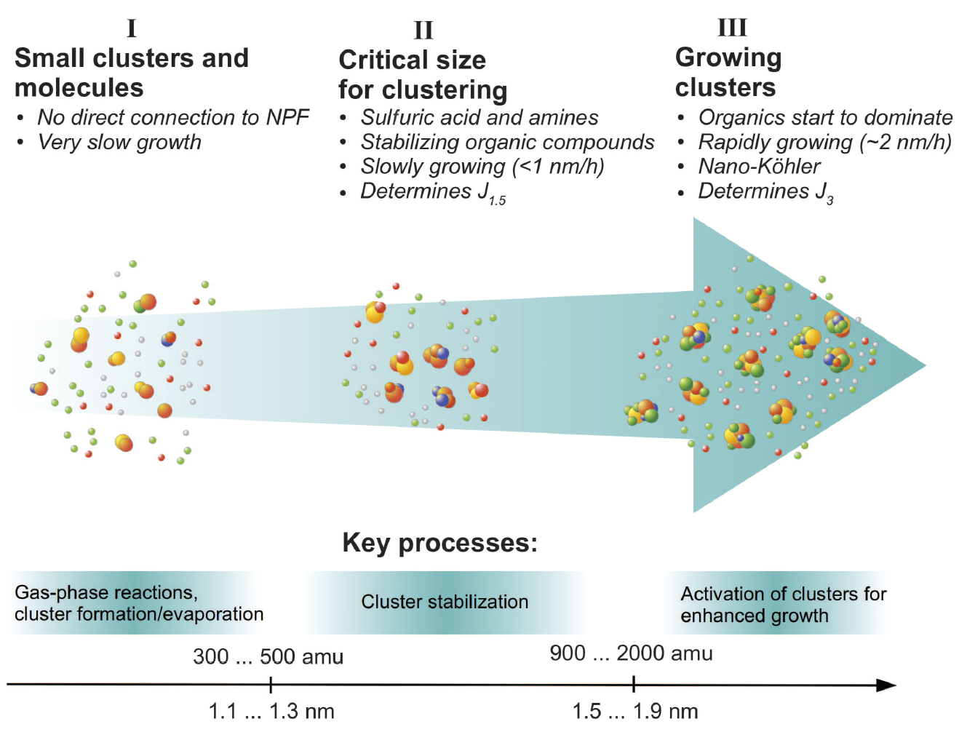
No new particle formation observed at surface under pristine conditions in Amazon
New particle formation: a two-step process:
1st step: sulfuric acid and amines, ammonia, or organic vapor form stable clusters
2nd step: organic vapor leads to enhance growth rate of the clusters to larger sizes.
Kulmala et al., 2013
Why no new particle formation?
Low SO₂ concentration (20-30ppt) suggests the concentration of H₂SO₄ is low
Organic concentration may be low for the growth of stable clusters.
What is the impact of Manaus plume on NPF?

Slide 27
New particle formation? Bursts of particles 10<D_{p}<30 nm.
Aerosol size distributions measured in 2009 Apr 4th. There was a burst of ultrafine particles from 2:00 to 4:00 UTC time.
New particle formation and subsequent growth was seldom observed along two years of measurements. Nevertheless, in 70% of the days, bursts of particles with diameters in the range 10-40nm were detected. The events usually lasted from 20 to 120min, and the subsequent growth to larger sizes was not always clearly observed.

Slide 28
Biogenic potassium salt particles as seeds for secondary organic aerosol in the Amazon
STXM-NEXAFS measurements (Pöhlker et al., 2012)
Our findings suggest that the primary emission of biogenic salt particles effectively regulates the number concentration of cloud condensation nuclei, directly influencing the microphysics and dynamics of cloud formation and precipitation over the rainforest.

Slide 29
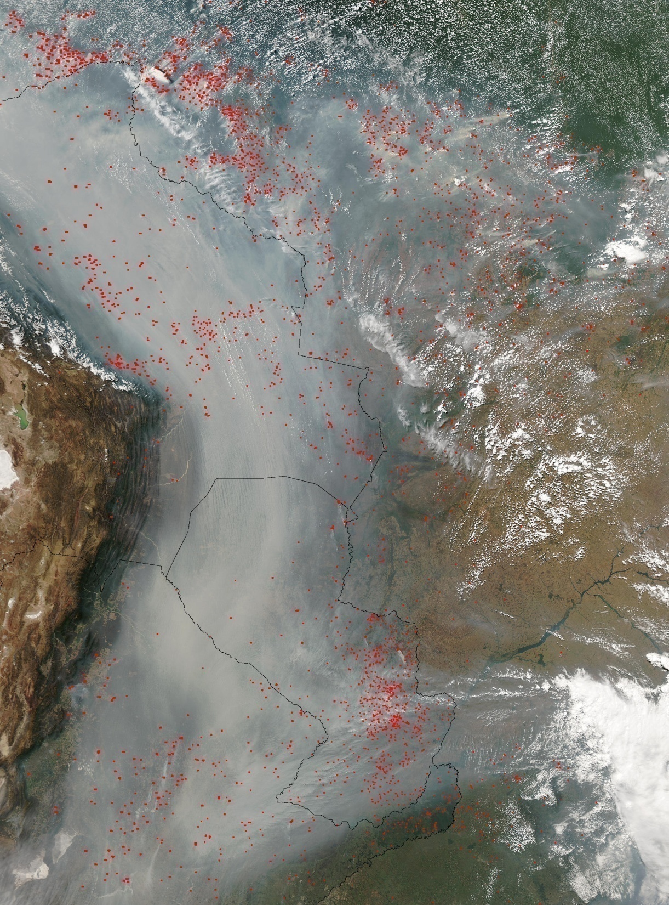

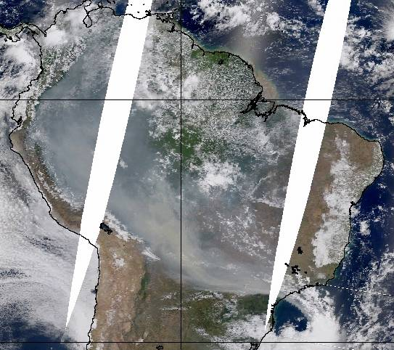
Large scale aerosol distribution in Amazonia
Severe health effects on the Amazonian population (about 20 million people)
Climatic effects, with strong effects on cloud physics and radiation balance.
Changes in carbon uptake and ecosystem functioning

Slide 30
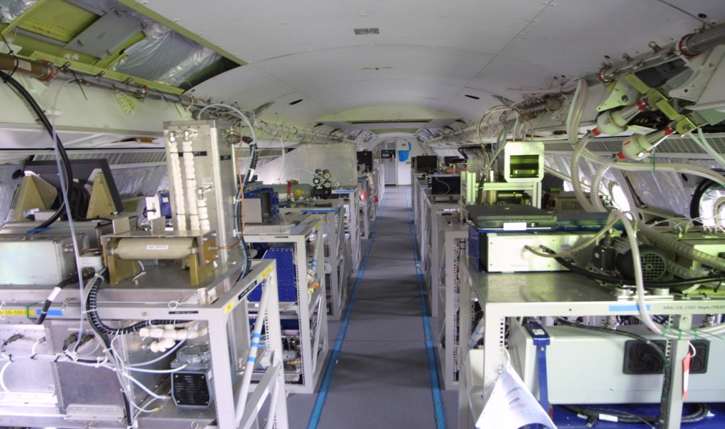

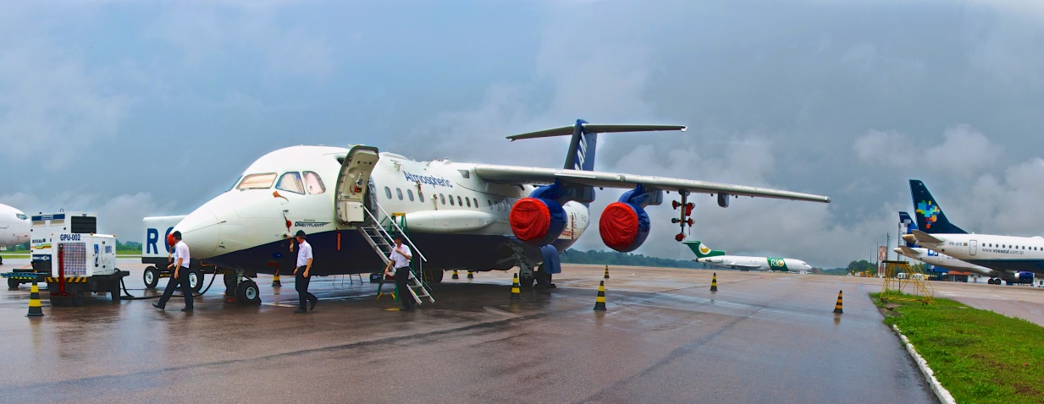
SAMBBA - South American Biomass Burning Analysis

Slide 31
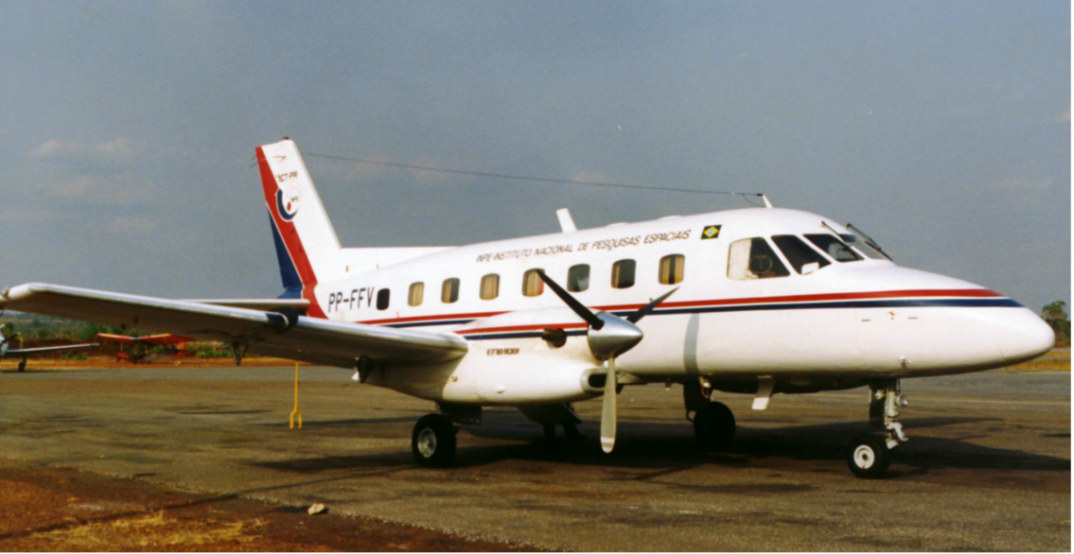
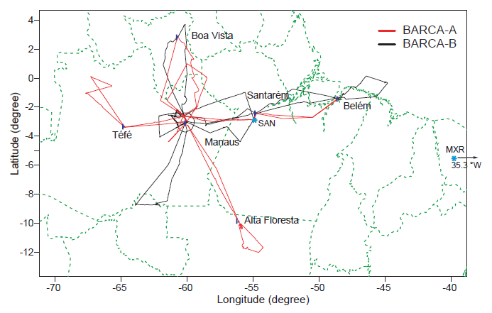
BARCA – Balanço Regional de Carbono na Amazonia
USP – INPE - Harvard – Max Plank
Flight tracks of the BARCA aircraft campaigns (red: BARCA-A, black: BARCA-B.

Slide 32
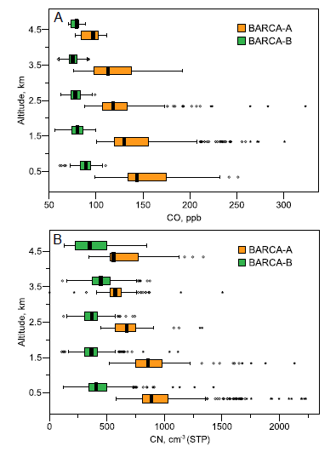
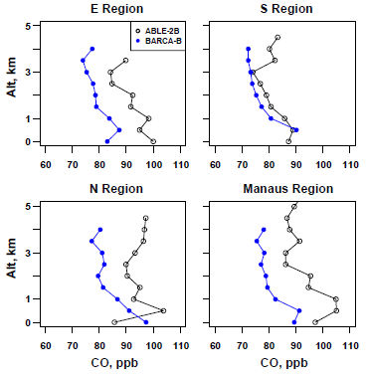
Comparisons of median vertical profiles for the Equatorial Transect east of Manaus (“E. Region”), N and S transects along
60Wlongitude, and near Manaus (excluding local pollution). Note the strong similarities between ABLE-2B and BARCA-B data taken
more than 20 years apart. (Source of ABLE data: Harriss et al., 1990b).
Vertical profiles of CO mixing ratios (A) and CN number concentrations (B) during BARCA-A (excluding the smoky region) and BARCA-B.
Andreae et al., 2012

Slide 33
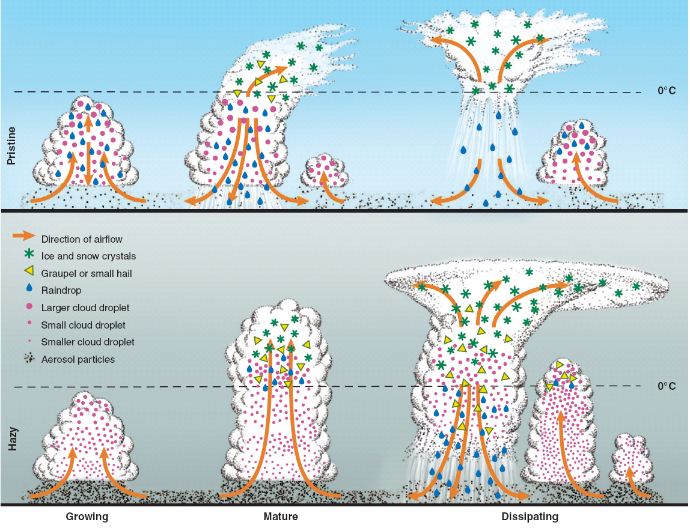

Rosenfeld D., et al., 2008: Flood or Drought: How Do Aerosols Affect Precipitation? Science, 321
Growing Mature Dissipating
Hail

Slide 34
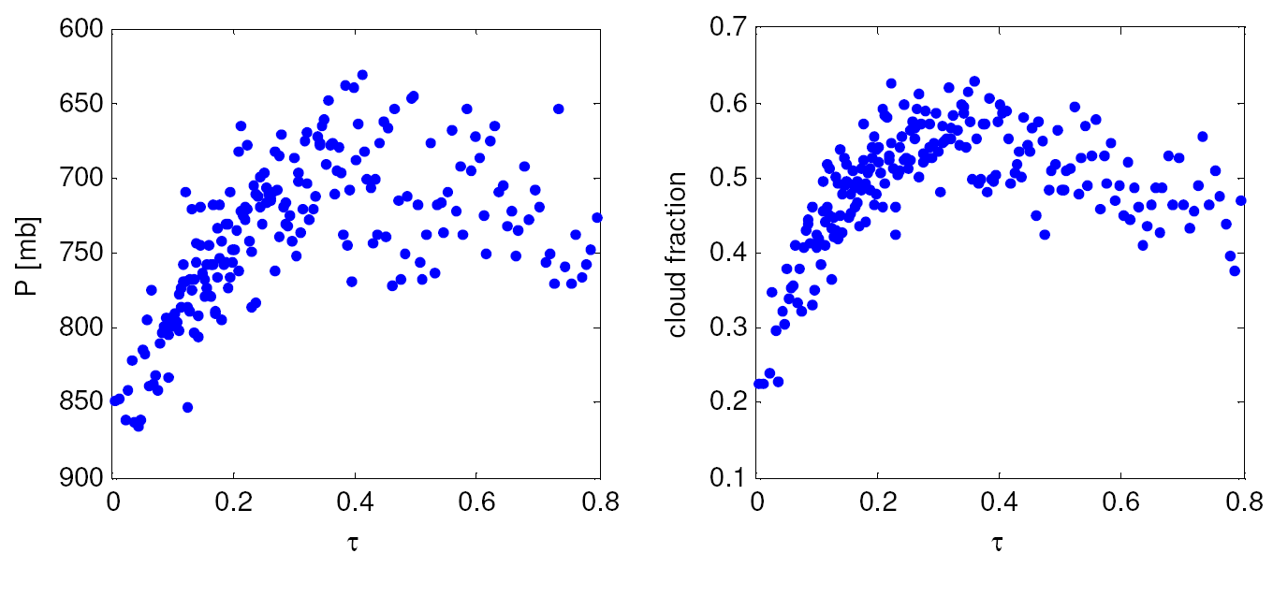
Clouds and aerosols in Amazonia
Microphysics
absorption effects
Cloud top pressure (P) vs. AOD
Cloud fraction vs. AOD.
Koren et al., Science 2008

Slide 35
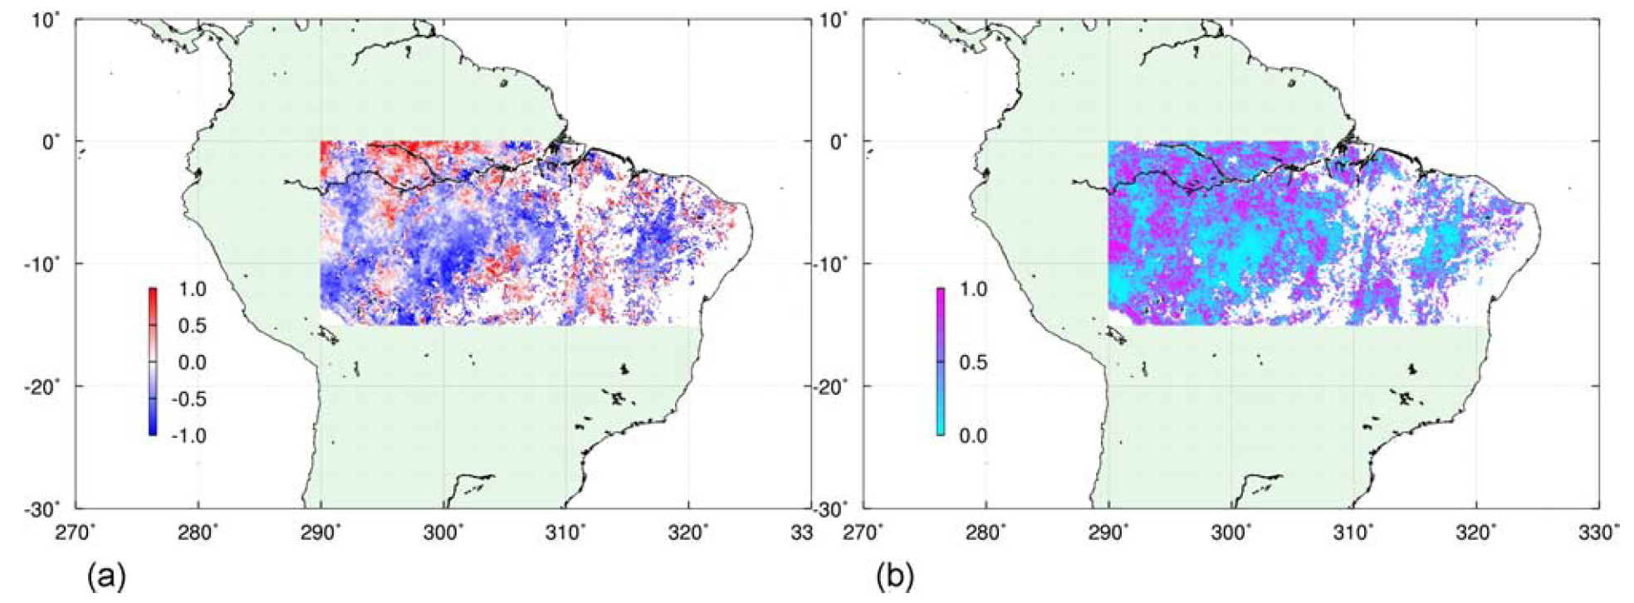

Correlation between aerosols and precipitation in Amazonia
(a) Correlation coefficient between AOD and precipitation for September 1995–2007. (b) Correlation p value.
Aerosols extending the duration of dry season
Region-mean end of dry season and corresponding 550-nm AOD.
Bevan et al., JGR 2009

Slide 36


Ice nuclei from biogenic emissions and Sahara dust in Central Amazonia
Dust relation to ice-nucleus measurements. Dust concentrations during AMAZE-08. a, GEOS-Chem simulated dust from 2–6 March at 18 UTC. The field site, shown as a black diamond, typically fell near the edge of the plumes. Fine-dust concentrations from PIXE measurements (black rectangles; µg/m³, dp<2µm.

Slide 37

Rain rate (TRMM) versus Aerosol Optical Depth (MODIS)
Amazonia
13:30 local-time map of rain rate (R) and the observed trend with aerosol loading in four selected regions. Period: July and August 2007. b, The average R values are plotted for six aerosol-loading sets (blue, including zero R grid squares; red, without zero R grid squares). Note the R intensification as a function of AOD in all cases. (Koren et al., Nature 2012)

Slide 38

Is the Amazonian hydrological cycle intensifying?
Maximum monthly, annual mean and minimum monthly mean Amazon river discharge at Óbidos and in green maximum and minimum daily mean river discharge, (b) δ¹⁸O in precipitation in Bolivia derived from tree rings (Brienen et al. 2012) and (c) tropical Atlantic sea surface temperature from Extended reconstructed sea surface temperature) (Gloor et al. 2013).

Slide 39

Average spatial distribution of the direct radiative forcing (DRF) of biomass burning aerosols in Amazonia during the dry season of 2010
CERES (Clouds and the Earth's Radiant Energy System) and MODIS

Slide 40

Mean Diurnal Radiative Forcing due to change in surface albedo in Rondonia:
-7.3 + 0.9 W/m²
Mean Diurnal Aerosol Forcing Efficiency:
Forest: -22.5 + 1.4 W/m²
Cerrado: -16.6 + 1.7 W/m²
Water column difference by 6-10%
Forcing of water vapor column: -0.4 to -1.2 W m⁻²
Land-use change radiative forcing. Forested areas are selected in red and deforested areas are selected in yellow.
Sena et al., 2013

Slide 41

HOW MUCH CARBON DO PLANTS TAKE FROM THE ATMOSPHERE?
MODIS gross primary productivity (GPP) estimation from NDVI 2000-2010
Notes:
HOW MUCH CARBON DO PLANTS TAKE FROM THE ATMOSPHERE? SVS CATALOG 3764
Terra - MODIS
Plant life converts atmospheric carbon dioxide into biomass through photosynthesis, a process called 'fixing'. This is one of the main ways in which carbon dioxide is removed from the atmosphere and is a major part of the carbon cycle. The amount of carbon removed is called the gross primary productivity (GPP), and the change in GPP due to rising global temperatures is very important factor in the response of the Earth to climate change.
Data from the MODIS instrument on NASA's Terra satellite has been recently used to calculate the GPP for the whole world for the last 10 years. This animation shows a time sequence of GPP on land as measured by MODIS during the years 2000 through 2009. Two things to note are the year-long productivity of the tropical regions and the large seasonal productivity in the northern hemisphere. A close look at the animation also reveals major urban areas for which the productivity is negligible.

Slide 42

Aerosol Effects on
Net Plant Productivity
CO₂ Concentration
Aerosol Concentration
+
-
+
Temperature
+
+
+?
Photosynthesis
BVOC emissions
+
Kulmala et al., 2004

Slide 43

Strong aerosol effect on forest photosynthesis diffuse radiation have a large effect on CO2 fluxes
Increase in aerosol loading

Slide 44



Aerosols effects on NEE – Manaus and Rondonia
(Glauber Cirino, INPA, 2013)
f max: ~ 0,80
  NEE (max): ~ -20 µmol/m²s
  AOT: ~ 0,5
Manaus K34 tower

Slide 45

Transport of Sahara dust and smoke from Africa to Amazonia

Slide 46

Sahara dust transport to Amazonia
(Yuval et. al, 2011).
Notes:
Perfis verticais de retroespalhamento atenuado noturnos (em km⁻¹sr⁻¹) obtidos através do satélite CALIPSO mostram o transporte de areia do deserto do Saara para a região amazônica. Os eixos de perfil de vertical mostram até 5km de altitude ( Yuval et. al, in press).

Slide 47

African aerosol in central Amazonia
Smoke and dust AOD for the 17 observation cases in 2008 indicating the advection of African aerosol toward Amazonia.
Baars et al., 2011

Slide 48

Raman Lidar: aerosols and water vapor up to 13 Km in Manaus
Henrique Barbosa, 2011

Slide 49


Efeitos do material particulado na saúde da população
- Efeitos diretos sobre o sistema respiratório e cardiovascular
Tempo de residência das partículas (Tr)
Populações mais afetadas: crianças e idosos
(Moda fina > Moda grossa)
Brônquios
Combustão de partículas, compostos orgânicos, etc
Bronquíolos
Cabelo humano
Bronquíolos
respiratórios
Poeira, pólen, etc
Alvéolos
Areia fina de praia
(diâmetros em micrômetros)
Fonte: Valdir Soares, 2013

Slide 50
- Polycyclic Aromatic Hydrocarbons in intense and moderate biomass burning in the Amazon region
53% of identified PAHs are mutagenics
20% of identified PAHs are mutagenics and carcinogenics
Nilmara Alves et al., 2013

Slide 51

Mechanisms of action of PM₁₀ in lung cells
Human lung cells
DNA damage
Cell death
INCREASE THE LUNG CANCER RISK
Alves, Hacon et al., 2013

Slide 52



ATTO Footprint
C. Gerbig MPIBGC
Amazonian Tall Tower Observatory
ATTO – 320 meters
Long term broad objectives observatory

Slide 53

ATTO site: Picture of the 85 meters tall tower at the left that is being used for aerosol and trace measurements and the proposed 320 tall tower under construction.

Slide 54

Experimento GoAmazon 2014

Slide 55



A expansão da agricultura e a variabilidade climática são agentes importantes nas alterações que estão ocorrendo no ecossistema amazônico. Em partes da região é possível observar sinais de transição para um regime dominado pelas alterações ambientais. Estes sinais incluem mudanças no balanço de energia e hidrológico na porção sul e este da Bacia Amazônica.
Interações entre mudanças globais, mudanças de uso do solo, queimadas, hidrologia, ecologia e dimensões humanas na Amazônia
Forçantes são indicadas por ovais vermelhos. Processos são as caixas verdes e consequencias estão nas caixas azuis.

Slide 56


Processos físicos, químicos, biológicos e sociais na Amazônia forman um sistema fortemente acoplado.
Ainda temos muito a prender como funciona este sistema…
Obrigado pela atenção!!!

