Slide 1
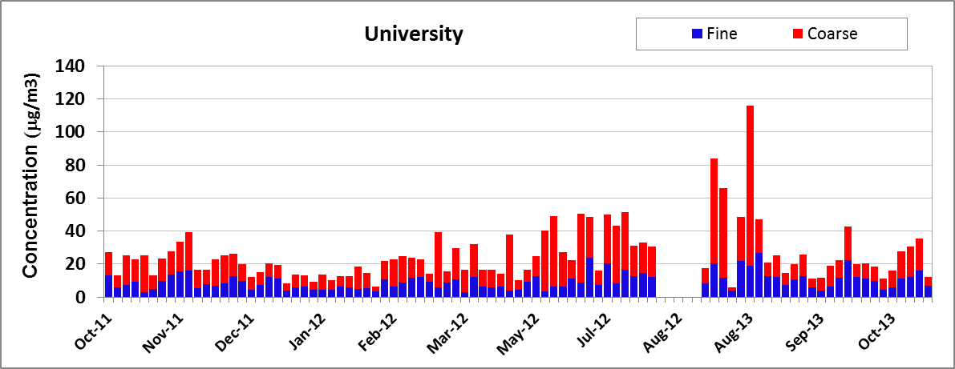
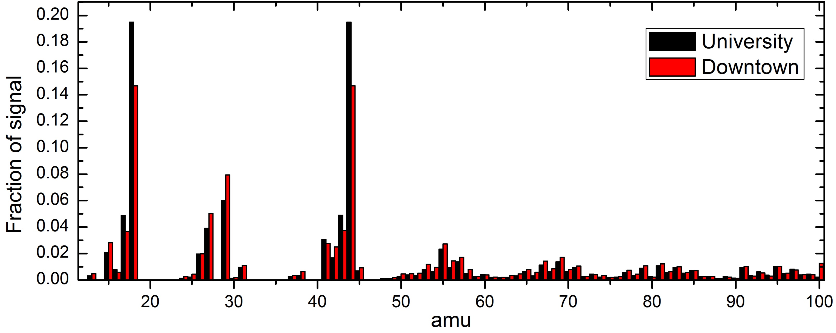
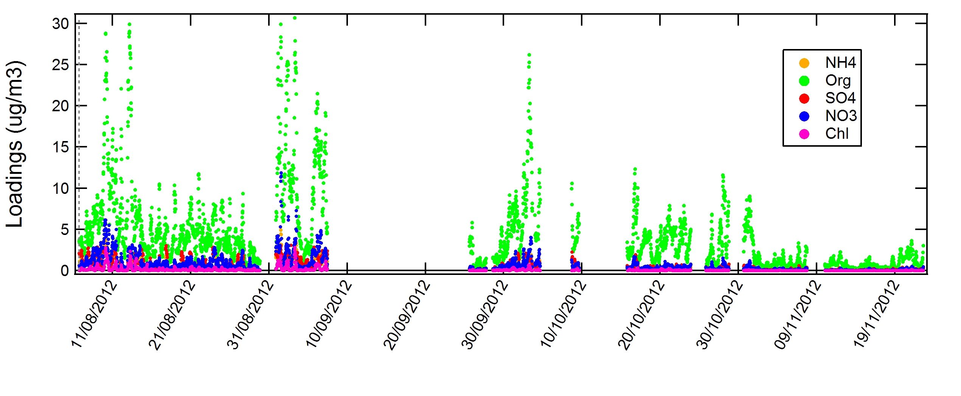
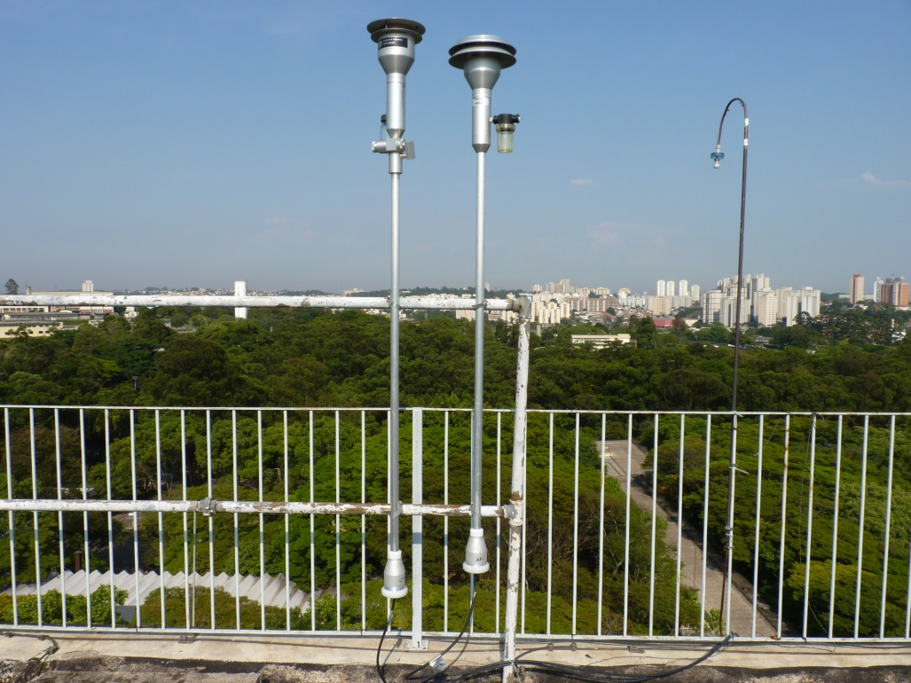
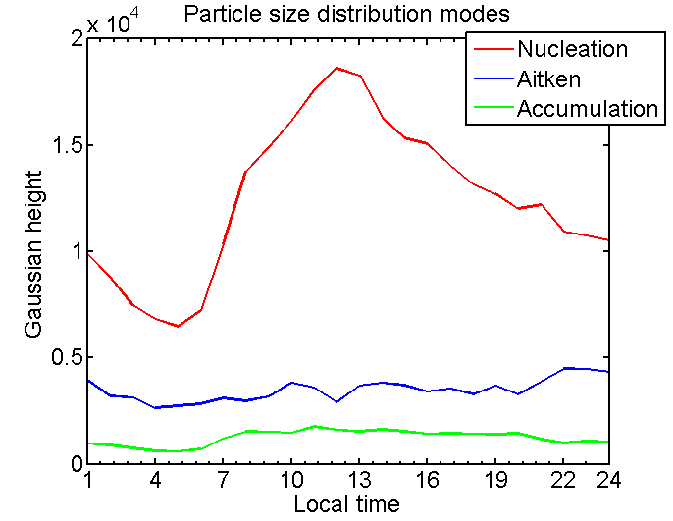
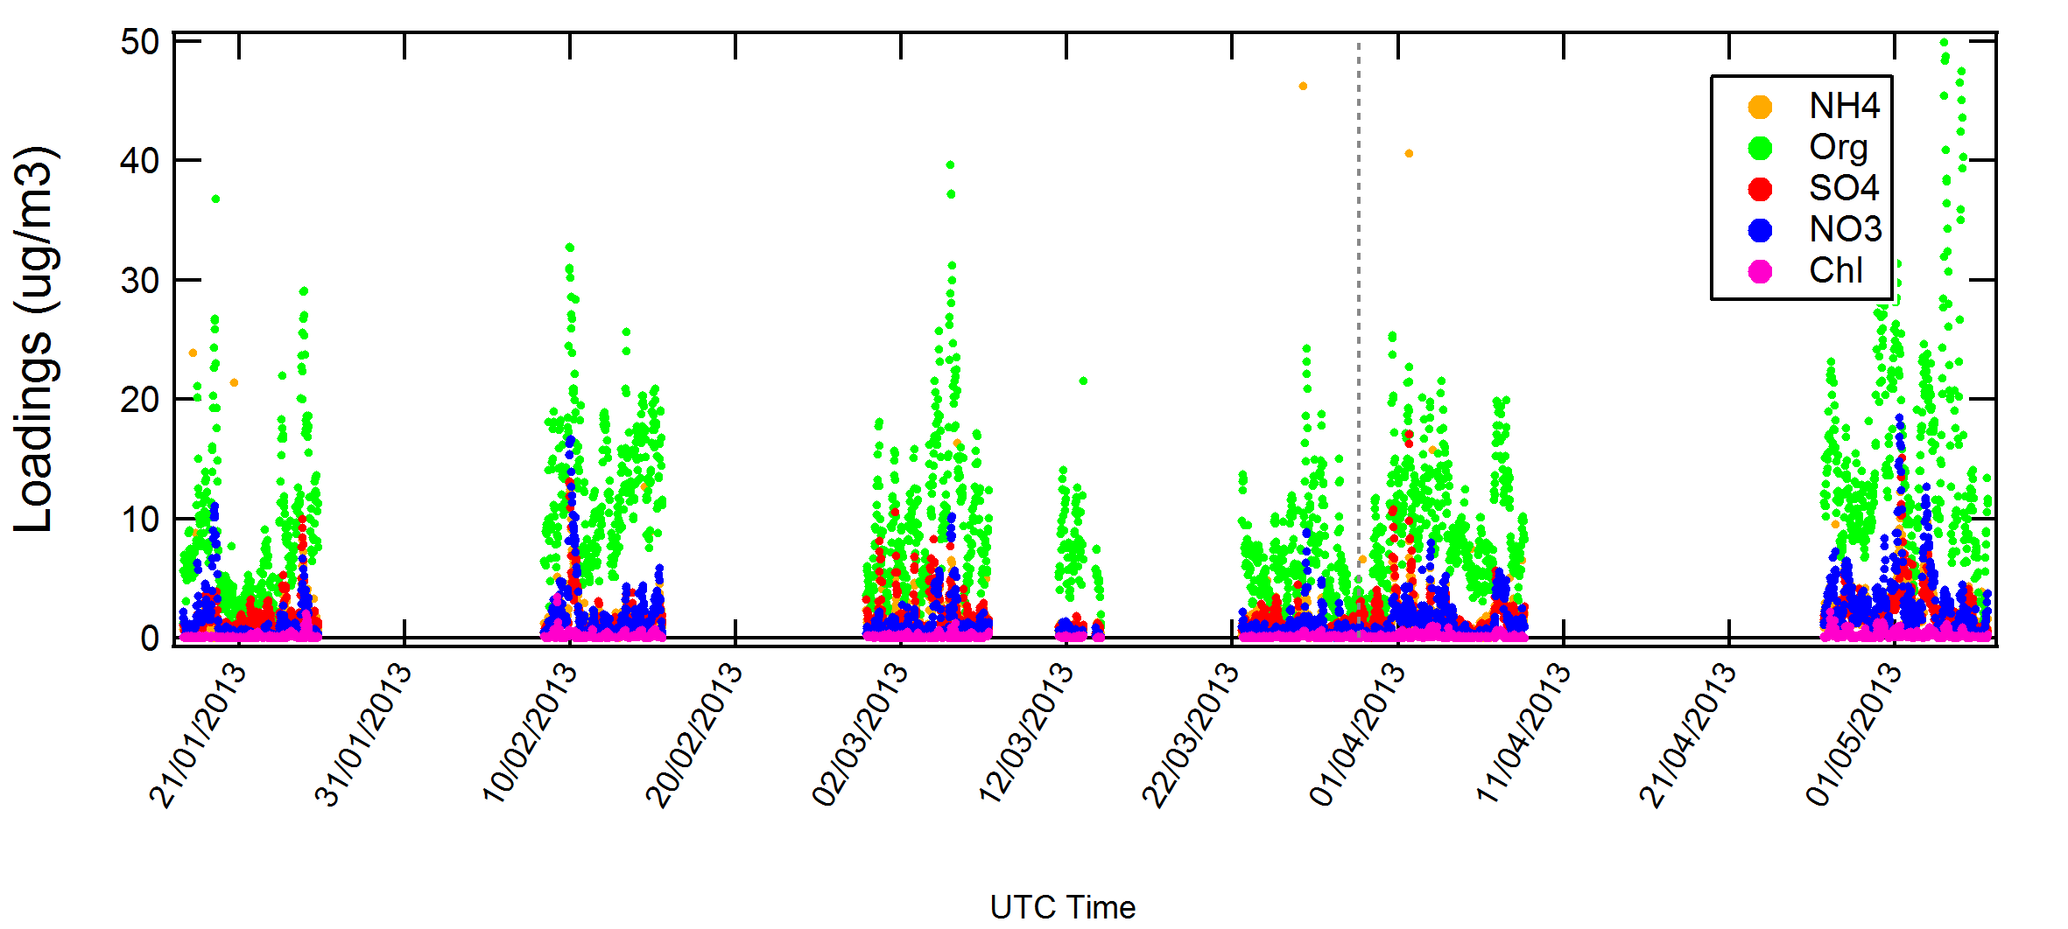
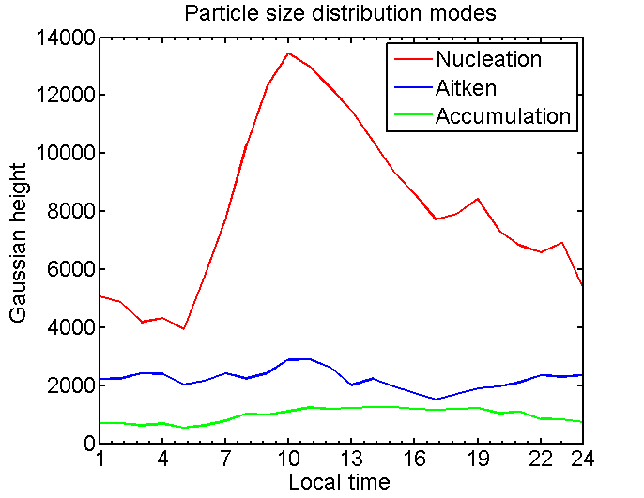
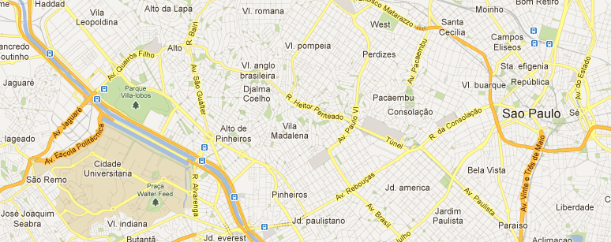
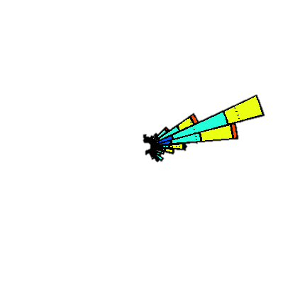
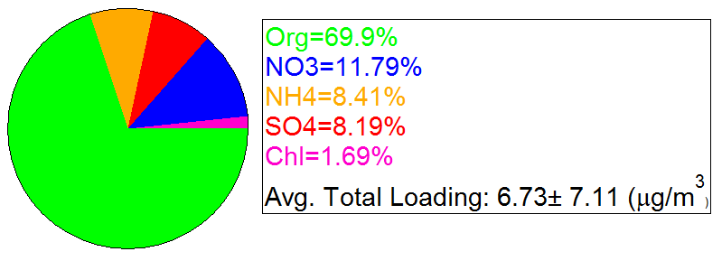
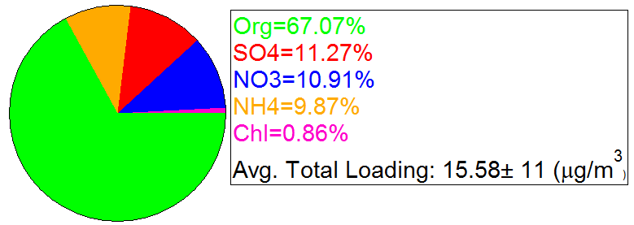
Chemical Characterization of Submicron Aerosol Particles in São Paulo, Brazil
J. Brito¹, L-V. Rizzo², J-M. Godoy³, M-L. Godoy⁴, J. V. de Assunção⁵, N. Alves⁶, P. Artaxo ¹
¹University of São Paulo, Brazil, ²Federal University of São Paulo, Brazil, ³Pontifical Catholic University of Rio de Janeiro, Brazil, ⁴Institute of Radiation Protection and Dosimetry, Brazilian Nuclear Energy Commission, Brazil, ⁴School of Public Health, University of São Paulo, Brazil, ⁶Petrobras, Brazil
An extensive source apportionment study is underway in the Sao Paulo Metropolitan Area. Atmospheric measurements were performed in two sites, University, a site considered background, from August-November 2012, and Downtown, from January to May 2013. PM1 non-refractory aerosol mass concentration was observed to be 6.7 µg m⁻³ at the University site and 15.6 µg m⁻³ at the Downtown site. Despite different season and sampling site, aerosol composition indicated somewhat similar aerosol composition on both sites, with organics contributing with roughly 70% of mass, and nitrates, ammonium and sulfate around 10% and chloride roughly 1%.
Introduction
Emissions from megacities are becoming a global issue, and in particular the impact of transportation sector is increasing worldwide. São Paulo, with a population of 18 million people, and 7 million cars is a major hotspot in air quality. Many aspects of transportation sector still remain unclear, especially the production of secondary organic aerosols and its impacts on air quality. One key element in the puzzle is the uniqueness of the Brazilian fuel, largely based on ethanol use. To improve the understanding of the role of such unique emission pattern we are currently running a source apportionment study at different sites in the São Paulo Metropolitan Area (SPMA). The results of ambient measurements are to be integrated with dynamometers measurements along with chemical modeling.
Among the instrumentation deployed, including long-term filter collection, an Aerosol Chemical Speciation Monitor (Aerodyne) has provided real-time (30min) submicron non-refractory aerosol composition.
Fig. 4 indicates the average submicron non-refractory aerosol composition during the sampling period.
The average organic aerosol spectrum is shown in Fig. 5, indicating that on both sites, especially at the University site, there is a large impact of CO₂⁺ ion (m/z 44), associated with oxygenated aerosols. The average O:C ratio at the Downtown site was estimated to be 0.65 and at the University site 0.80.
Fig. 6 below shows the average aerosol number distribution, indicating ultrafine aerosol strongly dominates on both sites, as well as the diurnal variation of the respective number concentration of particles residing in the nucleation, Aitken and accumulation modes. Results show strong enhancement of nucleation mode during the morning hours, probably as a results of vehicular fresh emission as well as secondary aerosol production.
Similar contribution of nucleation mode is considered to be biased by different sampling periods. Previous measurements at the University site during southern hemisphere summertime have observed weaker contribution of nucleation mode. Next steps include factor analysis, PMF and integration with gas and particulate measurements for an accurate source apportionment study.
Results
A large suite of instruments for aerosol and gas-phase characterization were deployed on two different sampling sites in São Paulo, shown in Figs. 1 and 2.
Sampling sites
University
Figure 6 – Average organic aerosol spectra for the University and Downtown sites.
Downtown
Downtown
Figure 1 – View of the inlet systems at the University site.
University
Figure 3 – Top: Gravimetric results of filter collections at the University site. Middle and bottom: PM1 non-refractory aerosol composition for the University and Downtown sites, respectively.
Figure 7 – Top: Average aerosol number distribution observed at both sites. Right: Diurnal variation of the respective number concentration of particles residing in the nucleation, Aitken and accumulation modes.
University
Downtown
Figure 2 – Overview of the geographic distribution of the sampling sites. Blue marker represents University site, studied during the second half of 2012, as well as its dominating wind direction. The red marker indicates the Downtown site, studied in summer/spring 2013.
Figure 4 – Pie chart of the submicron non-refractory aerosol composition.
Contact: jbrito@if.usp.br
Acknowledgments: We thank Petrobrás for funding this project. We acknowledge Alcides C. Ribeiro, Fernando G. Morais, Fábio O. Jorge, Ana L. Loureiro and Simara Morais for technical and logistical support.

