Slide 1




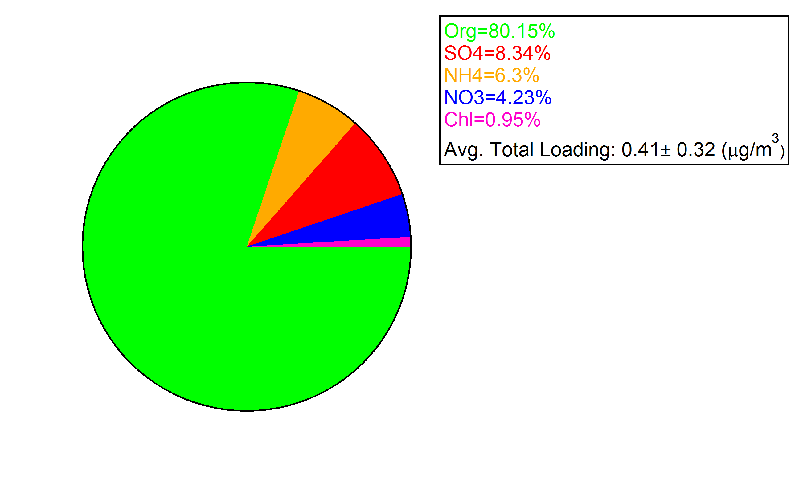
Biogenic aerosols from Amazonia: composition, size distributions and optical properties
Rizzo, L.V.¹, Artaxo, P.² , Brito, J.F.², Barbosa, H.M.², Andreae, M.O.³, Martin, S.T.⁴
¹ Federal University of Sao Paulo (UNIFESP), Brazil ; ² University of Sao Paulo (USP), Brazil, ³ Max Planck Institute for Chemistry, Germany , ⁴ Harvard University, USA
Experimental:
Aerosol properties have been measured since 2008 at two forest sites in Central Amazonia: the TT34 tower site and the ATTO tower site. Inlet lines run from the measurement level (45m, ~10 m above tree height) to a ground-based lab, climatically controlled. All aerosol measurements (PM10) were taken under dry conditions (RH<45%) and adjusted to STP conditions (1013.25 mbar; 0ºC).
Properties of Amazonian biogenic particles:
Tab.1 shows statistics for aerosol properties observed in the wet season (Jan-Jun) at both sites. In the wet season, the main aerosol source is biogenic, although episodes of particle advection from Africa (mineral dust and biomass burning) were recurrently observed between January and April. In the wet season, 75% of particle mass is in the coarse mode, and median particle number concentration is comparable to observations over remote ocean regions. Dry particle single scattering albedo (SSA) was 4% higher at the ATTO site. However, the measurement period is different at both sites, and year to year variability of African advection strength may affect statistics. Another possibility is the influence of the Manaus urban plume, occasionally detected at the TT34 site.
→ Chemical composition
 | TT34 | ATTO
PM₂ (µg.m⁻³) | 2.2 (1.1; 4.0) | -
PM₁₀ (µg.m⁻³) | 9.3 (4.9; 19) | -
N (cm⁻³) | 333 (175; 845) | -
Scat 550 (Mm⁻¹) | 6.3 (1.7; 17) | 7.1 (1.5; 21.2)
Abs 637 (Mm⁻¹) | 0.55 (0.10; 2.74) | 0.40 (0.05; 1.84)
SSA 637 | 0.88 (0.74; 0.95) | 0.92 (0.84; 0.96)
SAE | 1.4 (0.7; 2.1) | 1.2 (0.6; 1.9)
AAE | - | 1.4 (0.7; 2.4)
Fig. 2 – Observations of aerosol elemental composition with aerosol mass spectrometry at the TT34 site at the ZF2. The large dominance of organic particles with low sulfate is very clear. Part of this organic component is primary aerosol particles and part id secondary organic aerosol formed in the atmosphere
Fig. 1: Location of the TT34 (A) and ATTO (B) towers in Amazonas State, Brazil. Prevailing wind direction is Eastern at both tower sites.
Tab1: Statistics for wet season particle properties at TT34 (2008-2011) and ATTO sites (2013): median (p₁₀; p₉₀). N = particle number concentration; SSA = single scattering albedo; SAE = scattering Angstrom exponent; AAE = absorption Angstrom exponent.
Submicrometer particle size distributions:
Submicrometer particle size spectra (10-500 nm) were measured at the TT34 site between 2008-2009. During the wet season, the Aitken mode (~30-100 nm) was prominent, while in the dry season the accumulation mode (100-500 nm) dominated the particle number size spectra (Fig.3). A dip between Aitken and accumulation modes, (Hoppel minimum), was frequently observed in the wet season. It is usually associated with in-cloud aerosol processes, indicating that secondary aerosol formation in Amazonia may happen both through gas-phase pathways (VOC oxidation) and through particle-phase pathways (heterogeneous reactions in cloud droplets eventually mixed down to the boundary layer). New particle formation and subsequent growth was rarely observed. Nevertheless, bursts of ultrafine particles with diameters in the range 10-20 nm were detected in 93 out of 133 wet season days with observations (70%). The bursts typically lasted 20-120 min, and most events (75%) occurred at nighttime. One of these events is illustrated on Figure 4.
Seasonality of particle optical properties:
Due to the influence of regional biomass burning emissions, higher aerosol loadings are observed during the dry season (Jul-Dec) as compared to the wet season (Jan-Jun). Particle scattering coefficients typically increase by a factor of 3 from wet to dry season, while absorption coefficients increase by a factor of 5, at both sites (Fig.5). Median absorption Angstrom exponent (AAE) for wet season at the ATTO site was 1.4 (Fig.6), indicating that biogenic aerosols are light absorbing (brown carbon), particularly at short visible wavelengths (λ<400 nm).
Fig.5 (left): Daily medians of particle optical properties measured at TT34 and ATTO sites between 2008 and 2013. Nephelometer truncation error was corrected.
Fig. 3: Median particle number size distribution for wet and dry season at the TT34 site between 2008-2009..
Fig. 4: Contourplot showing an example of particle burst at TT34 site. Before the burst, Aitken and accumulation modes were present, showing a Hoppel minimum; at 10 pm local time a third mode appears, dominating the other two; after 4 am the ultrafine mode gets less and less intense, as particles grow to the Aitken mode; at 6 am the Hoppel minimum is gone and the Aitken mode dominates the paticle size spectra.
Fig.6 (above): Median particle absorption spectrum at the ATTO site, for 2012-2013 dry and wet season data. Dashed line shows a typical absorption spectrum of black carbon particles, with AAE=1.0 (Absorption Angstrom Exponent). Aethalometer data were corrected for filter loading and multiple scattering effects.
Acknowledgements:
We would like to thank FAPESP, CNPq, LFA-USP technicians, INPA staff support, Dr. Erik Swietlicki, and Dr. Alfred Wiedensohler.
Notes:
TITLE: Biogenic aerosols from Amazonia: Composition, size distributions and optical properties AUTHORS (FIRST NAME, LAST NAME): Luciana Varanda Rizzo¹, Paulo Prof Artaxo², Joel Ferreira Brito², Henrique M Barbosa², Meinrat O Andreae³, Scot T Martin⁴ INSTITUTIONS (ALL): 1. Exact and Earth Sciences, Federal University of Sao Paulo, Diadema, Sao Paulo, Brazil.
2. Physics Institute, University of Sao Paulo, Sao Paulo, Sao Paulo, Brazil.
3. Max Planck Institute for Chemistry, Mainz, Germany.
4. Harvard University, Cambridge, MA, United States.
ABSTRACT BODY: Amazonia is an excellent laboratory to study atmospheric processes that are characteristic of natural conditions, as they existed prior to the impact of industrialization on the regional and global atmosphere. Biogenic aerosols dominate the particle population in Amazonia, showing a strong link between forest biology and atmospheric composition. In the fine fraction, aerosols are mostly secondary organic particles formed from biogenic emissions of trace gases, with a contribution of primary particles. In the coarse mode, primary biogenic particles dominates the picture. Aerosols have been continuously measured at the TT34 LBA tower at the ZF2 ecological station about 55 Km North of Manaus since January 2008. Fine mode aerosol mass concentration is very low in Amazonia, with PM2.5 of about 1.3±0.7 µg m-3 and 3.4±2.0 µg m-3 in the wet and dry seasons, respectively. In terms of particle number concentrations a median value of 220 cm-3 in the wet season and 2,200 cm-3 in the dry season were observed. An aerosol chemical speciation monitor (ACSM) was deployed in 2013, and it shows that organic aerosol account to 81% to the non-refractory PM1 aerosol loading at TT34, while in the dry season, a high 93% content of organic particles was observed. Size distribution shows the occurrence of bursts of particles with about 20 nanometers at night time, possibly associated with biological process. Very few events of new particle formation are observed. Aerosol light scattering and absorption coefficients at the TT34 site were low during the wet season, increasing by a factor of 5, approximately, in the dry season due to long range transport of biomass burning aerosols reaching the forest site. Aerosol single scattering albedo (SSA) ranged from 0.84 in the wet season up to 0.91 in the dry, indicating a surprising high absorption in the wet season, associated with biogenic particles.

