Slide 1
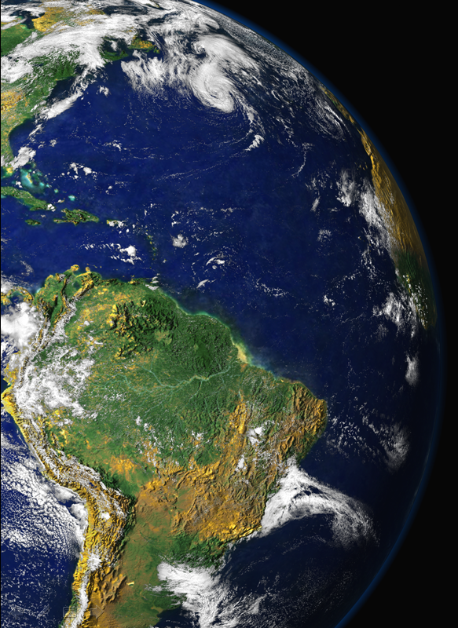
Black Carbon in Andes Meeting
Santiago de Chile, October 10, 2013
Black Carbon from Biomass Burning in Amazonia
Paulo Artaxo,
Luciana Rizzo, Joel Brito
University of São Paulo, Brazil,

Slide 2
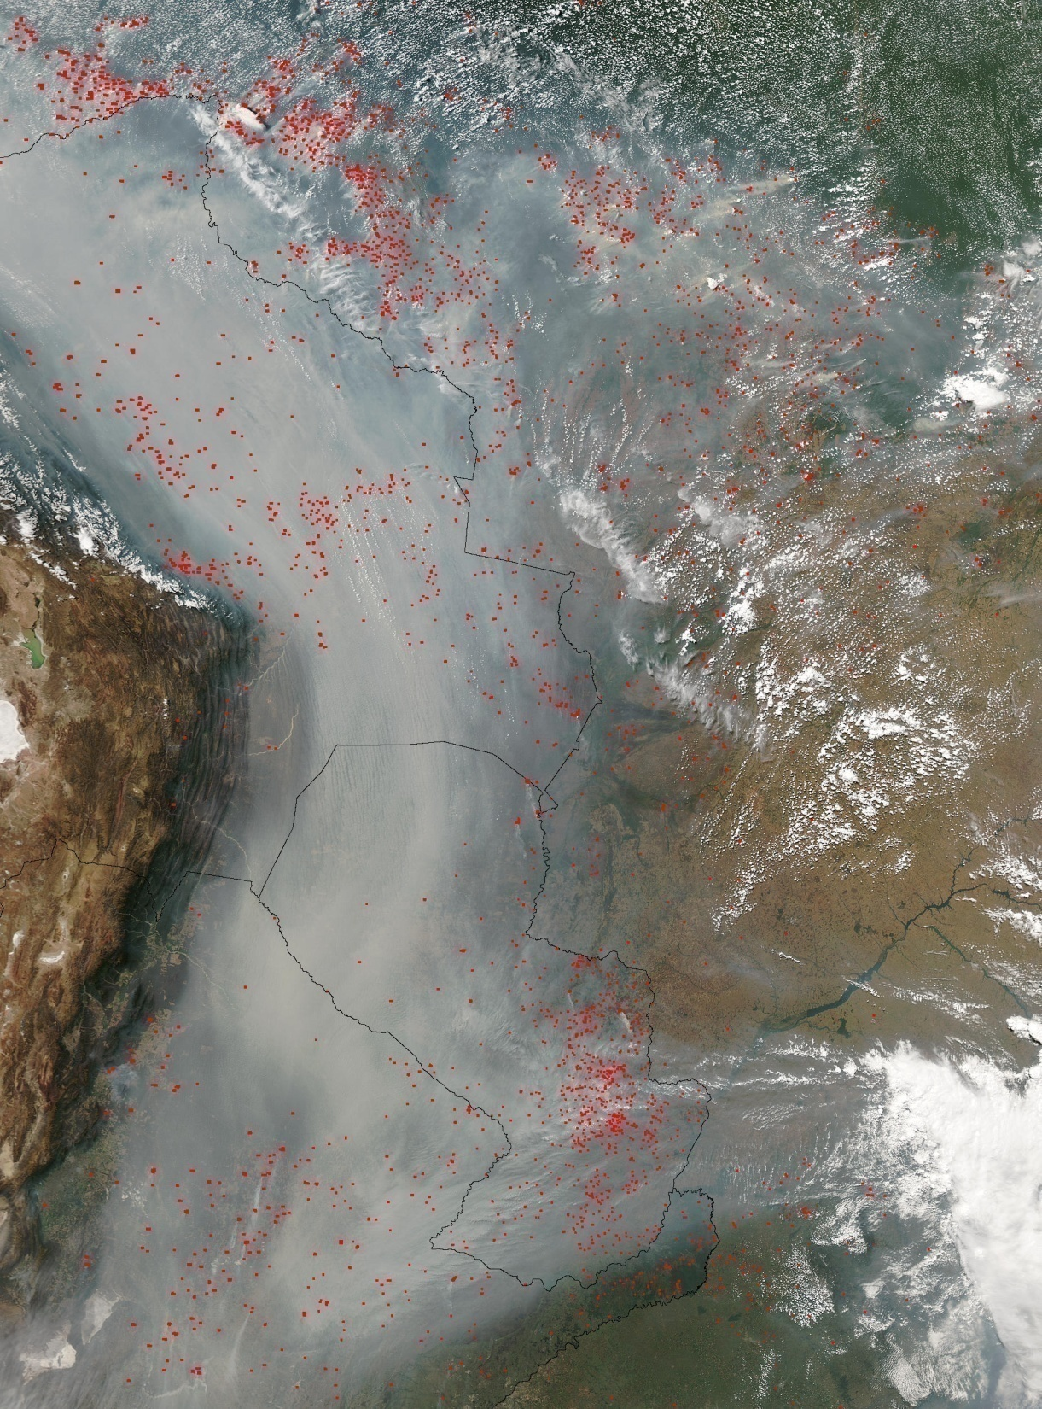

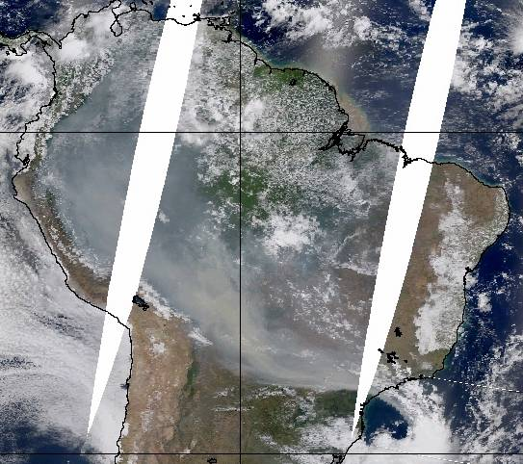
Biomass Burning in Amazonia
Severe health effects on the Amazonian population (about 20 million people)
Climatic effects, with strong effects on cloud physics and radiation balance.
Changes in carbon uptake and ecosystem functioning

Slide 3
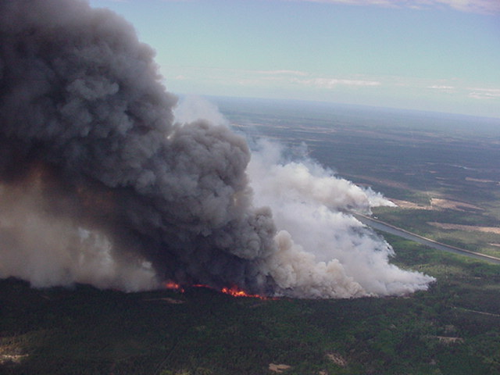
Aerosol single scattering albedo:
highly variable

Slide 4
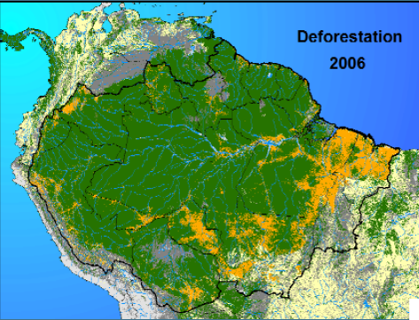
Deforestation was reduced from 27,700 Km² in 2004 to 4,571 Km² in 2012.
A very dynamical system, and we need to know what effects on the ecosystem these changes have produced
4.571 Km²
in 2012
What public policies are needed to sustain this strong reduction?

Slide 5
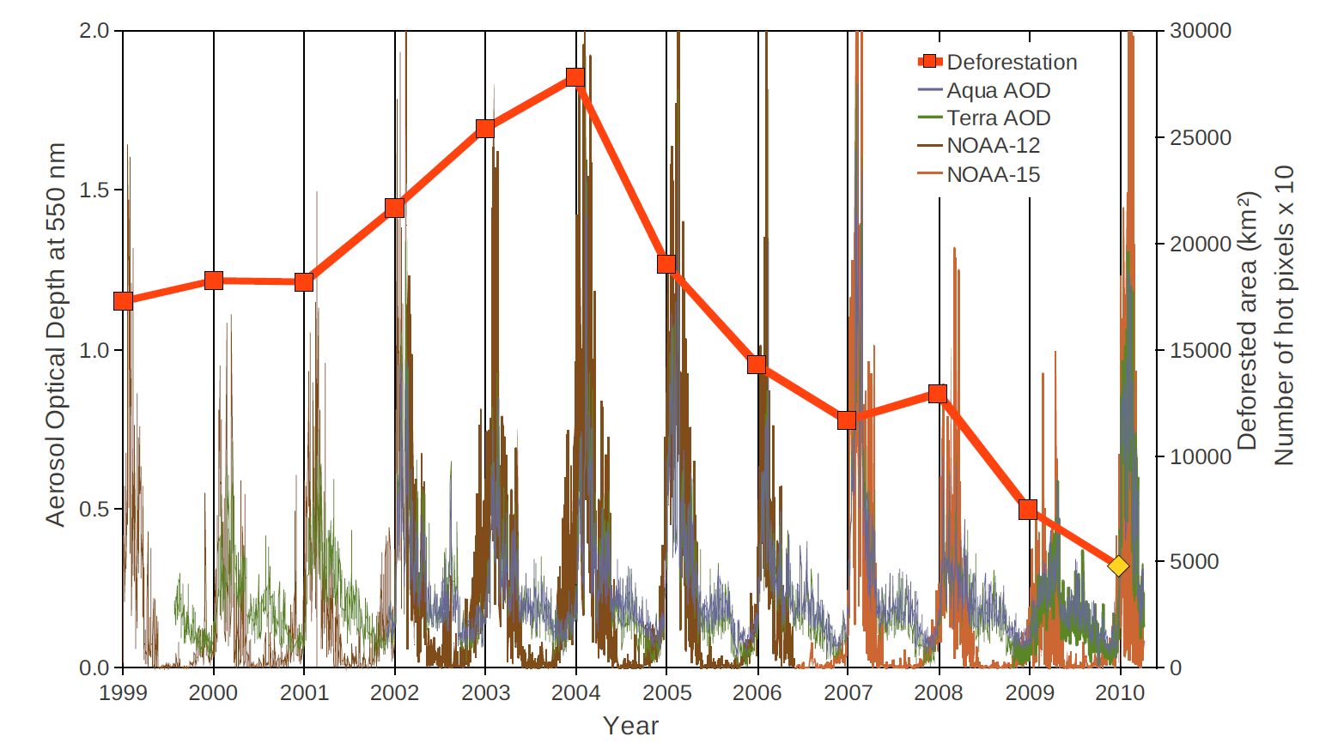
Yearly deforestation and MODIS AOD and hot pixels from NOAA-12/15
Yearly deforestation over the Brazilian Amazon region (INPE, 2010) compared to MODIS daily smoke optical depth and the daily number of hot pixels from NOAA-12 and NOAA-15. The results are shown according to the hydrological year, from August 1st of the previous year to July 31st of the years shown in the graph. The vertical lines indicate August 1st , which correspond to the onset of the burning season.

Slide 6
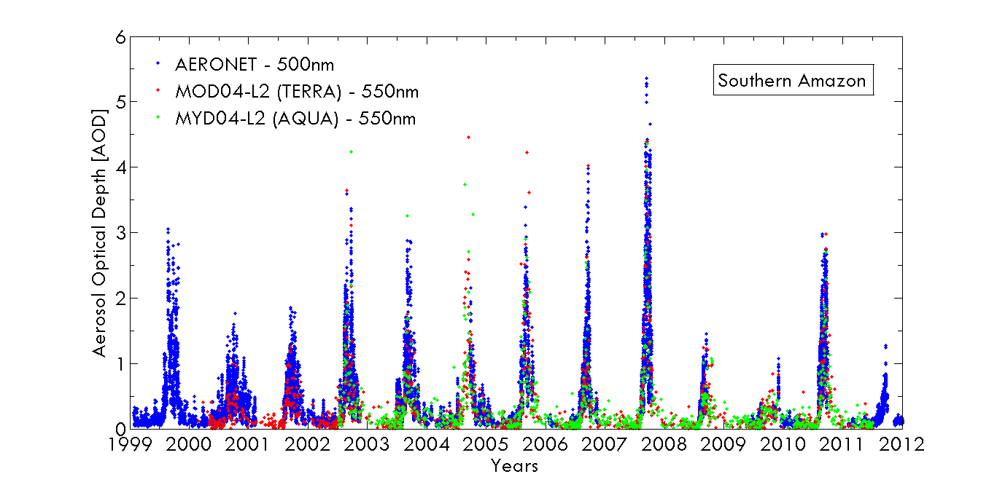
AOD 550 nm 1999-2012 in Porto Velho, Rondonia

Slide 7
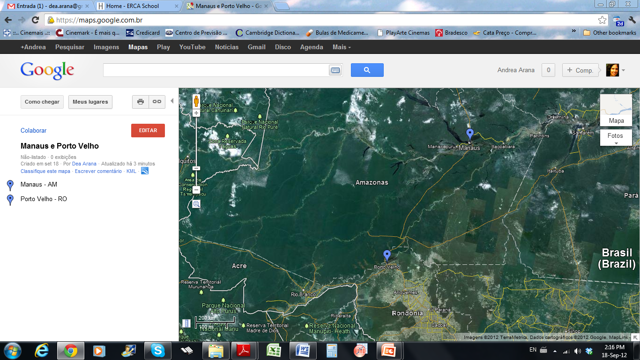
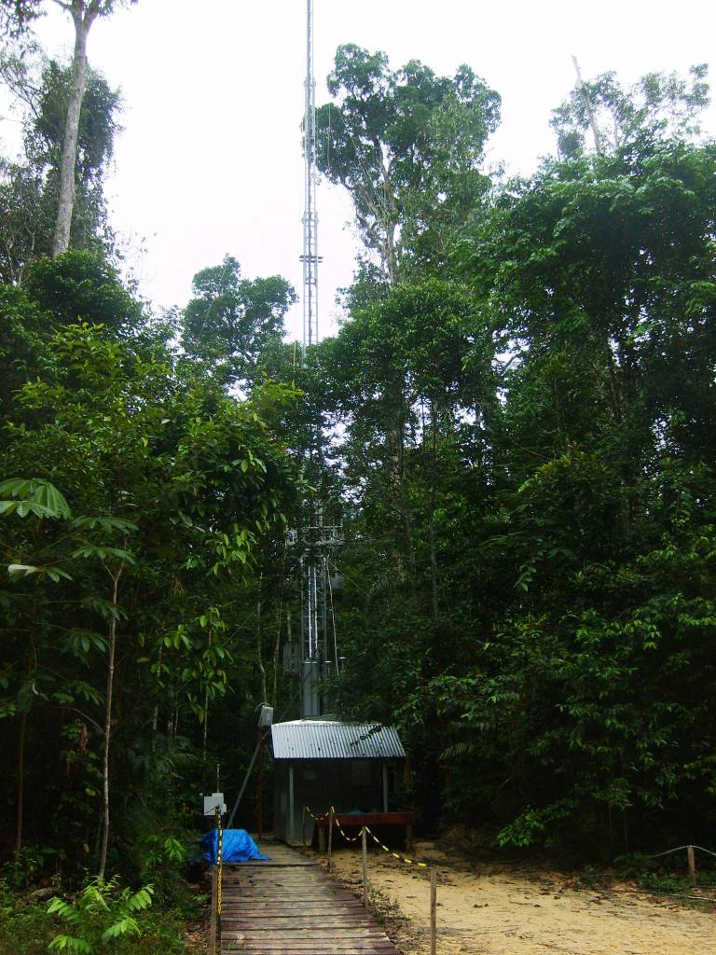
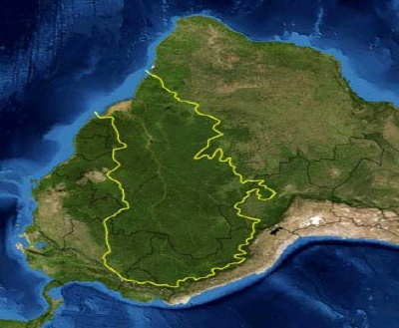
Rebio Cuieiras
Manaus
Porto Velho
Notes:
Os sítios de medida foram Rebio Cuieiras e Porto Velho.

Slide 9
Porto Velho aerosol mass concentration and black carbon from 1999 to 2012

Slide 10
Termograms showing the types of carbon present in atmospheric aerosol in Porto Velho and Rebio Cuieiras.

Slide 11
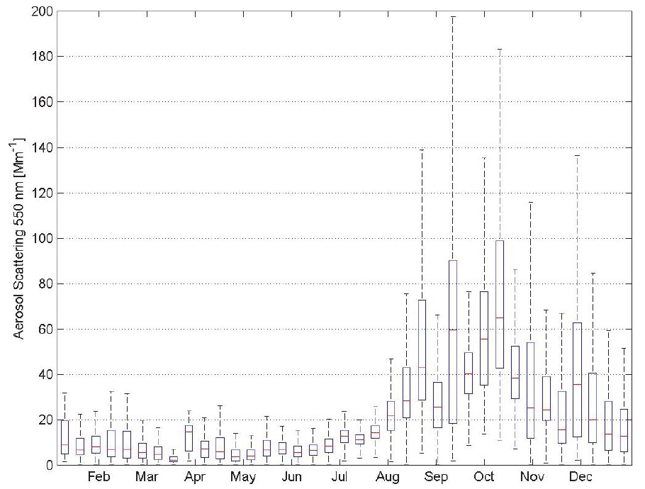
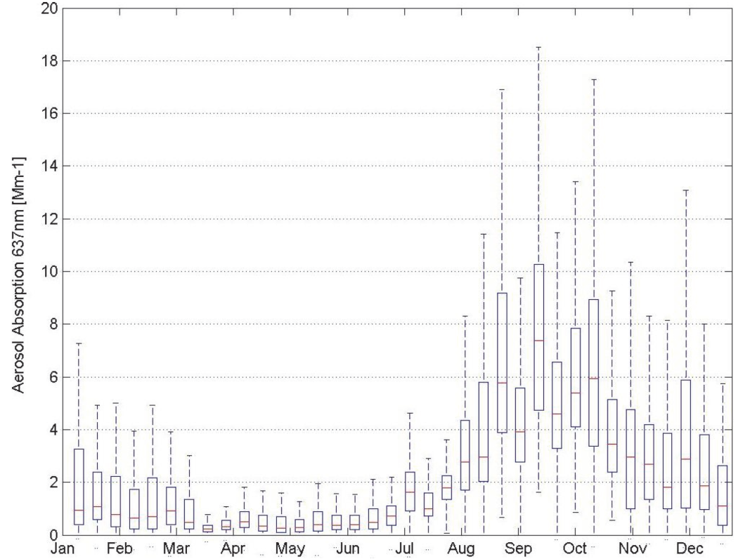
Seasonality of scattering and absorption
particle scattering coefficients at 550nm
aerosol absorption coefficients at 637nm
Particle scattering coefficients at 550nm between February 2008 and May 2011. Statistics were calculated for each 10 Julian days
Aerosol particle absorption coefficients at 637nm between February 2008 and May 2011. Statistics were calculated for each 10 Julian days

Slide 12
Scattering, absorption and SSA in Manaus and Porto Velho
Monthly statistics (2009 – 2012) for light scattering coefficient σ_{s} at 637 nm and light absorption coefficient σ_{a} at 637 nm in Mm⁻¹ for Porto Velho (PVH, in black) and central Amazonia (TT34, in red).
Single Scattering Albedo Lower at the pristine site
Artaxo et al., 2013

Slide 13
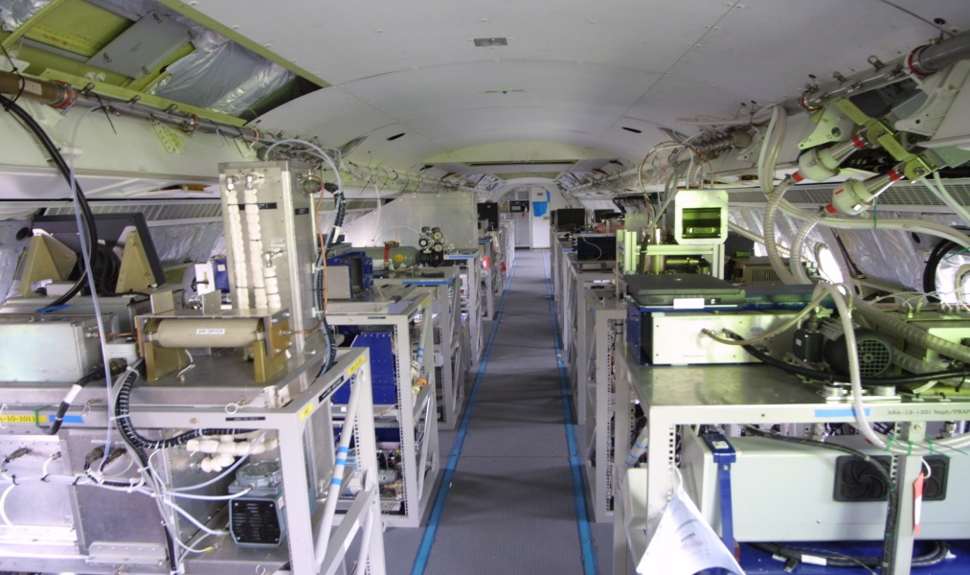
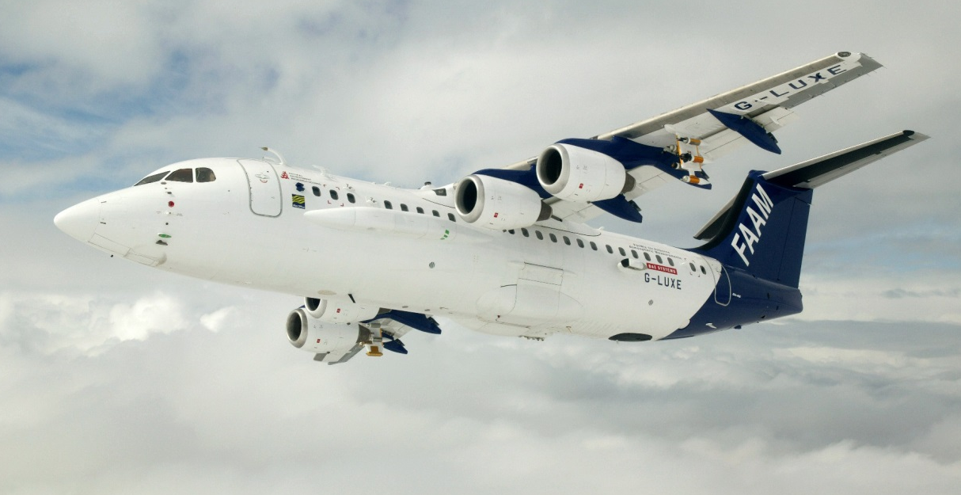
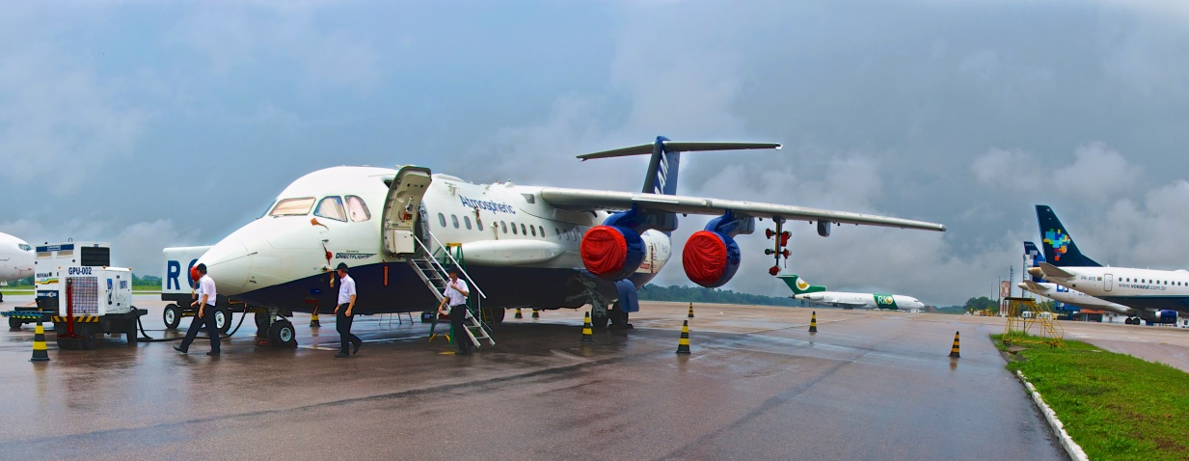
SAMBBA - South American Biomass Burning Analysis
NERC-FAPESP
Collaboration

Slide 14
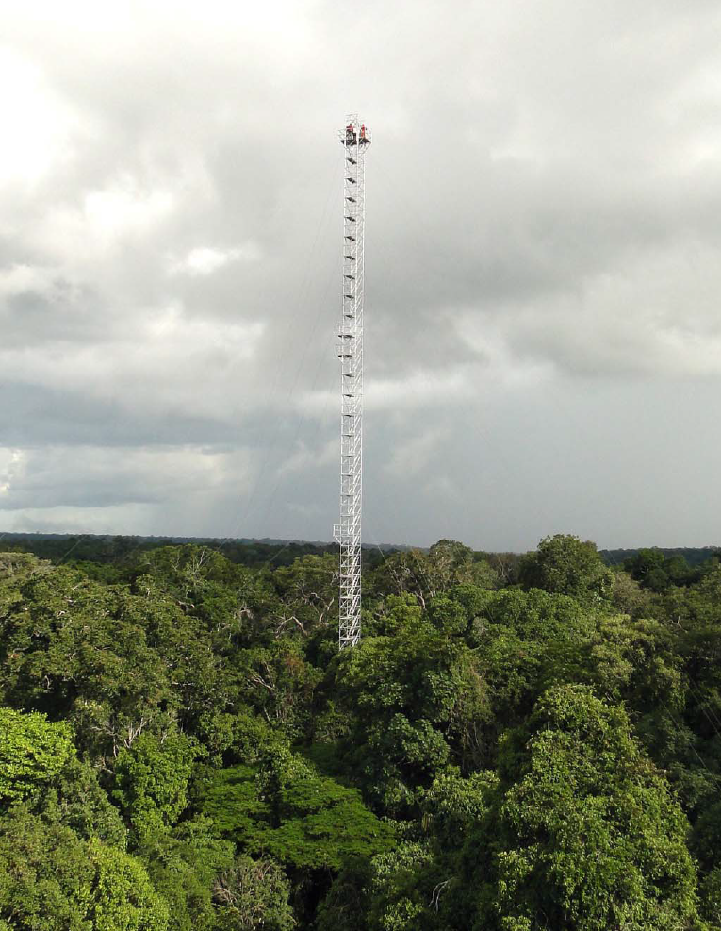
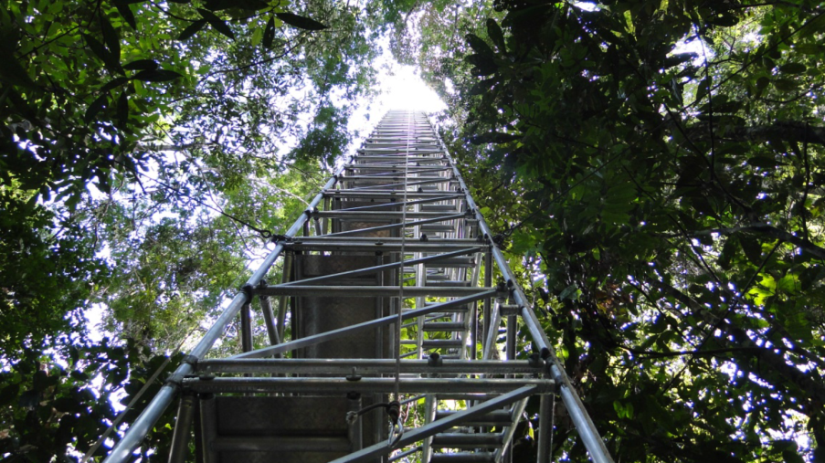
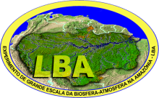
Four flux towers with 85 meters already in operation at the ATTO site
Measurements at 6 levels for
Ozone, CO, VOCs (PTR-MS), aerosol number size distribution, composition with ACSM, Light scattering (TSI Neph), light absorption using MAAP, Aethalometer, SP2), CO2, CH4, water vapor and others.

Slide 15

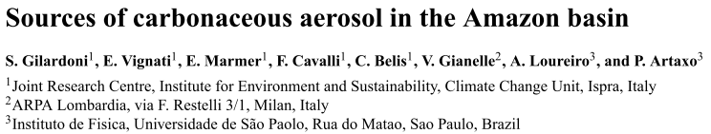
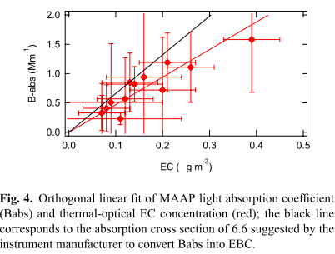
MAC = 4.7 m² g⁻¹ em 637nm
Petzold and Schomlinner (2004) = 7.8 – 9.2 m² g⁻¹
Bond and Bergstrom
(2006) = 6.4 m² g⁻¹
Área
urbana

Slide 16
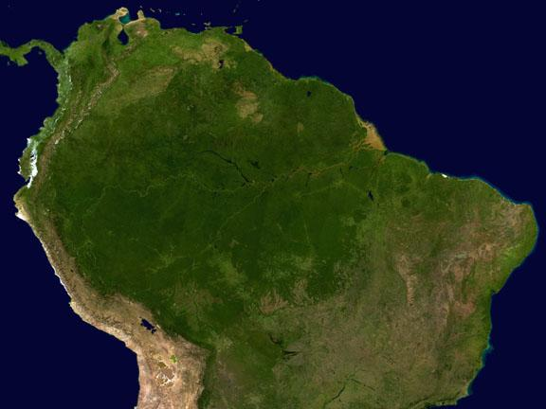
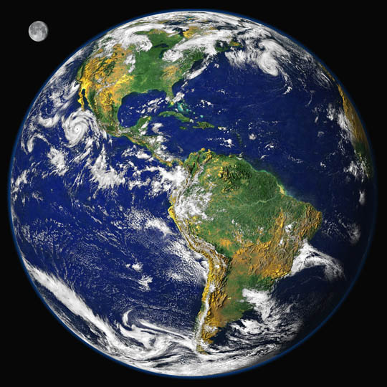
Cooperation is key!!!!
Thanks for the attention.

