Slide 1
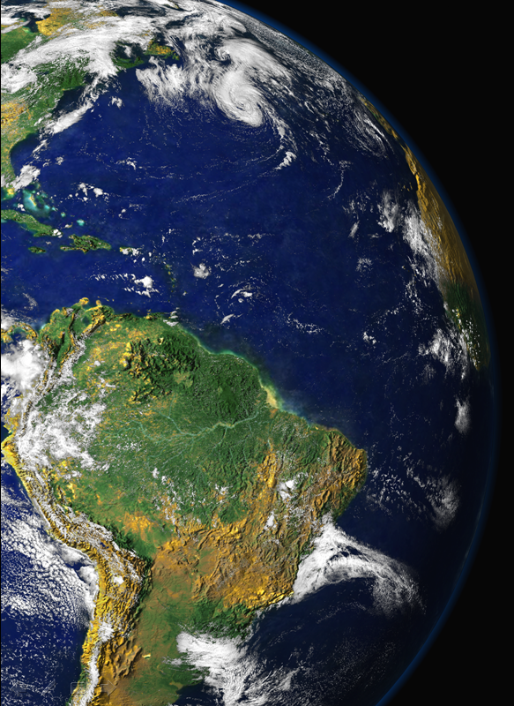
EAC 2013 European Aerosol Conference , Prague, Sept. 2, 2013
The optical properties of aerosols in Amazonia: from natural biogenic to biomass burning particles
Paulo Artaxo, Xuguang Chi, Henrique Barbosa, Luciana Rizzo, Andrea Arana, Joel F. Brito Elisa Sena, Joel Schaefer, Meinrat O. Andreae.
Institute of Physics, University of São Paulo, Brazil, artaxo@if.usp,br,
NASA Goddard, Max Planck Institute for Chemistry, Mainz, Germany

Slide 2
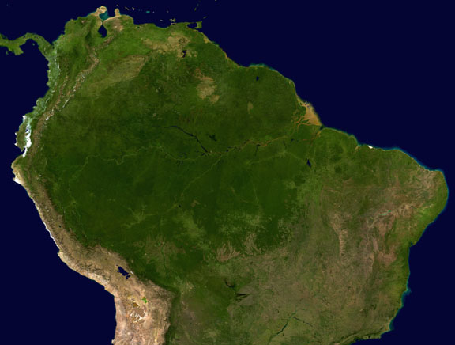
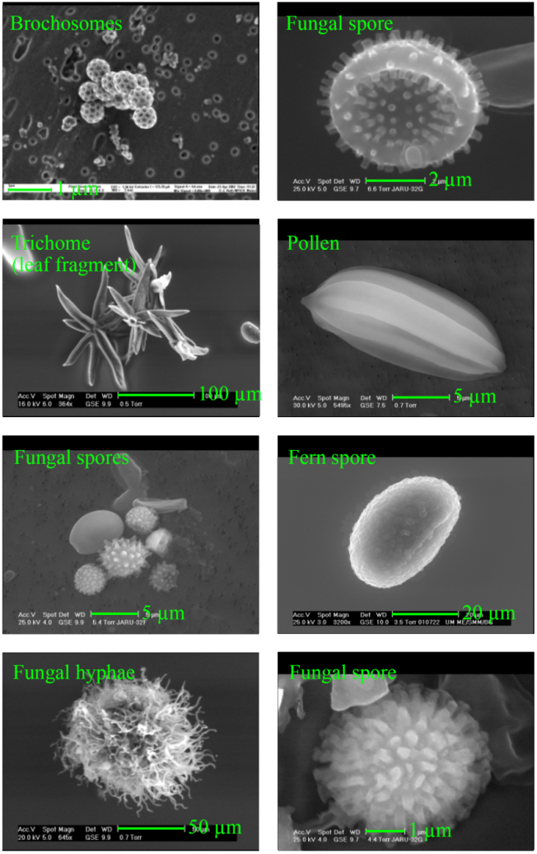
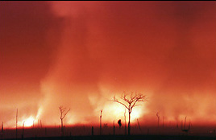
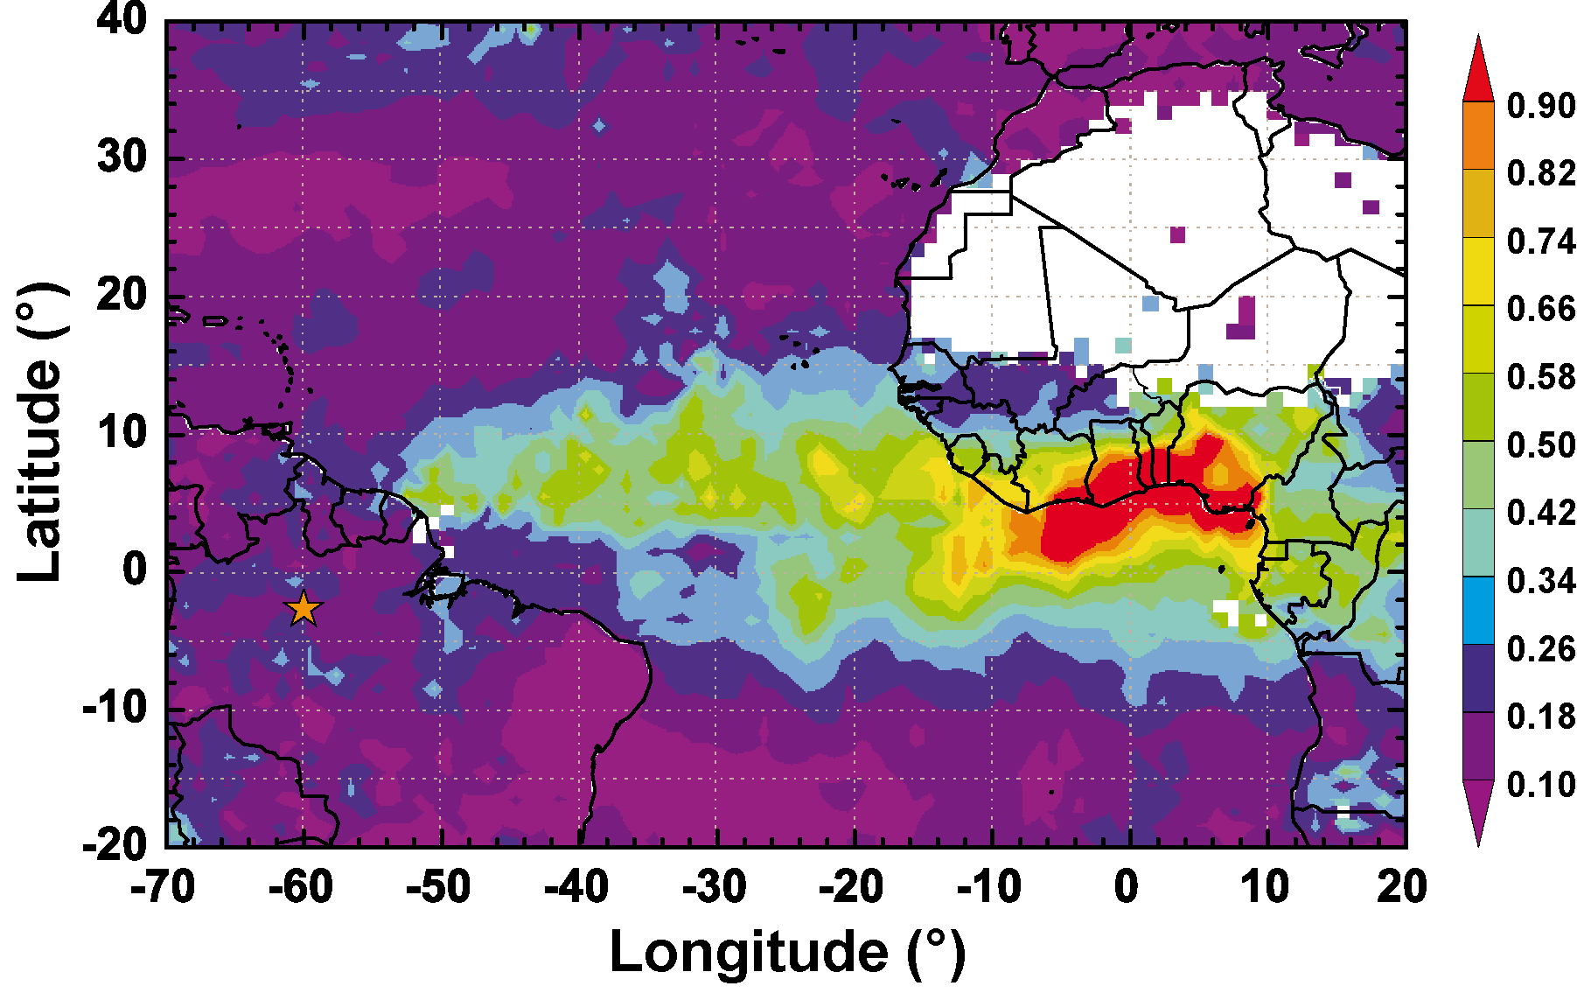
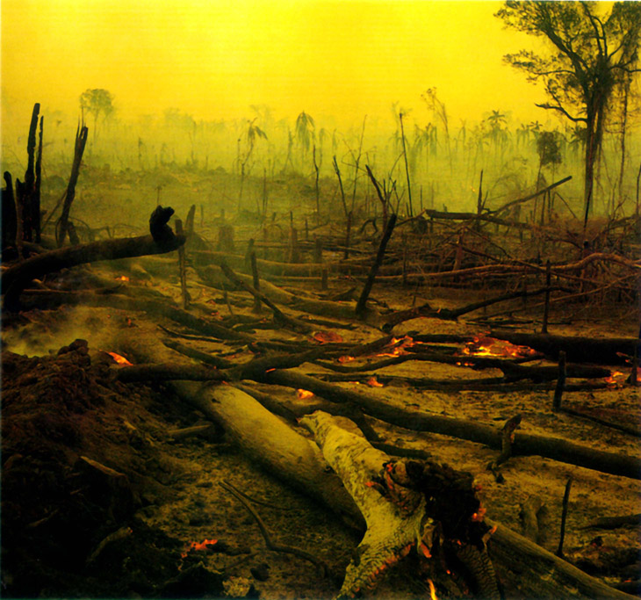
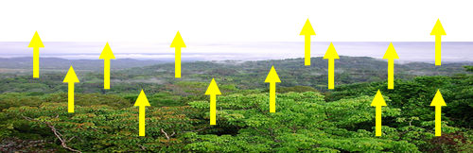
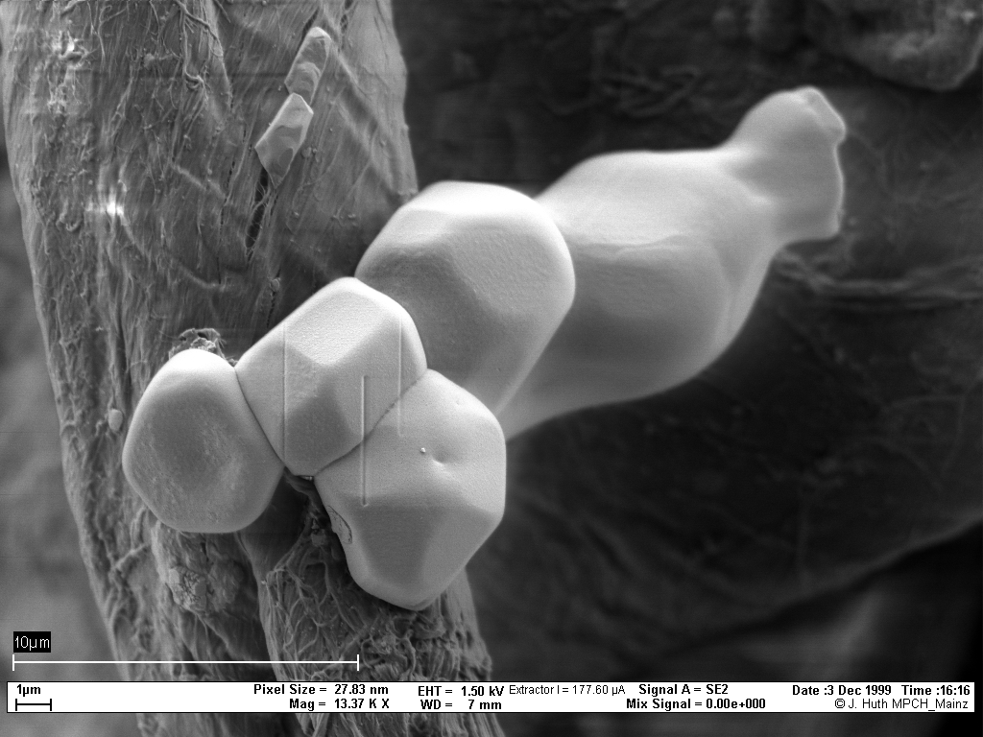
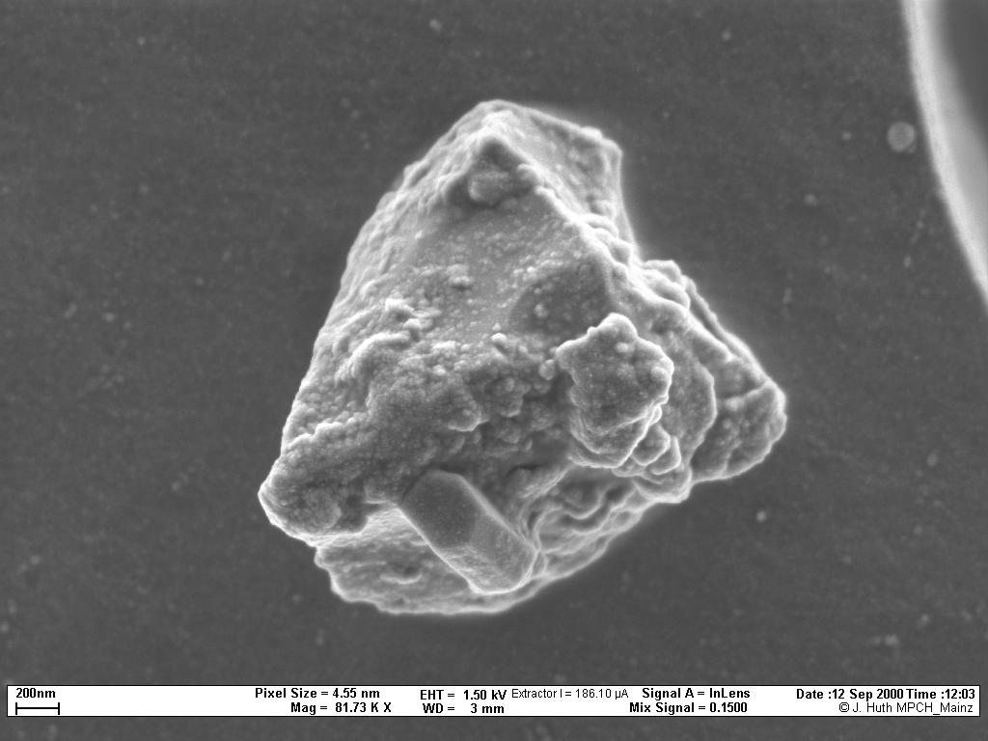
Amazonia: 3 different types of aerosols
Biogenic (primary and SOA)
Biomass Burning
Dust from Sahara
Each with VERY different properties and impacts

Slide 3
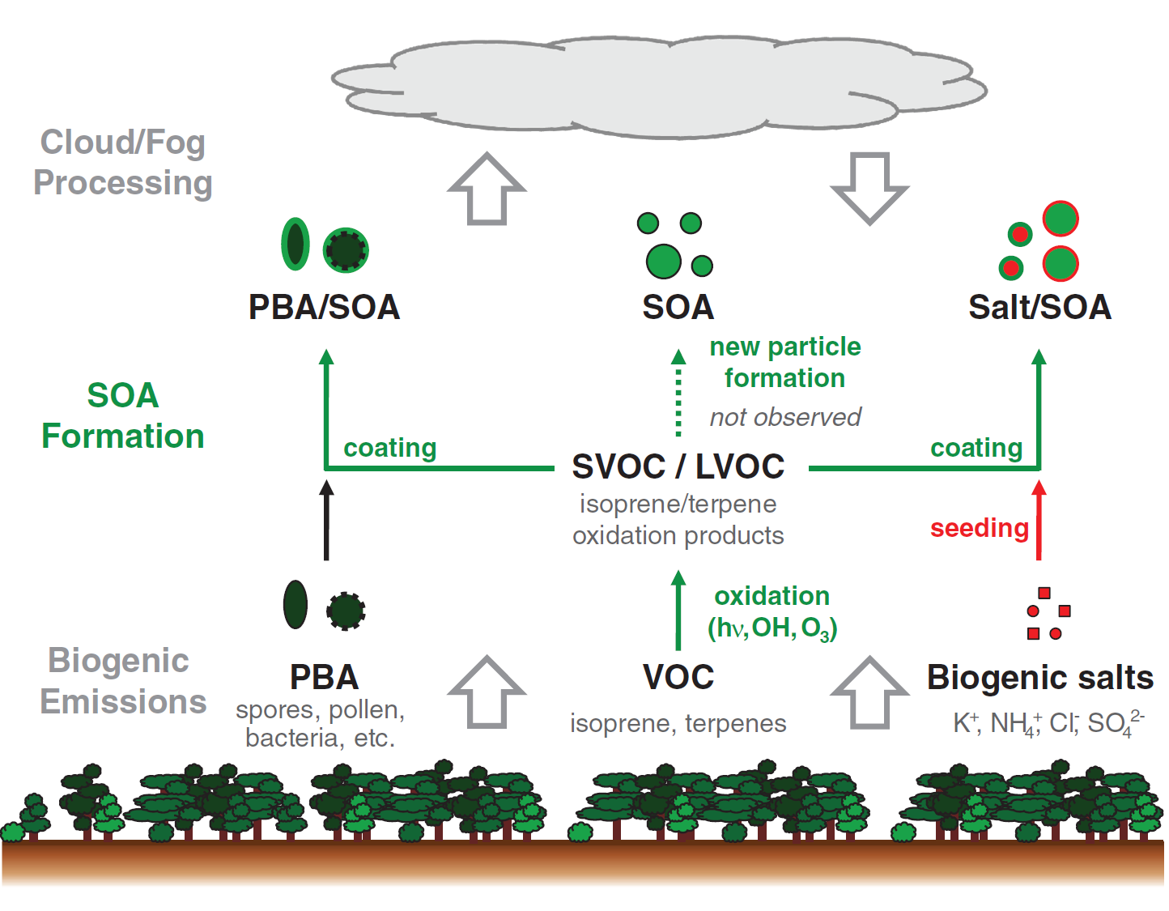
Sources and processing of organic aerosol in pristine Amazonian boundary layer air
C. Pöhlker et al.,
Science 2012

Slide 4
Four years continuous aerosol sampling in two sites: Pristine: Central Amazonia at ZF2 LBA and ATTO towers. Perturbed: Porto Velho, Rondonia.
Absorption: MAAP (637 nm) and Aethalometer (7λ)
Scattering: TSI (450, 550, 700 nm) and Aurora 3000 Nephelometers
DRY aerosol (RH<40%) , PM_{2.5} inlet
AERONET (7 Sites), MODIS+CERES aerosol radiative forcing
Instruments | Analysis
PM₁₀ PM_{2.5} Nuclepore Filters | Fine and coarse mode particulate matter & trace elements
PM_{2.5} Quartz Filters | EC/OC analysis using a Sunset and EUSAR protocol
MAAP (Thermo@637 nm) | Aerosol light absorption and Black Carbon concentration
Aethalometer (Magee Sci. 7λ) | Spectral aerosol light absorption and BC concentration
Nephelometer (TSI 3563) | Aerosol light scattering at 3 wavelengths
TEOM (Thermo Dual Channel) | Fine and coarse mode particulate matter
SMPS (TSI+3772) | Aerosol Number Size Distribution (10 to 450 nm)
OPC (GRIMM) | Aerosol Number Size Distribution (0.25-10 µm)
CPC (TSI 3772) | Particle number concentration
ACSM (Aerodyne) | Non-refractory aerosol composition for d<1.0µm.
O₃, CO, CO₂ (Picarro+Thermo) | Trace gas concentrations

Slide 5
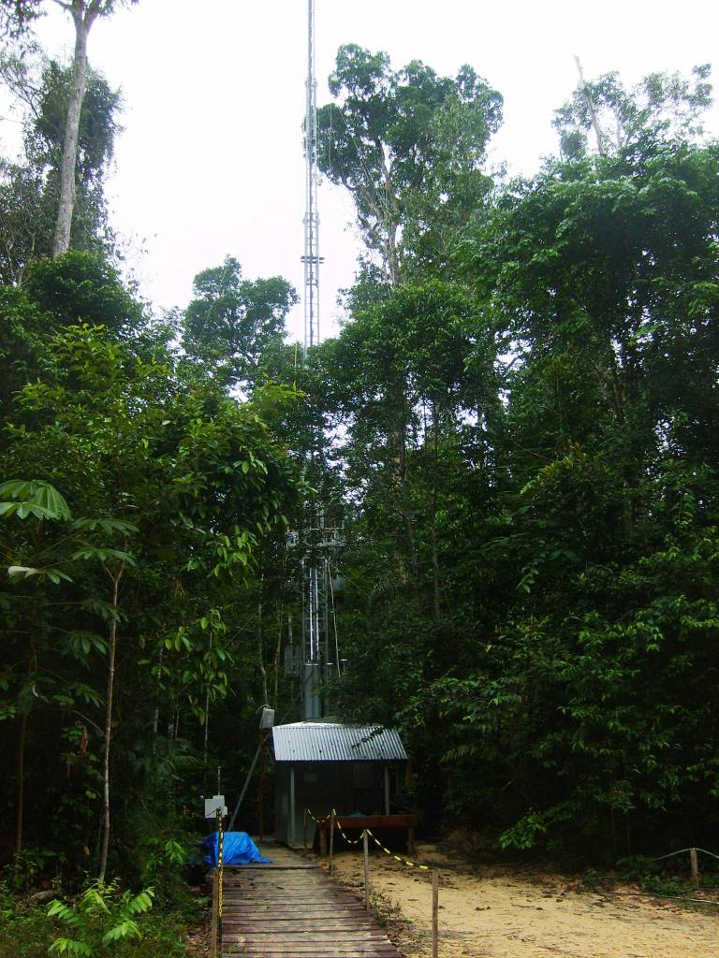
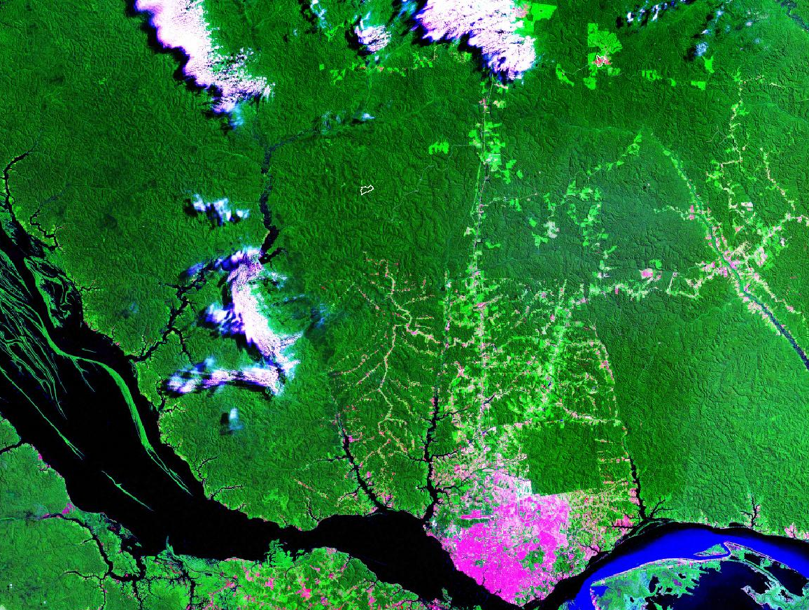
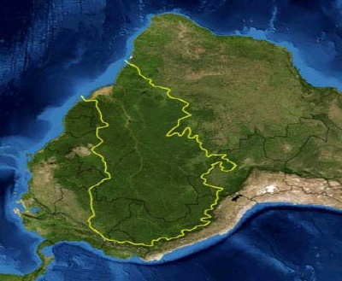
The measurement
site in Central Amazonia
Rbio Cuieiras
Manaus
Dry aerosol (RH<40%)
Site continuously operational since Feb 2008.

Slide 6
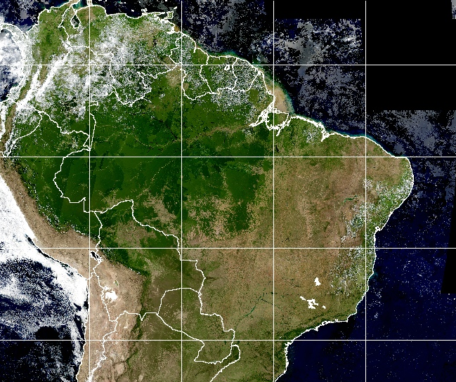
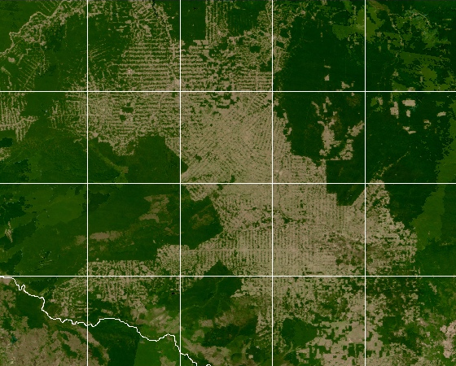
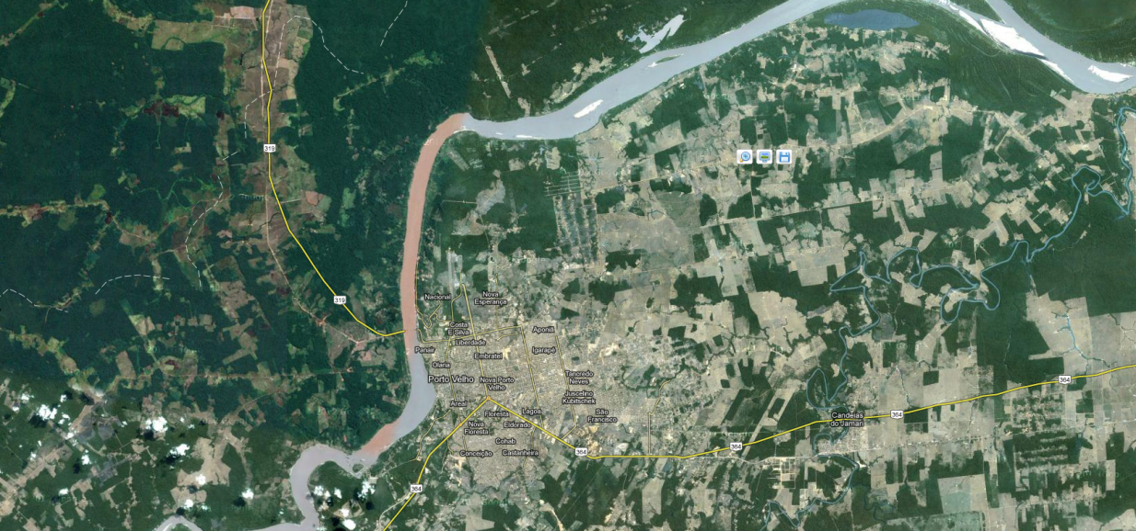
-80
-70
-60
-50
Porto Velho
The measurement site in
Porto Velho, Rondonia
-10
5
-11
-12
-5
-64
-63
-62
-61
-15
-15
-25
-25
-80
-70
-60
-50
-40
-30

Slide 7
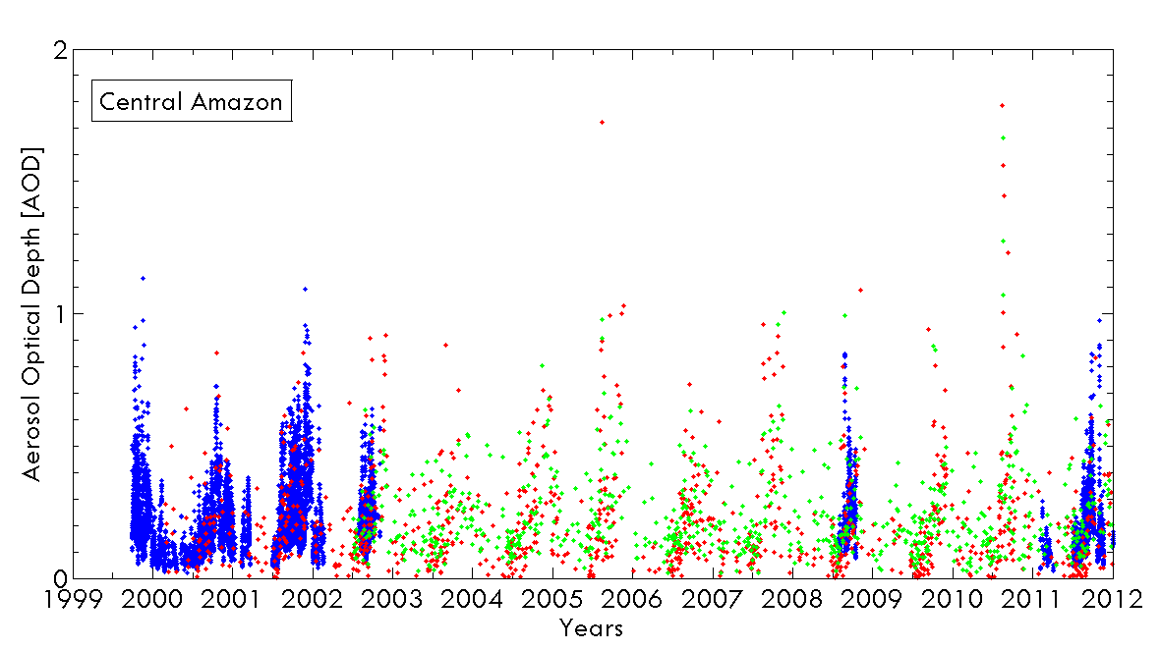
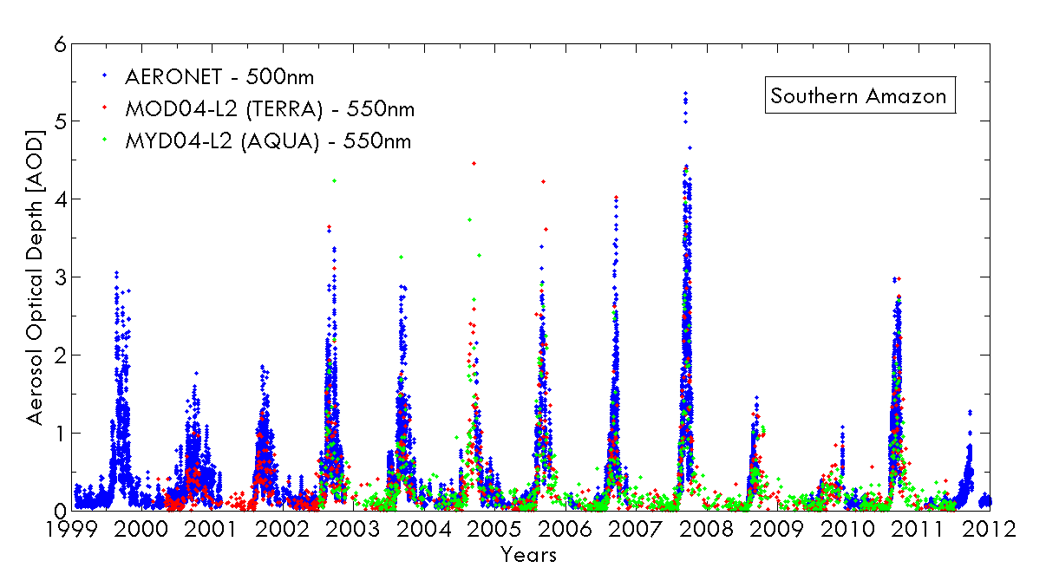
Time series of aerosol optical depth at the Central and Southern Amazonia with MODIS (550 nm) and AERONET (500 nm) retrievals from 1999 to 2012.

Slide 9
Porto Velho aerosol mass concentration and black carbon from 1999 to 2012

Slide 10
Manaus ACSM 2013 wet season measurements

Slide 11
ACSM measurements in Rondonia

Slide 12
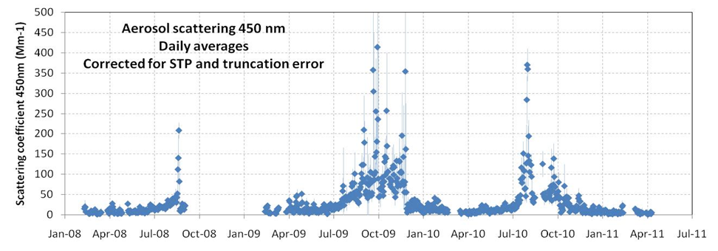
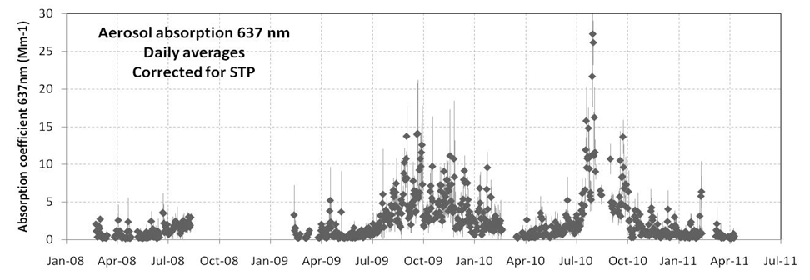
Manaus aerosol light scattering TSI Nephelometer 2008-2011
Manaus aerosol light absorption MAAP 2008-2011

Slide 13
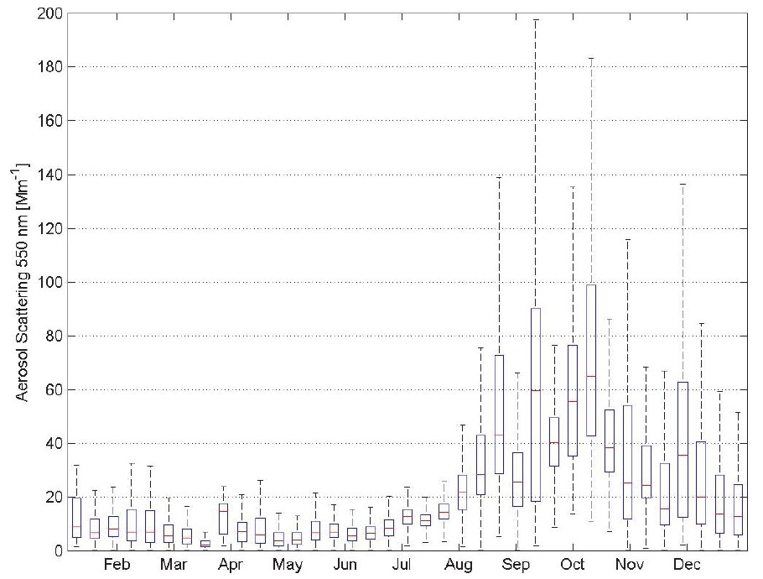
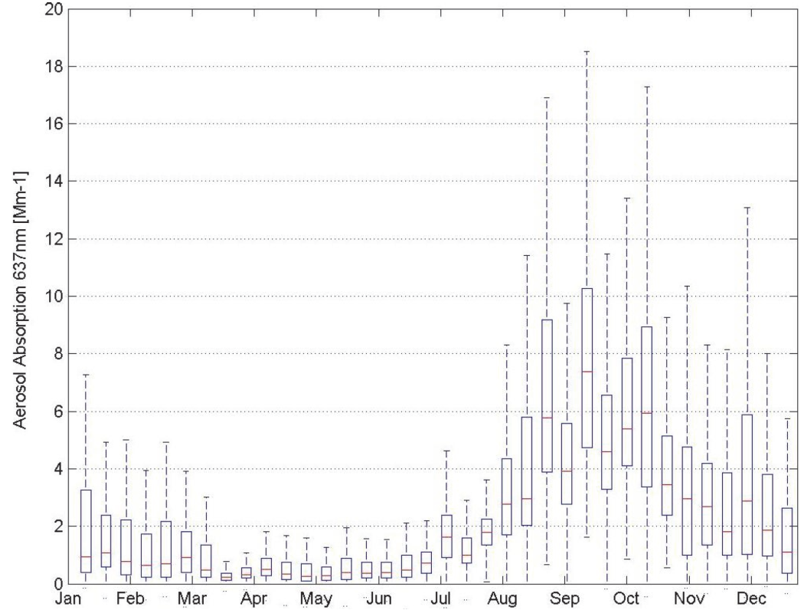
Manaus seasonality of scattering and absorption
particle scattering coefficients at 550nm
aerosol absorption coefficients at 637nm
Particle scattering coefficients at 550nm between February 2008 and May 2011. Statistics were calculated for each 10 Julian days
Aerosol particle absorption coefficients at 637nm between February 2008 and May 2011. Statistics were calculated for each 10 Julian days

Slide 14
Scattering, absorption and SSA in Manaus and Porto Velho
Monthly statistics (2009 – 2012) for light scattering coefficient σ_{s} at 637 nm and light absorption coefficient σ_{a} at 637 nm in Mm⁻¹ for Porto Velho (PVH, in black) and central Amazonia (TT34, in red).
Single Scattering Albedo Lower at the pristine site
Artaxo et al., 2013

Slide 15
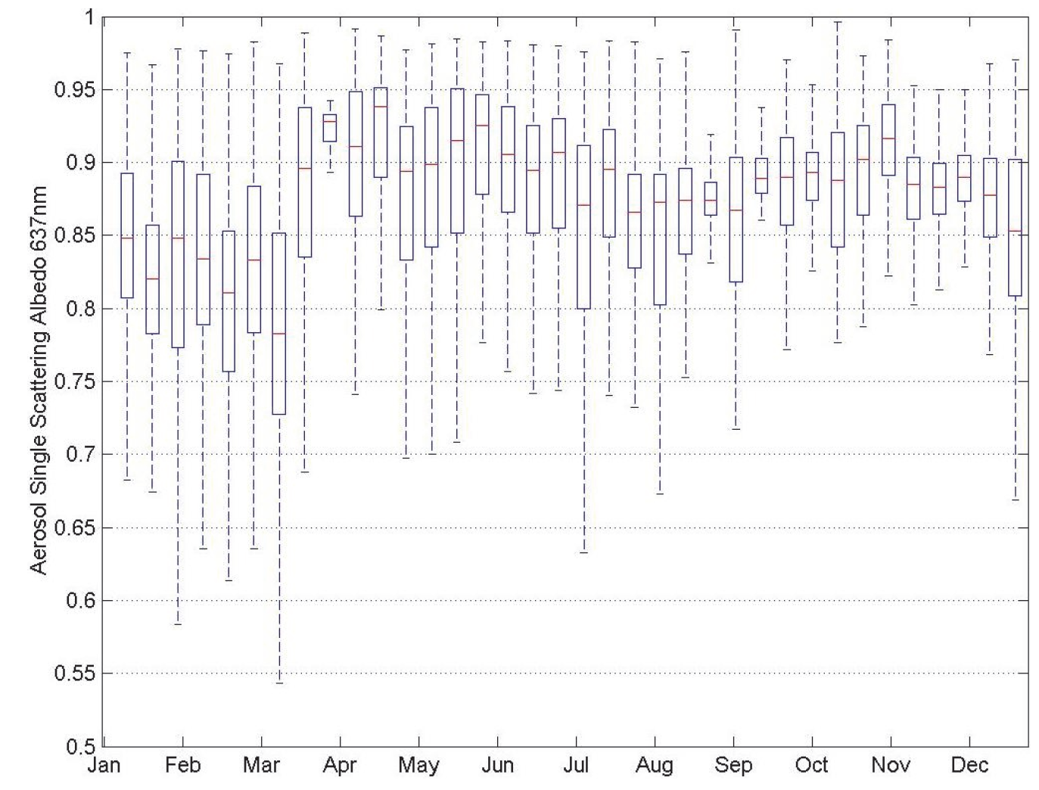
Seasonal variability of aerosol single scattering albedo at 637nm between 2008 and 2011 at ZF2 site in Manaus.
Average
SSA=0.86

Slide 16
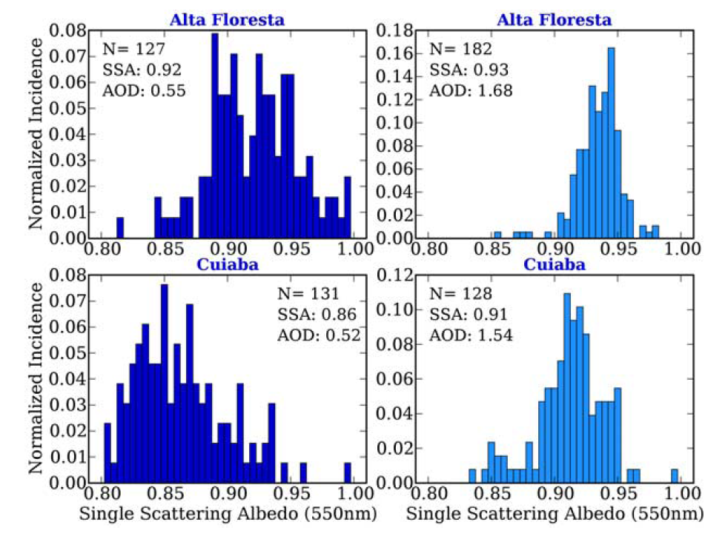
AERONET Single-scattering albedo (SSA 550nm)
Low AOT, more absorbing
High AOT, less absorbing
Histograms of single-scattering albedo (SSA550nm) measurements for Alta Floresta and Cuiaba´ partitioned into two AOD groups (moderate (AOD440nm = 0.4–0.7) plots on the left and high (AOD440nm >1.0) plots on the right). (Schafer et al., 2009)

Slide 17
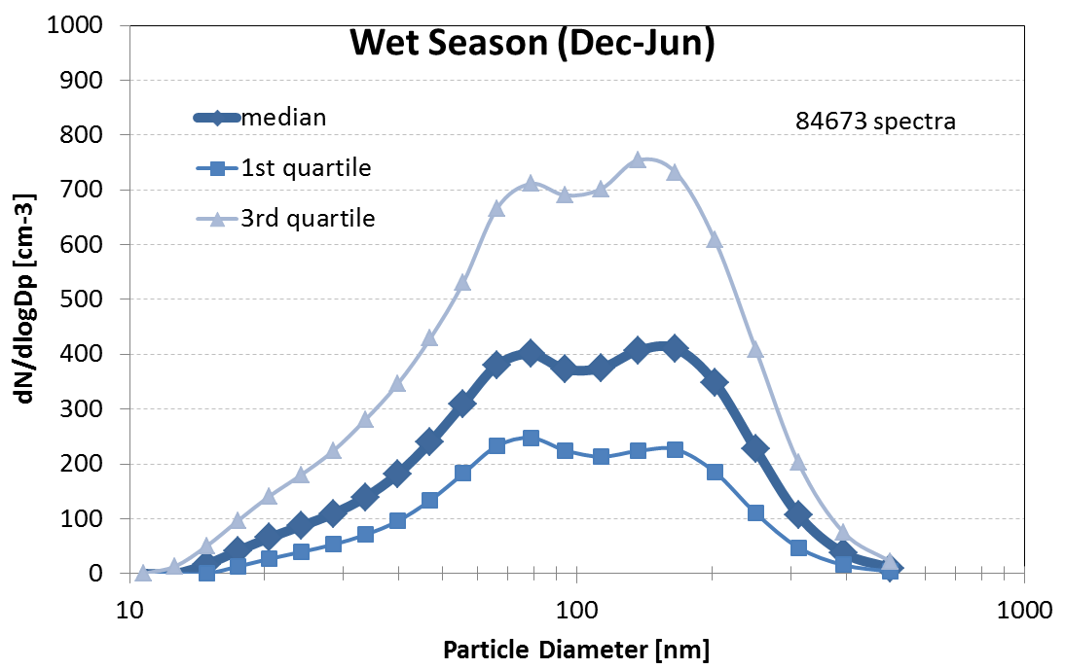
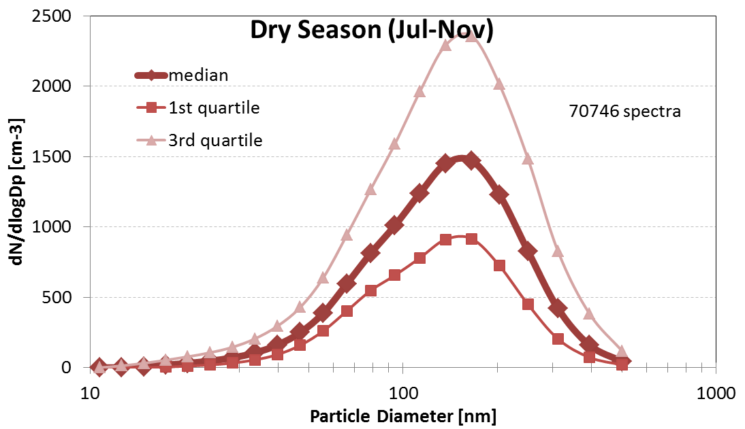
Manaus aerosol size distributions 2008-2011
Wet season
Dry season
Fit Parameters for median size distributions:
 | Ultrafine mode |  |  | Aitken mode |  |  | Accumulation mode
 | N1 [cm-3] | Dpg1 [nm] | sg1 | N2 [cm-3] | Dpg2 [nm] | sg2 | N3 [cm-3] | Dpg3 [nm] | sg3
Wet season (Dec-Jun) | 121 | 34.9 | 0.28 | 314 | 71.0 | 0.20 | 403 | 163.5 | 0.24
Dry season (Jul-Nov) |  |  |  | 926 | 117.3 | 0.36 | 699 | 175.9 | 0.22

Slide 18
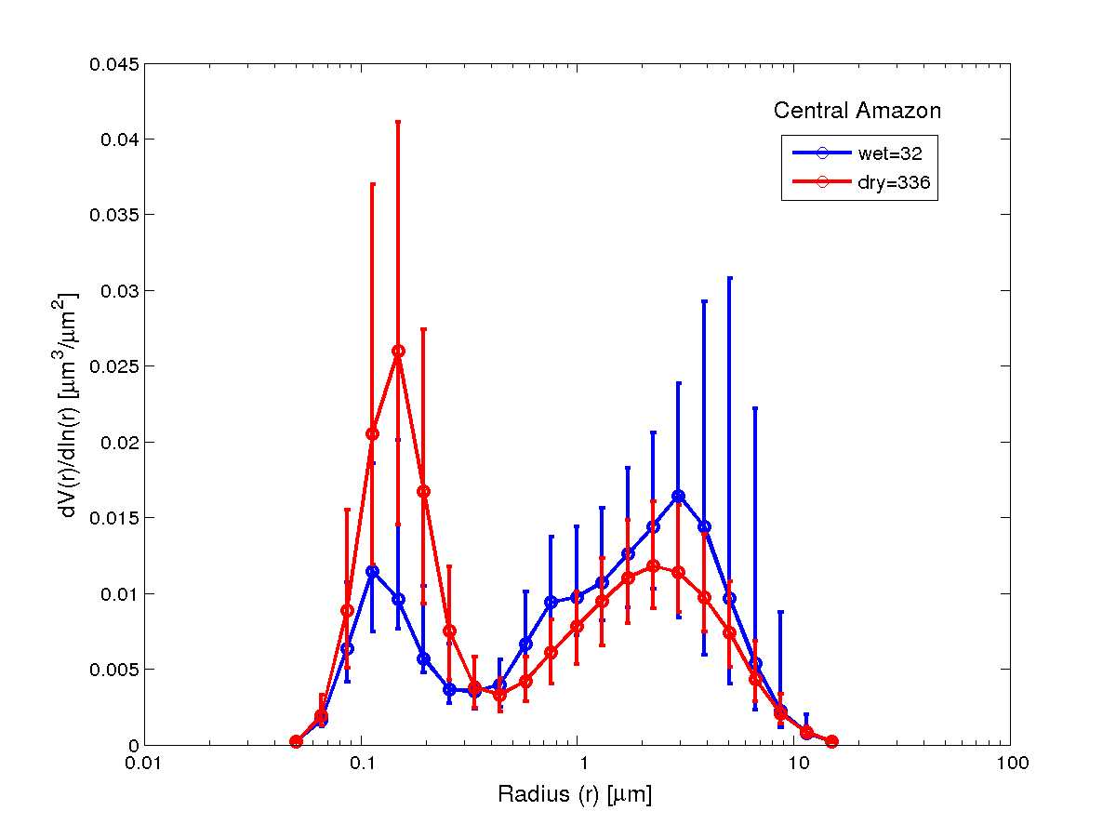
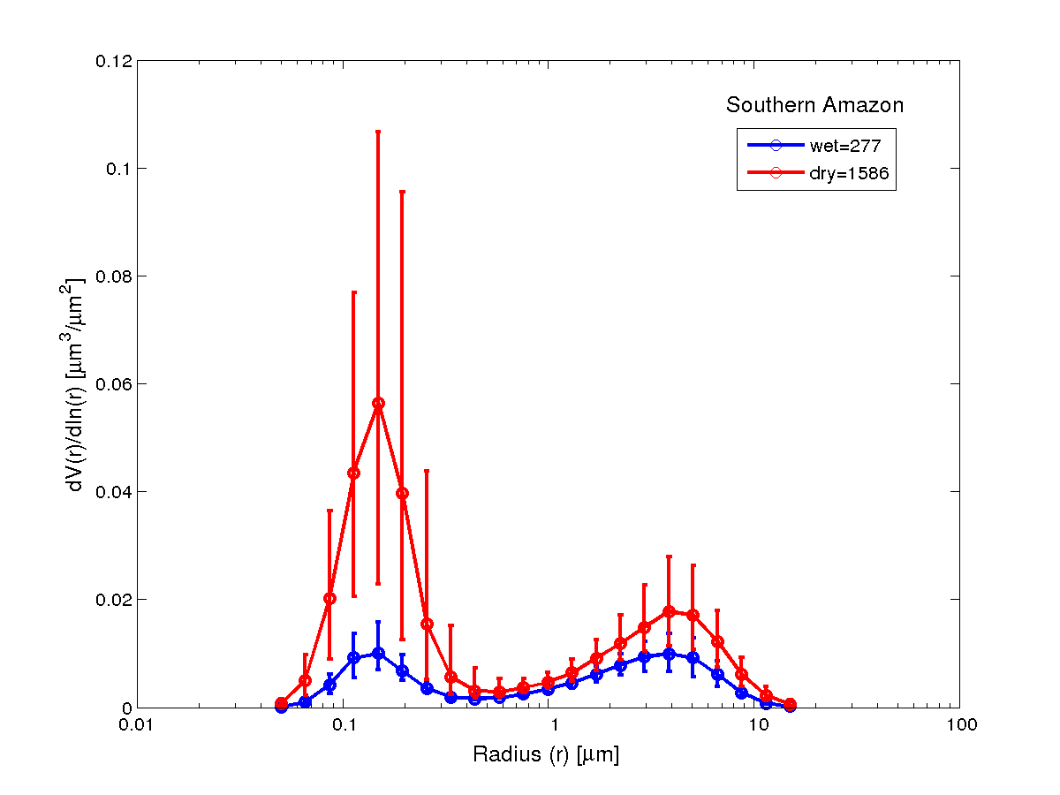
Aerosol size distributions:
SMPS and AERONET Manaus and Porto Velho
Manaus
test
Porto
Velho
test

Slide 19
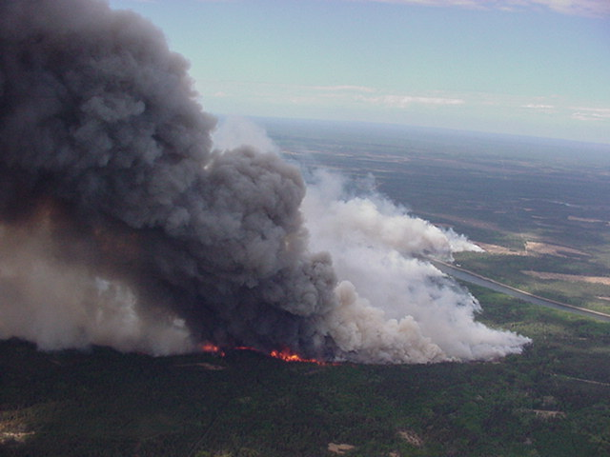
Aerosol emissions make the high variability visible – it also applies to the trace gases!
(M. Andreae, 2009)

Slide 20
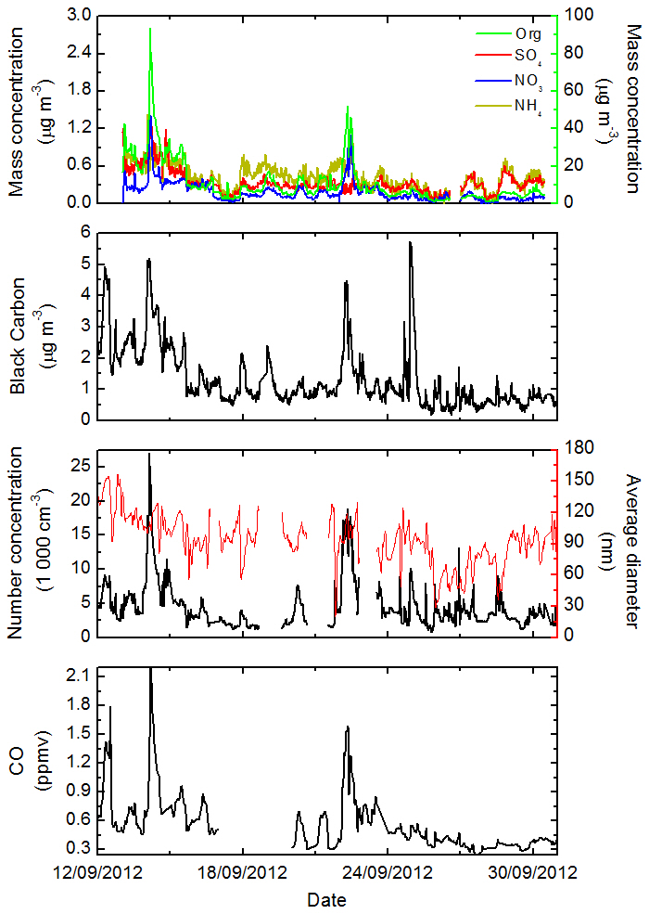
Porto Velho during SAMBBA
ACSM
Black Carbon
Particle Number
Average Diameter
Carbon
Monoxide
Brito et al., 2013

Slide 21
ACSM measurements in Rondonia
Brito et al., 2013

Slide 22
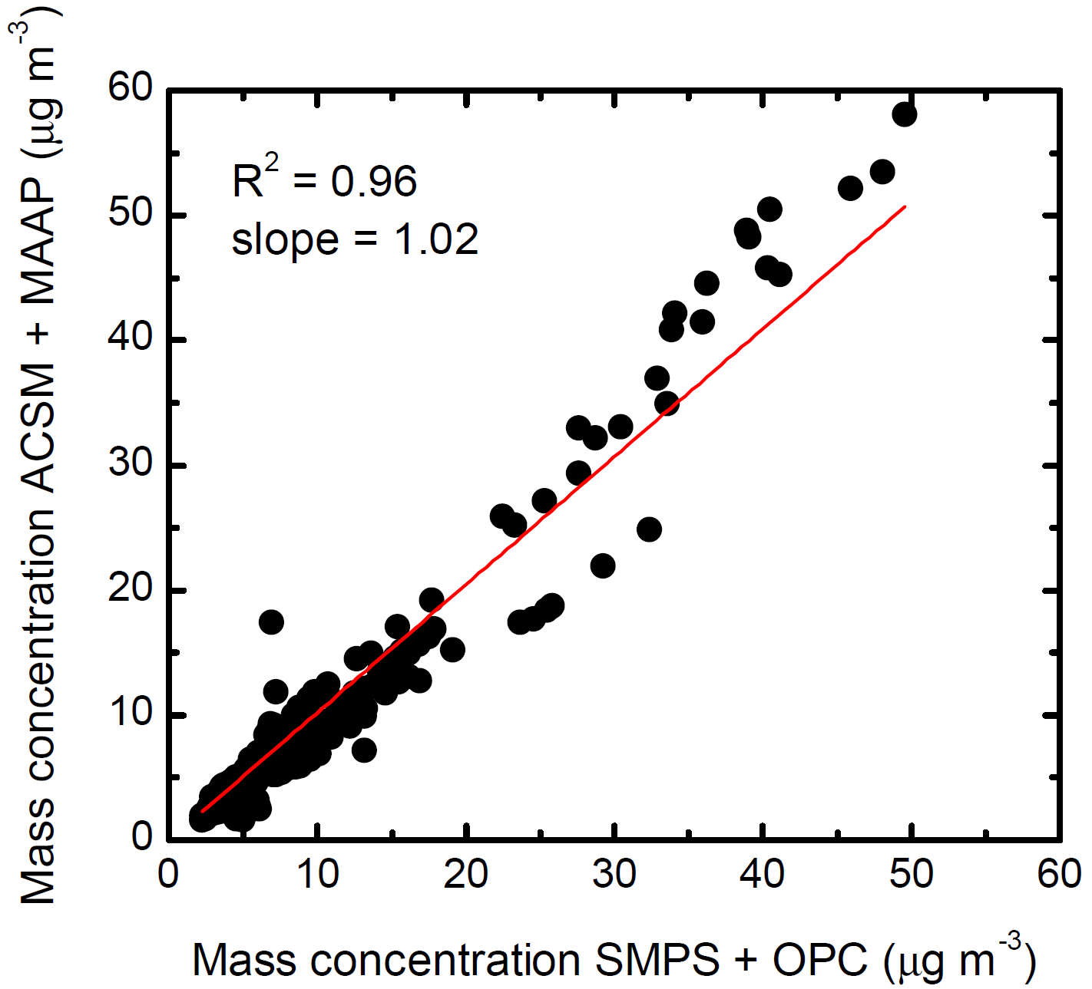
Mass Closure SAMBBA
Aerosol density = 1.2 g cm⁻³ CE=0.5
Brito et al., 2013

Slide 23
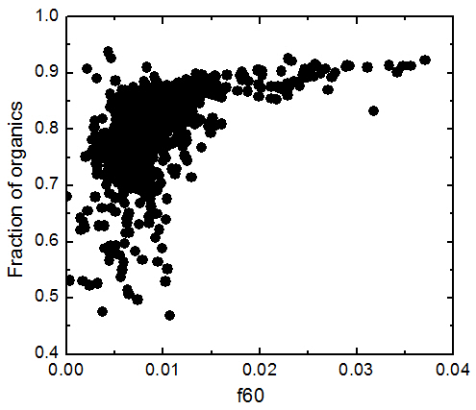
Porto Velho during SAMBBA
Fraction of organics: Organics/BC+SO4+NO3
Brito et al., 2013

Slide 24
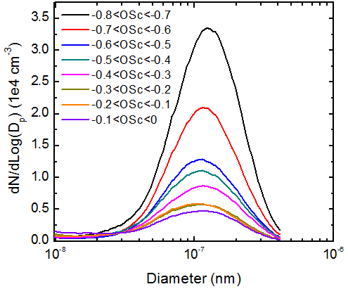
SAMBBA: aerosol size distribution versus oxidation states
Brito et al., 2013

Slide 25
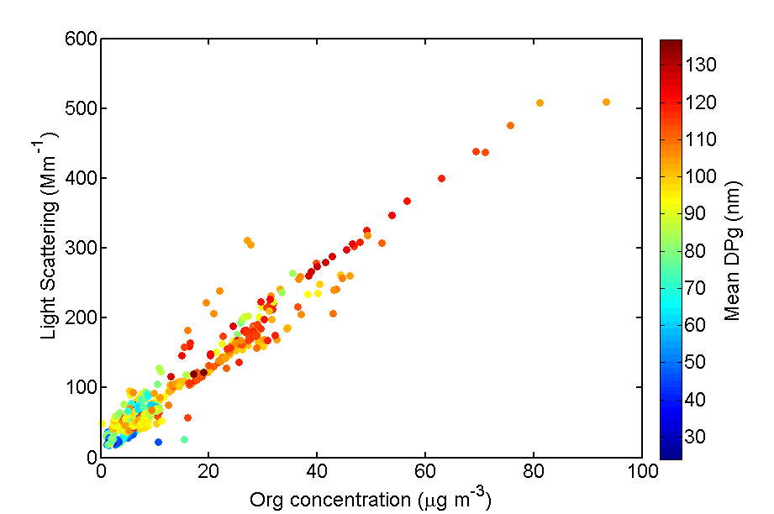
SAMBBA Light Scattering versus organics
Brito et al., 2013

Slide 26
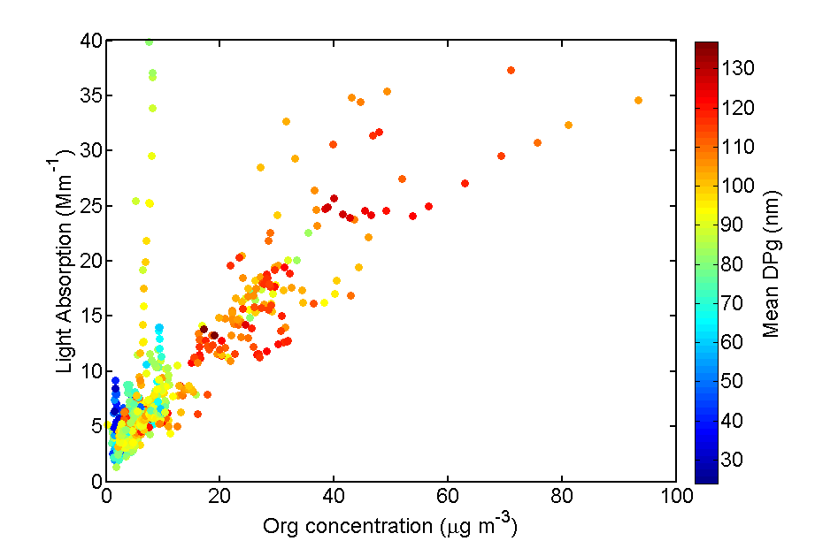
SAMBBA Light Absorption versus organics
Brito et al., 2013

Slide 27
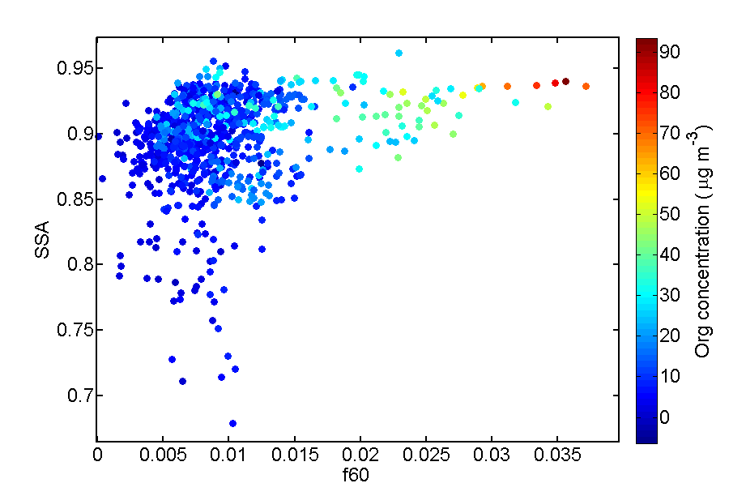
SAMBBA Single Scattering Albedo versus f60
f60 = Surrogate biomass burning ( linked with Levoglucosan, mannosan, etc.)
Brito et al., 2013

Slide 28
Monthly statistics (2009 – 2012) for light scattering coefficient σ_{s} at 637 nm and light absorption coefficient σ_{a} at 637 nm in Mm⁻¹ for Porto Velho (PVH, in black) and central Amazonia (TT34, in red).
Single Scattering Albedo
Artaxo et al., 2013

Slide 29
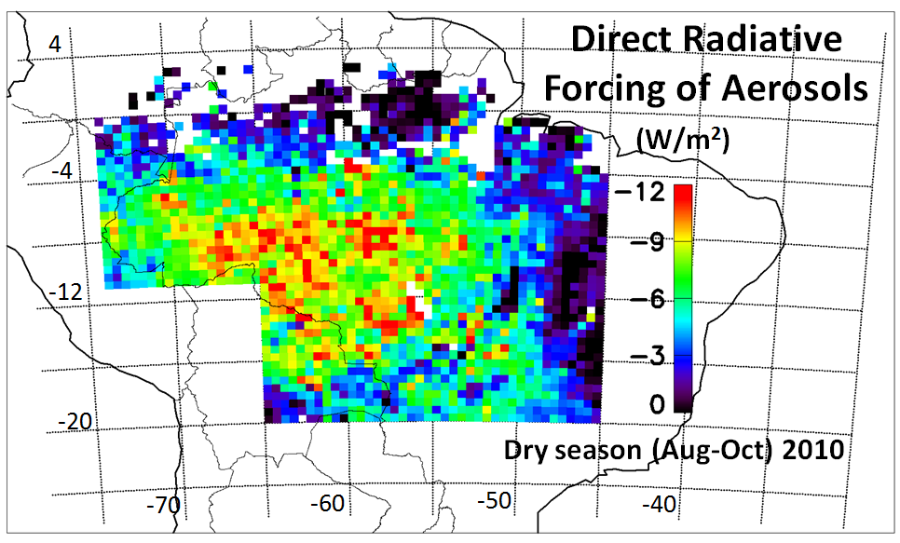
Average spatial distribution of the direct radiative forcing (DRF) of biomass burning aerosols in Amazonia during the dry season of 2010
CERES (Clouds and the Earth's Radiant Energy System) and MODIS

Slide 30
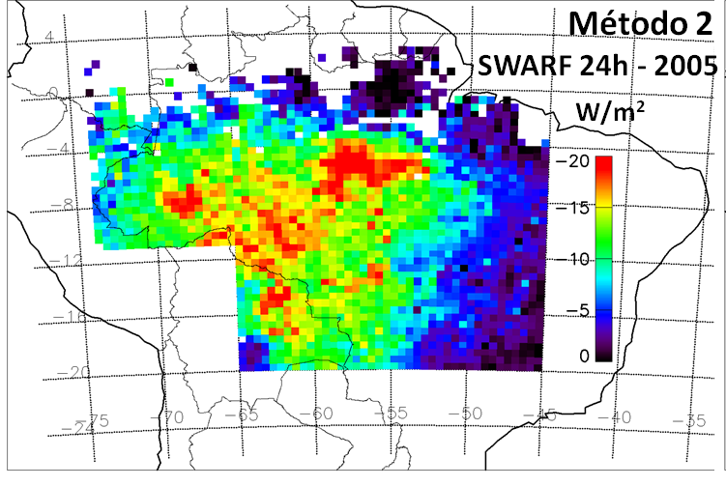
Average spatial distribution of the TOA direct radiative forcing - dry season of 2005

Slide 31
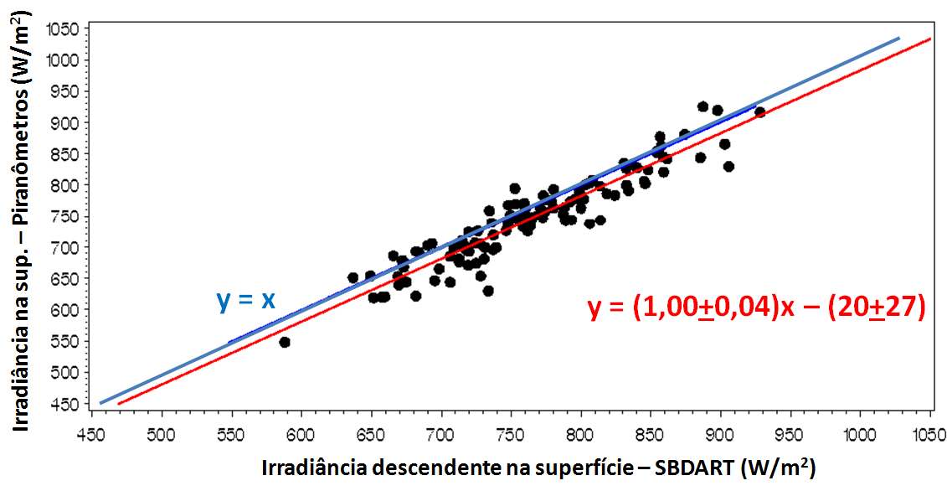
Radiation fluxes at surface: Flux-RadNet versus CERES+MODIS+SBDART
- Areas of 50x50 km centered on AERONET site. AOD, water vapor AERONET.
- w₀, g, Q_{ext}, a_{440-870nm}: AERONET from day inversions
AERONET RadNet surface (Wm²)
Irradiance at surface SBDART (Wm²)
Sena et al., 2013

Slide 32
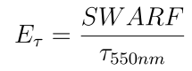
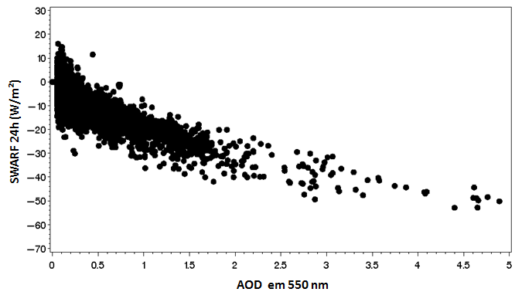
Mean Diurnal Aerosol Forcing Efficiency:
Forest: -19.5 + 1.4 W/m²
Cerrado: -16.6 + 1.7 W/m²
Forcing
Efficiency
Sena et al., 2013

Slide 33
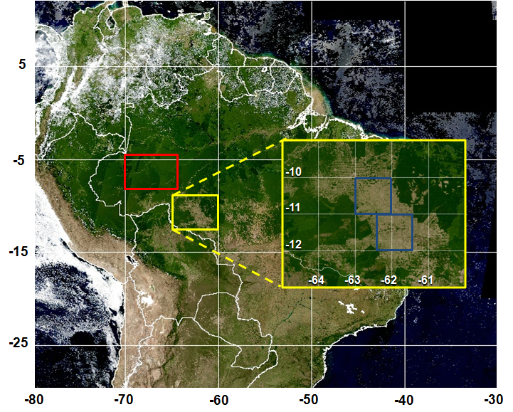
Mean Diurnal Radiative Forcing due to change in surface albedo in Rondonia:
-7.3 + 0.9 W/m²
Mean Diurnal Aerosol Forcing Efficiency:
Forest: -19.5 + 1.4 W/m²
Cerrado: -16.6 + 1.7 W/m²
Water column difference by 6-10%
Forcing of water vapor column: -0.4 to -1.2 W m⁻²
Land-use change radiative forcing. Forested areas are selected in red and deforested areas are selected in yellow.
Sena et al., 2013

Slide 34
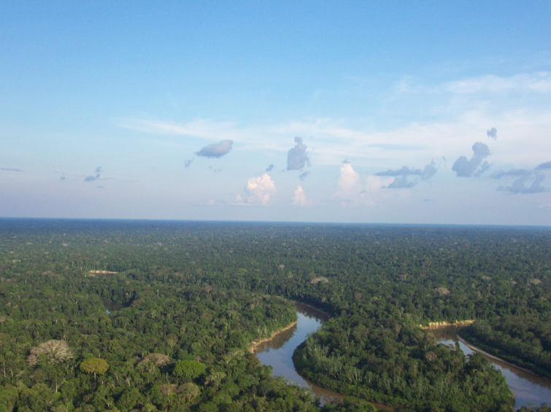
Biological, chemical, and physical processes over the Amazon form a pretty closely coupled system
Still a lot to learn…
Thanks for the attention!!!

Slide 35
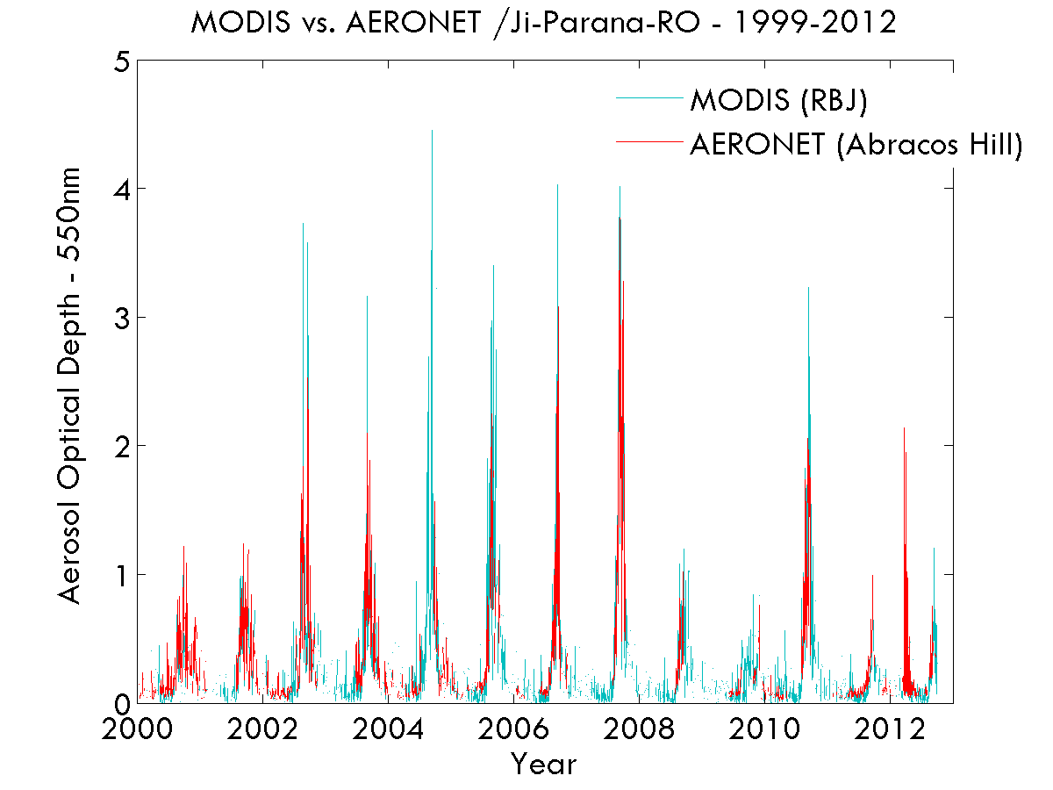
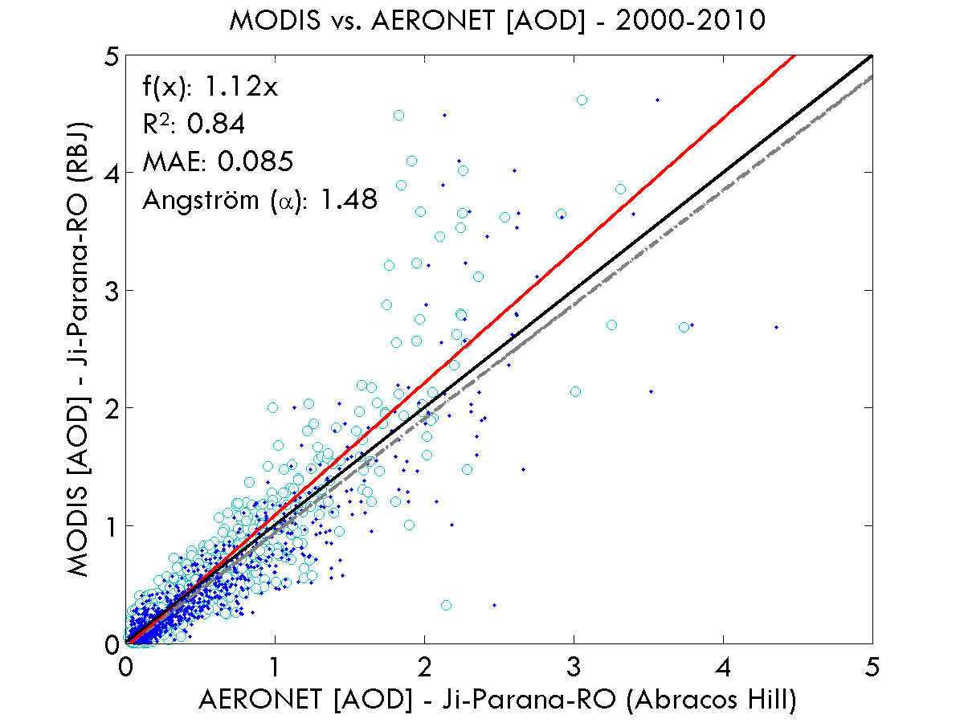
MODIS and AERONET Optical Thickness at 550 nm in Rondonia
Cloud cover an important issue in Amazonia. Too high AOD (AOD>3) not well measured
Effects of surface albedo changes important in the AOD retrieval algorithm.

Slide 36
Diurnal variability in scattering and absorption

Slide 37
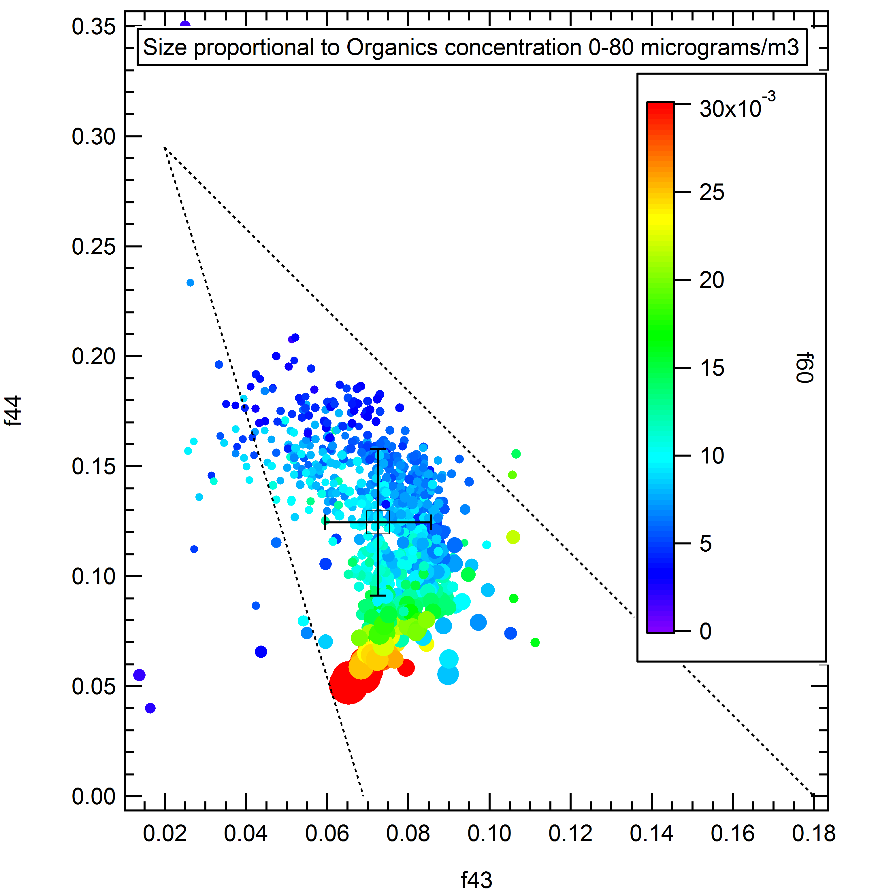
Aerosol composition - ACSM
f44 = mainly CO₂^{+,} an indicator of highly oxidized species
f43 = mostly due to C₂H₃O⁺, an indicator of less oxidized species.

Slide 38
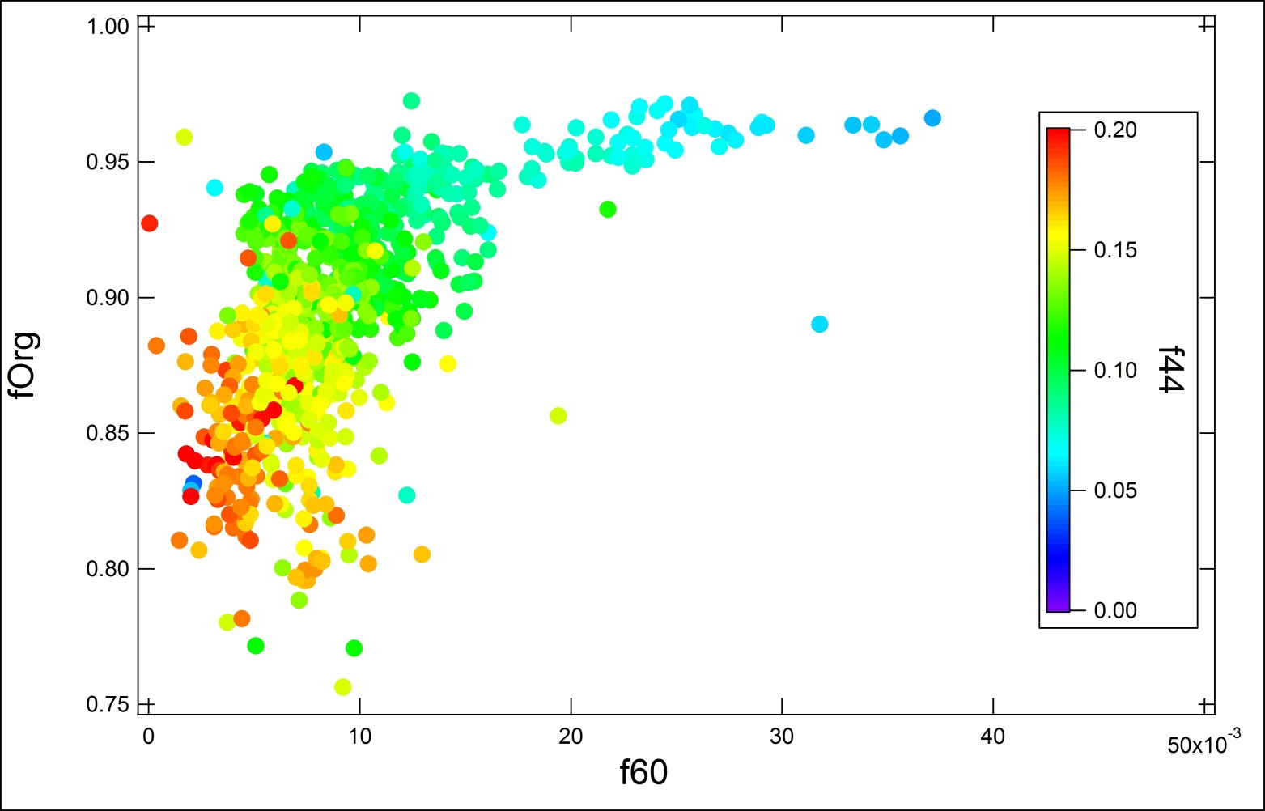
Aerosol composition - ACSM
fOrg = Org ÷ (Org + SO4 + NO3 + NH4 + Chl)
f60 = Surrogate biomass burning ( linked with Levoglucosan, mannosan, etc.)
f44 = mainly CO₂^{+,} an indicator of highly oxidized species
> 95% Organics

Slide 39
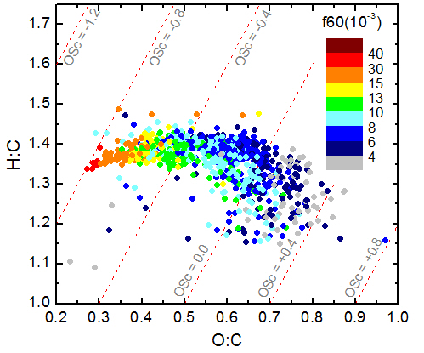

Slide 40
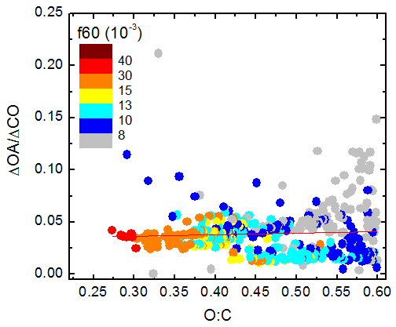

Slide 41
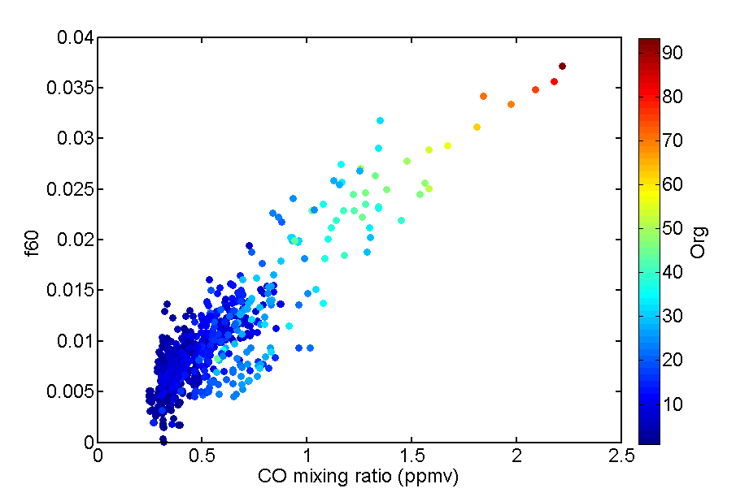

Aerosol composition - ACSM
f44 = mainly CO₂^{+,} an indicator of highly oxidized species
f60 = Surrogate biomass burning ( linked with Levoglucosan, mannosan, etc.)

Slide 42
Carbon monoxide

