Slide 1
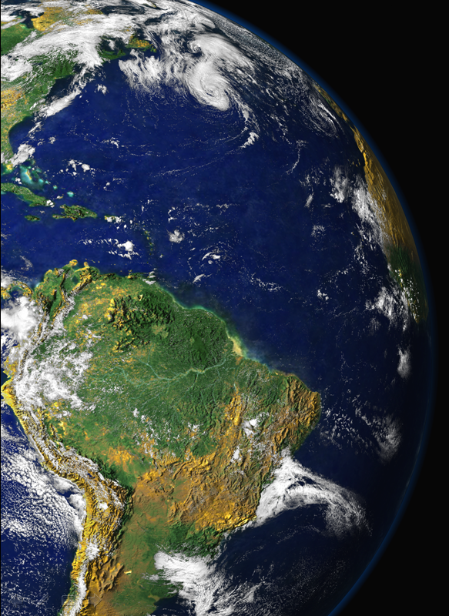

Goldschmidt Conference, Sacramento, June 10, 2014
THE CLOSE LINKS BETWEEN BIOLOGY AND THE CHEMISTRY OF PARTICLES AND TRACE GASES IN AMAZONIA.
Paulo Artaxo, Henrique J. M. Barbosa, Joel F. Brito,
Luciana V. Rizzo, Andrea Arana, Glauber G. Cirino,
Elisa T. Sena, Ana Maria Y. Serrano.
University of São Paulo, Brazil

Slide 2
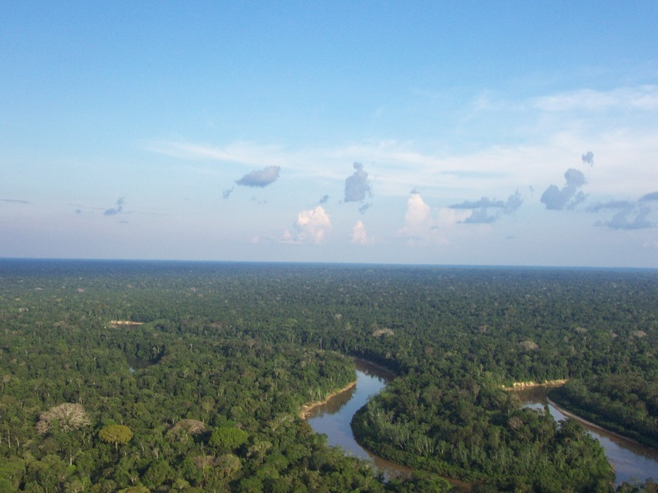
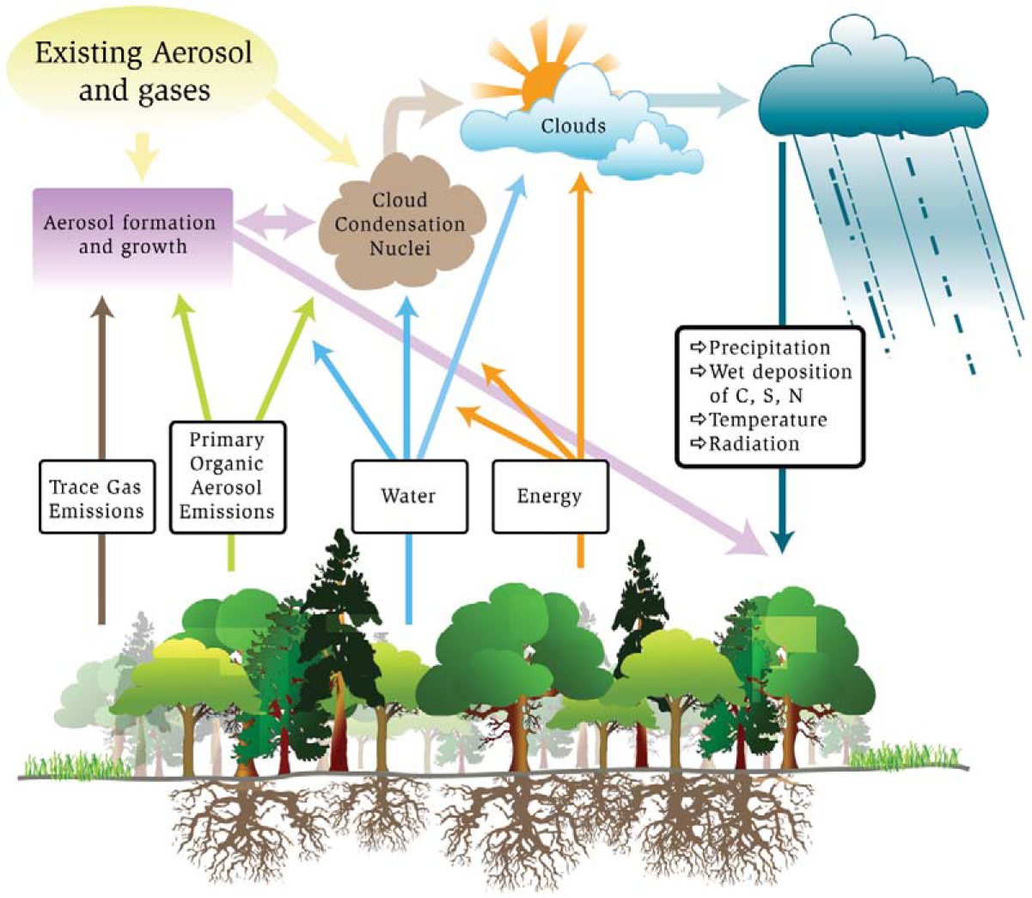
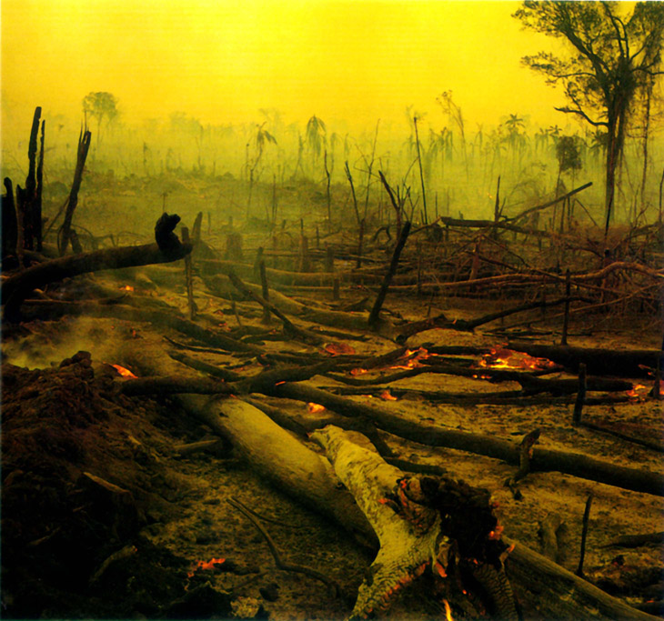
Naturally, the Amazon forest interacts strongly with the atmosphere and climate. There are strong and complex links between the forest biology, and the physics and chemistry of the atmosphere
Natural System
The Transition

Slide 3
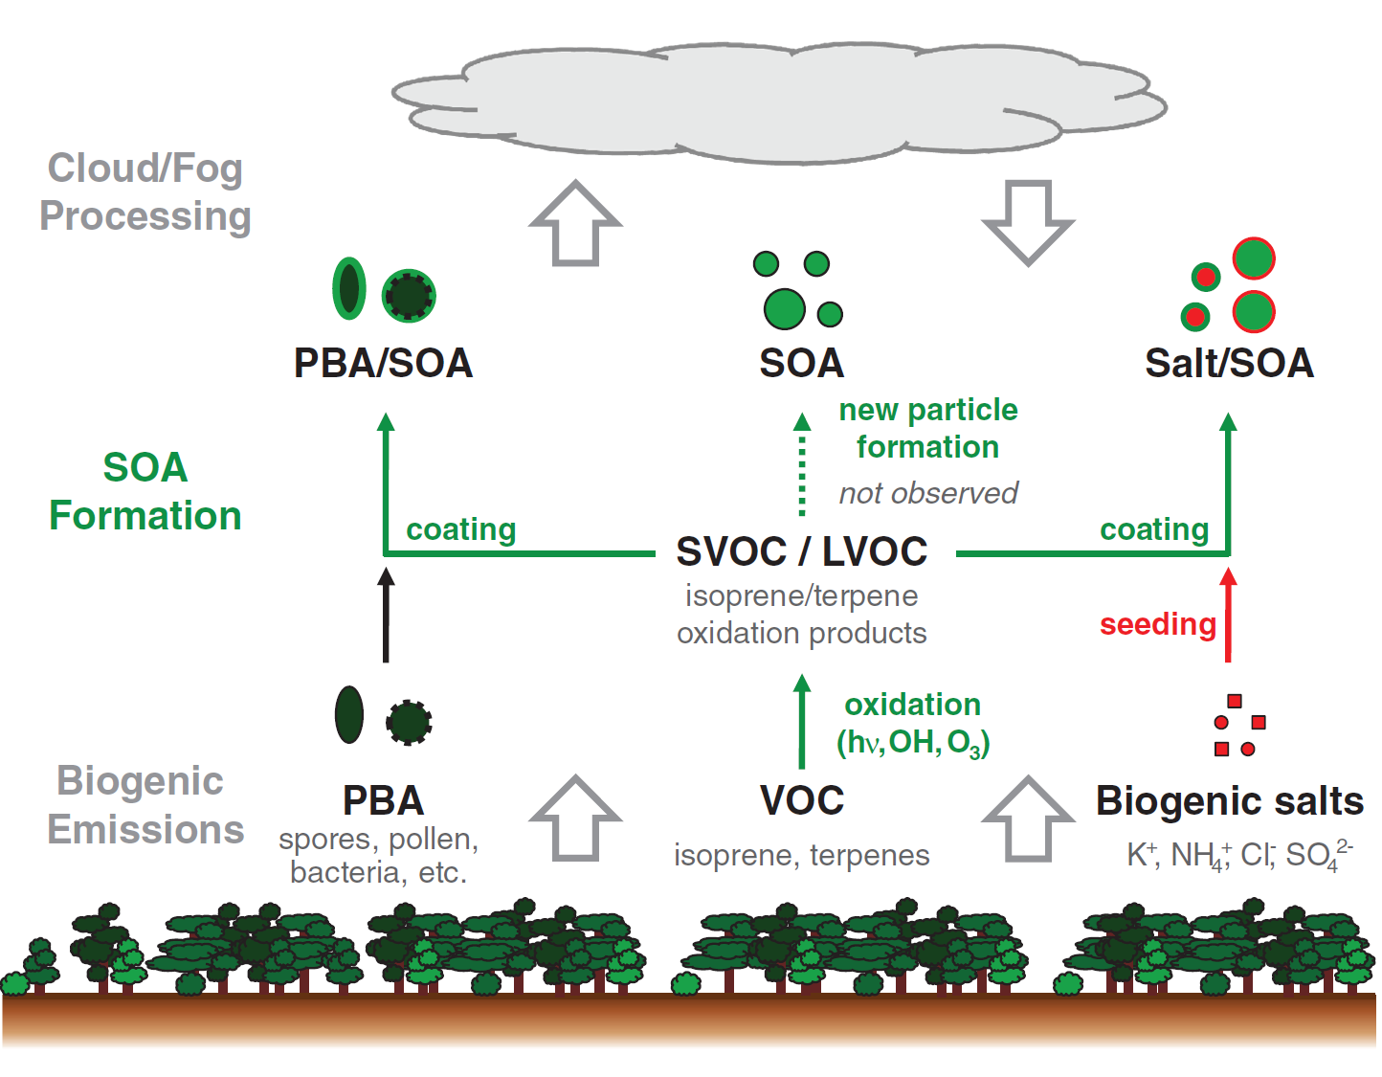
Sources and processing of organic aerosol in pristine Amazonian boundary layer air
C. Pöhlker et al.,
Science 2012

Slide 4
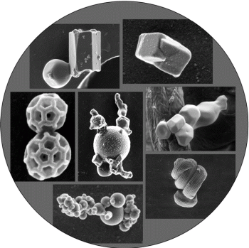
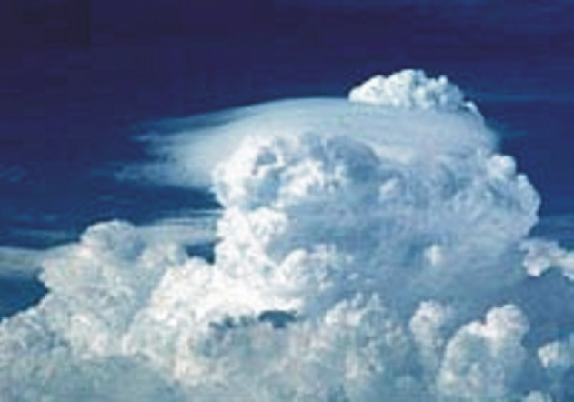
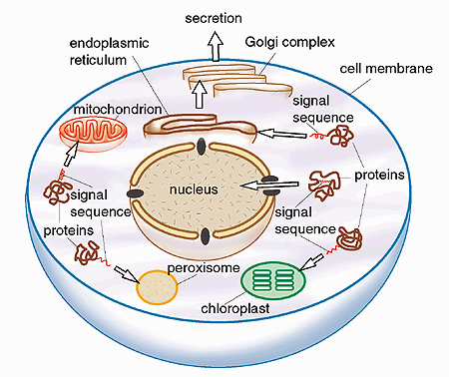
Atmospheric & Biological Particle Size
Aerosols: solid & liquid
nano- & micro-particles
Clouds, Fog & Precipitation:
dilute aqueous particles
Cells & Organelles: semi-solid & liquid nano- & micro-particles
Koop 2011
Blobel 1999
Clouds & Fog
Precipitation
(Rain, Snow, Graupel, Hail)
Aerosol
Gas
Molecules
Proteins
Viruses
Bacteria
Spores
Pollen
Sulfate, SOA, Soot
Mineral Dust, Sea Spray
Diameter (m)
100 pm
1 nm
10 nm
100 nm
1 μm
10 μm
100 μm
1 mm
1 cm
10 cm
- ultrafine -
- fine -
- coarse -
Pöschl Angew Chem 2005

Slide 5
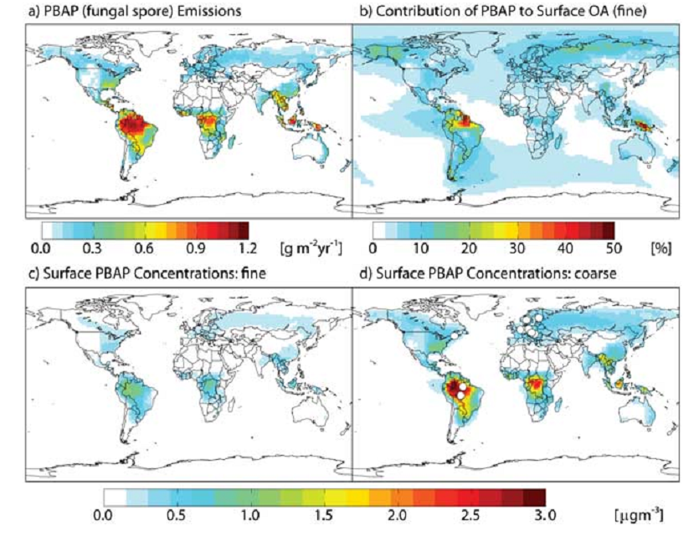
Biology matters on airborne aerosol particles
Atmospheric budget of primary biological aerosol particles from fungal spores
Annual mean of optimized GEOS-Chem simulation of fungal PBAP: (a) PBAP emissions, (b) percentage contribution of fungal PBAP to fin e organic aerosol (OA) surface concentrations, (c) fine-mode fungal PBAP surface concentrations, and (d) coarse-mode fungal PBAP surface concentrations.
Notes:
[ 1 ] The contribution of primary biological aerosol particles (PBAP) to the global budget of organic aerosol is poorly understood. Concentrations of mannitol, a biotracer for fungal spores, are used here t o constrain the first global model (GEOS-Chem) simulation of PBAP from fungi. Emissions are driven by leaf area index and atmospheric water vapor concentrations and are empirically optimized based on the geographical and seasonal variability of observed mannitol concentrations. Optimized global emissions total 28 Tg yr1 with 25% of that total emitted as fine mode (PM ) aerosol. Fungal spores contribute 23% of total primary emissions of organic aerosol, or 7% of t he fine -mode source. Annual mean simulated surface concentrations of PBA P over vegetated regions range from 0.1 – 0.7 m gm
2.5 3 (PM 2.5 ) and 0.4 – 3.0 m gm 3 (PM ), with the highest concentrations in the tropics, where PBAP may be the dominant source of organic aerosol. Further validation is required t o r educe the substantial uncertainties on this budget.

Slide 6
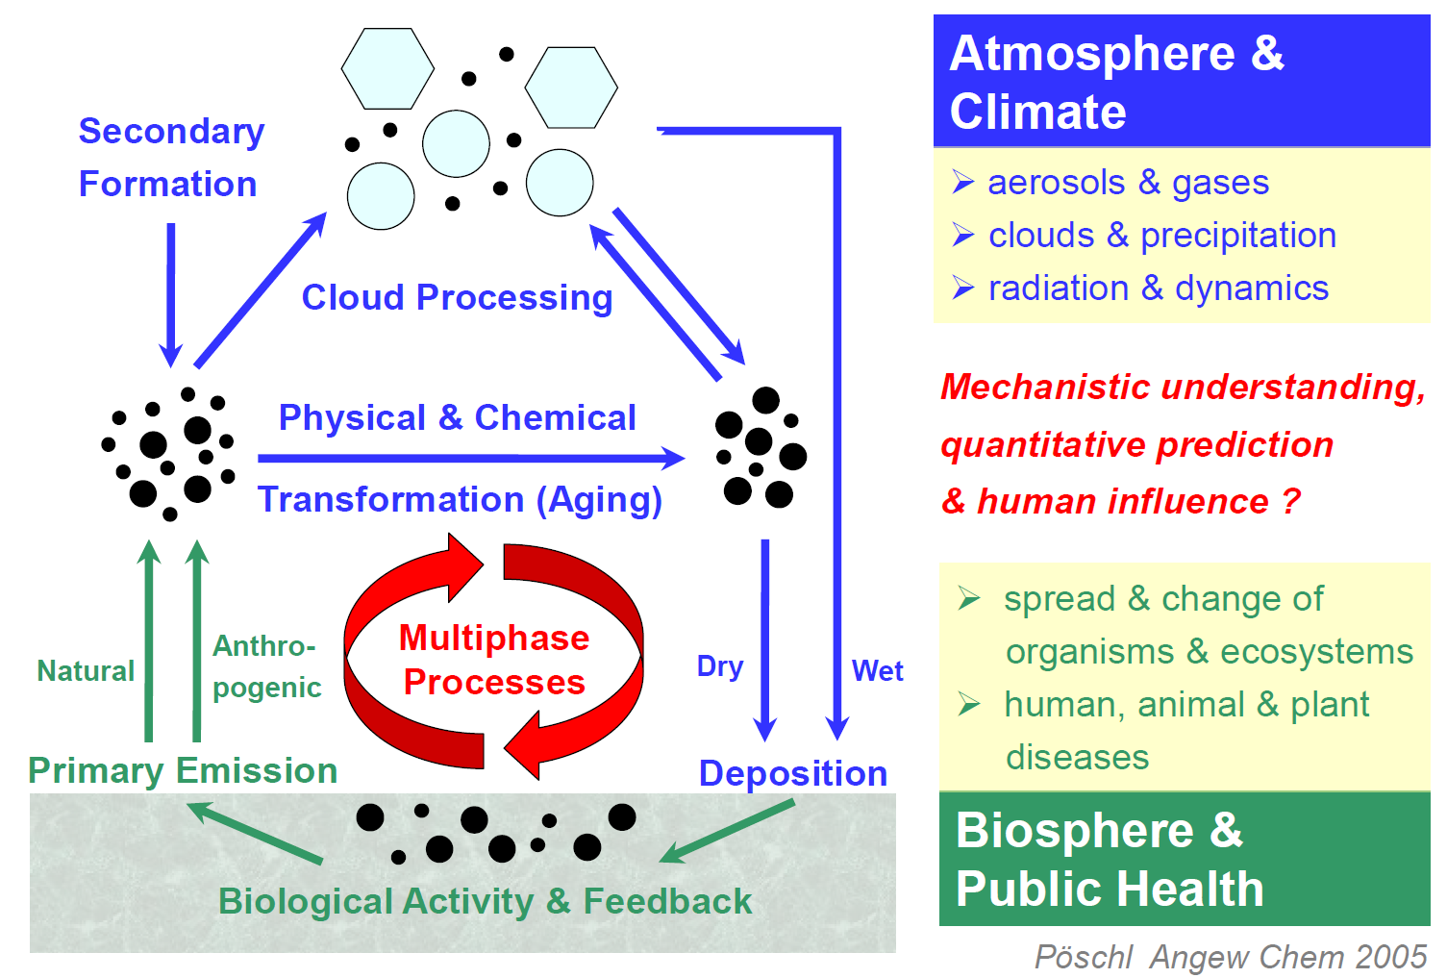
Aerosol cycling in Amazonia
Uli Pueschl, 2012

Slide 7
Aerosol and cloud lifecycles

Slide 8
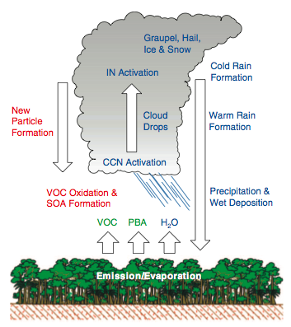
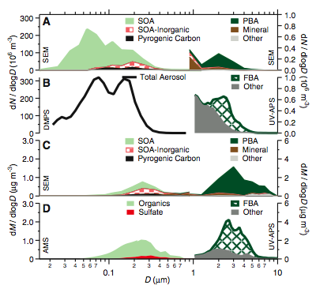
Natural biogenic trace components (gases & particles) substantially influence atmospheric composition, weather & climate
Pöschl et al., 2010, Science
CCN & IN numbers directly controlled by primary emissions ?

Slide 9
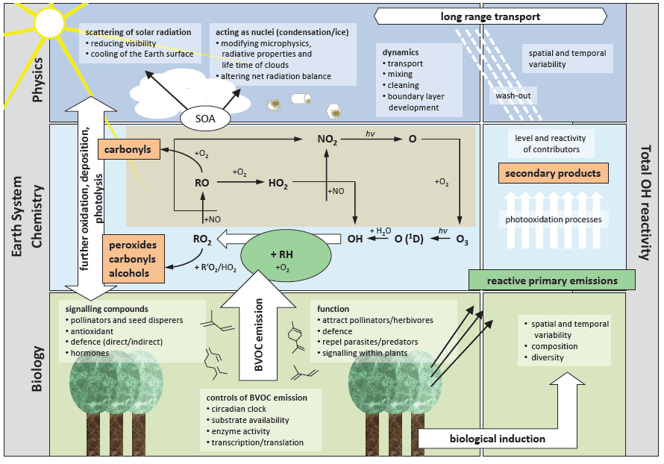
Amazonia as a Complex Nonlinear Interactive System
Illustration from Anke Nölscher

Slide 10
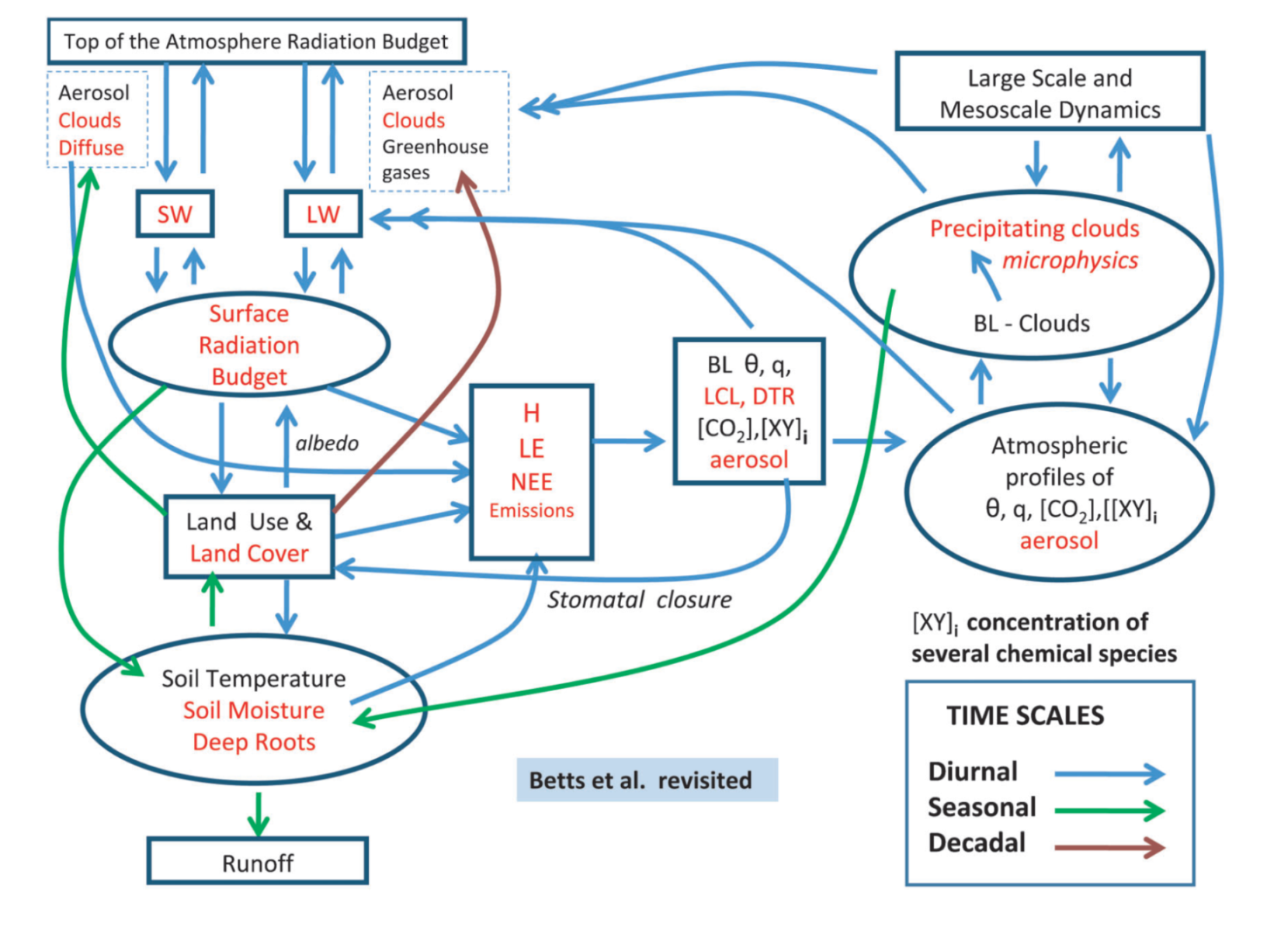
In Amazonia, the linkages are crucial.
Schematic of land-surface-atmosphere
Meteorology, atmospheric chemistry, ecosystem function, radiation, etc. all very linked (Betts et al. 2011)

Slide 11
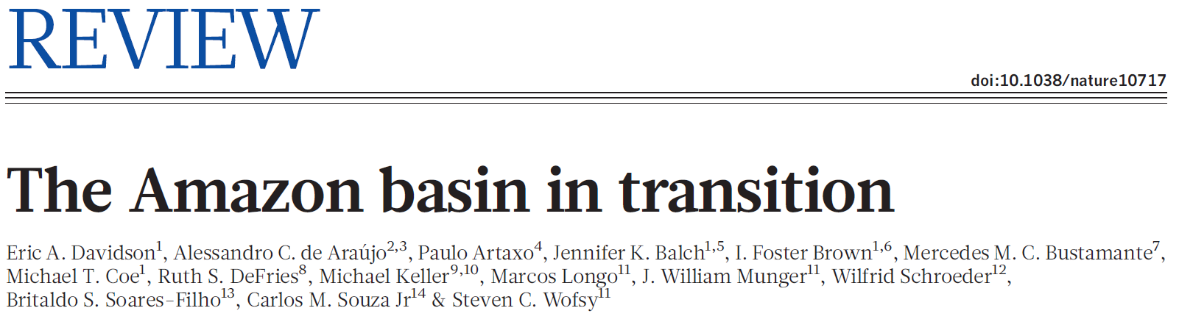
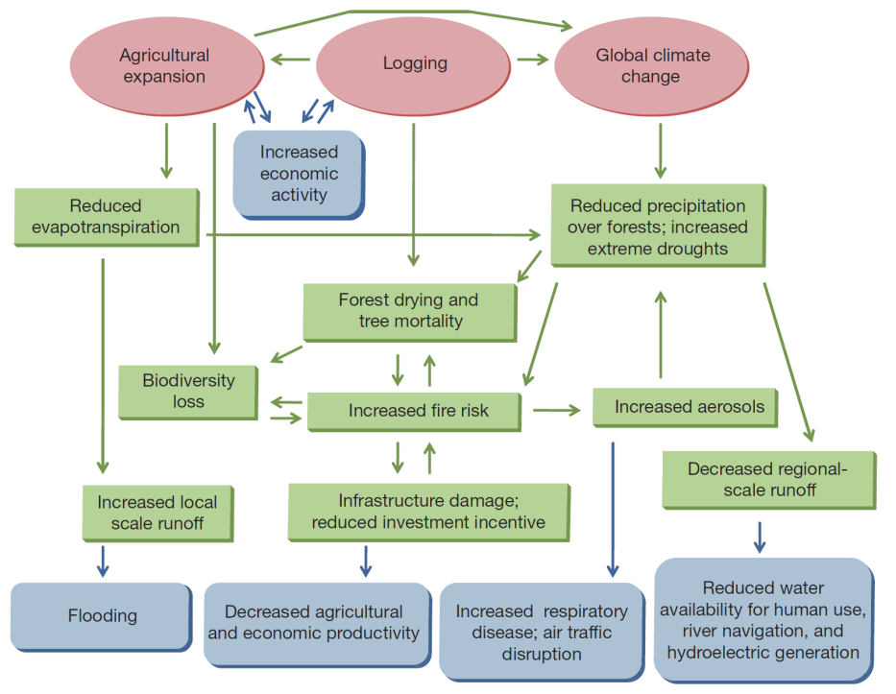
Agriculture expansion and climate variability are critical ingredients on Amazonian transition. Energy balance and hydrological cycles changes are already observed in Amazonia.
Interactions between land use change and climate change are major drivers for changes in Amazonia.

Slide 12
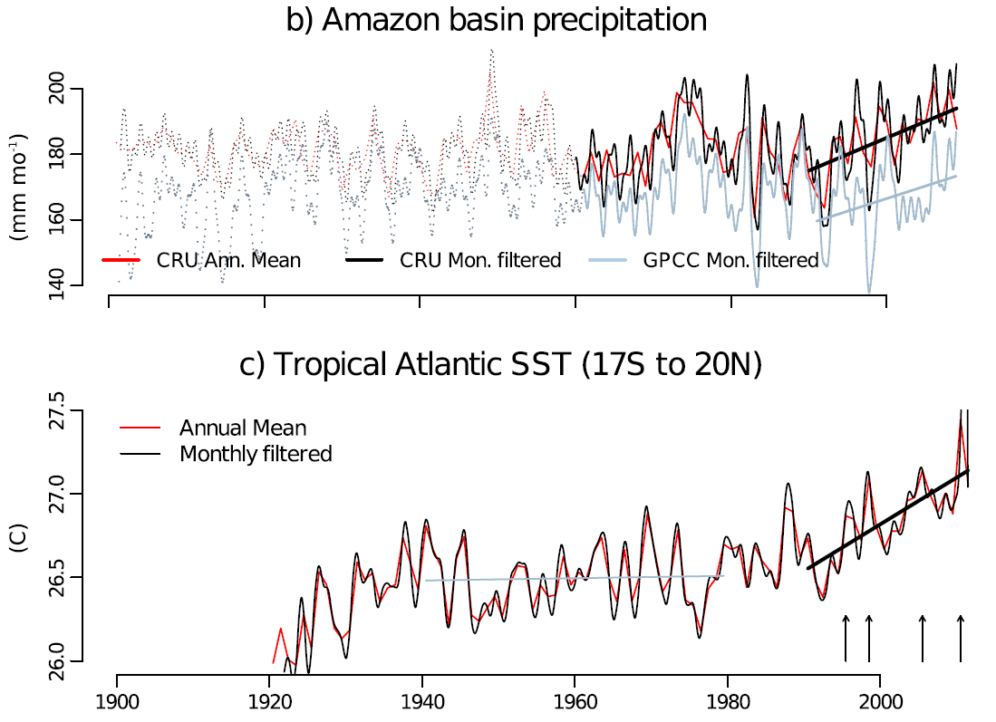
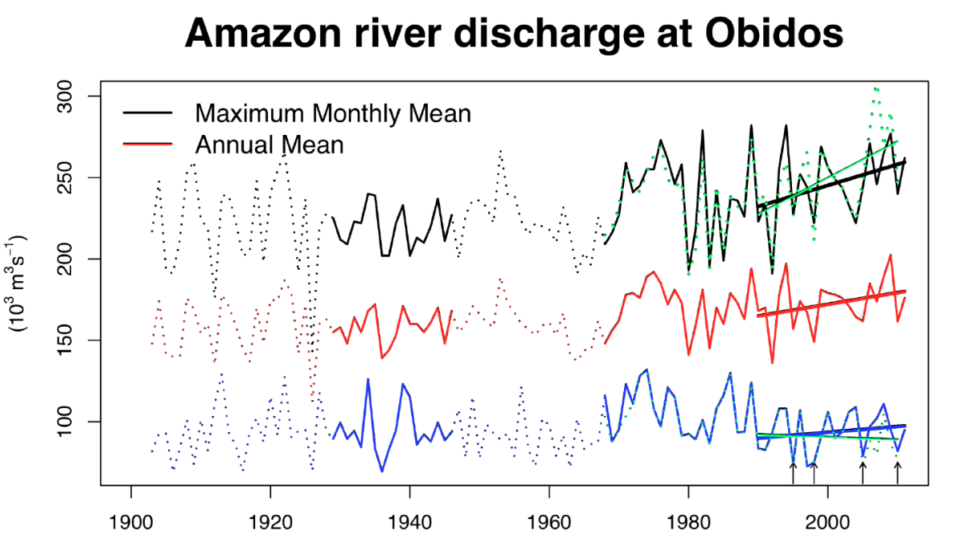
Is the Amazonian hydrological cycle intensifying?
Tropical Atlantic sea surface temperature
Maximum monthly, annual mean and minimum monthly mean Amazon river discharge at Óbidos and in green maximum and minimum daily mean river discharge, (Gloor et al. GRL 2013).

Slide 13
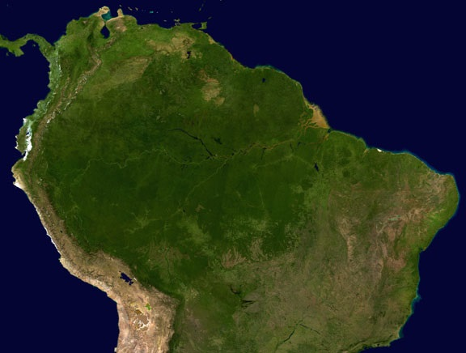
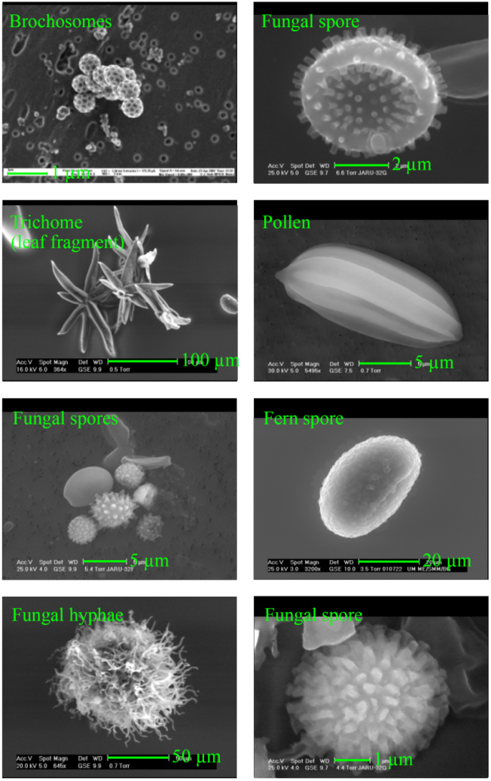
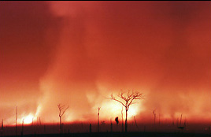
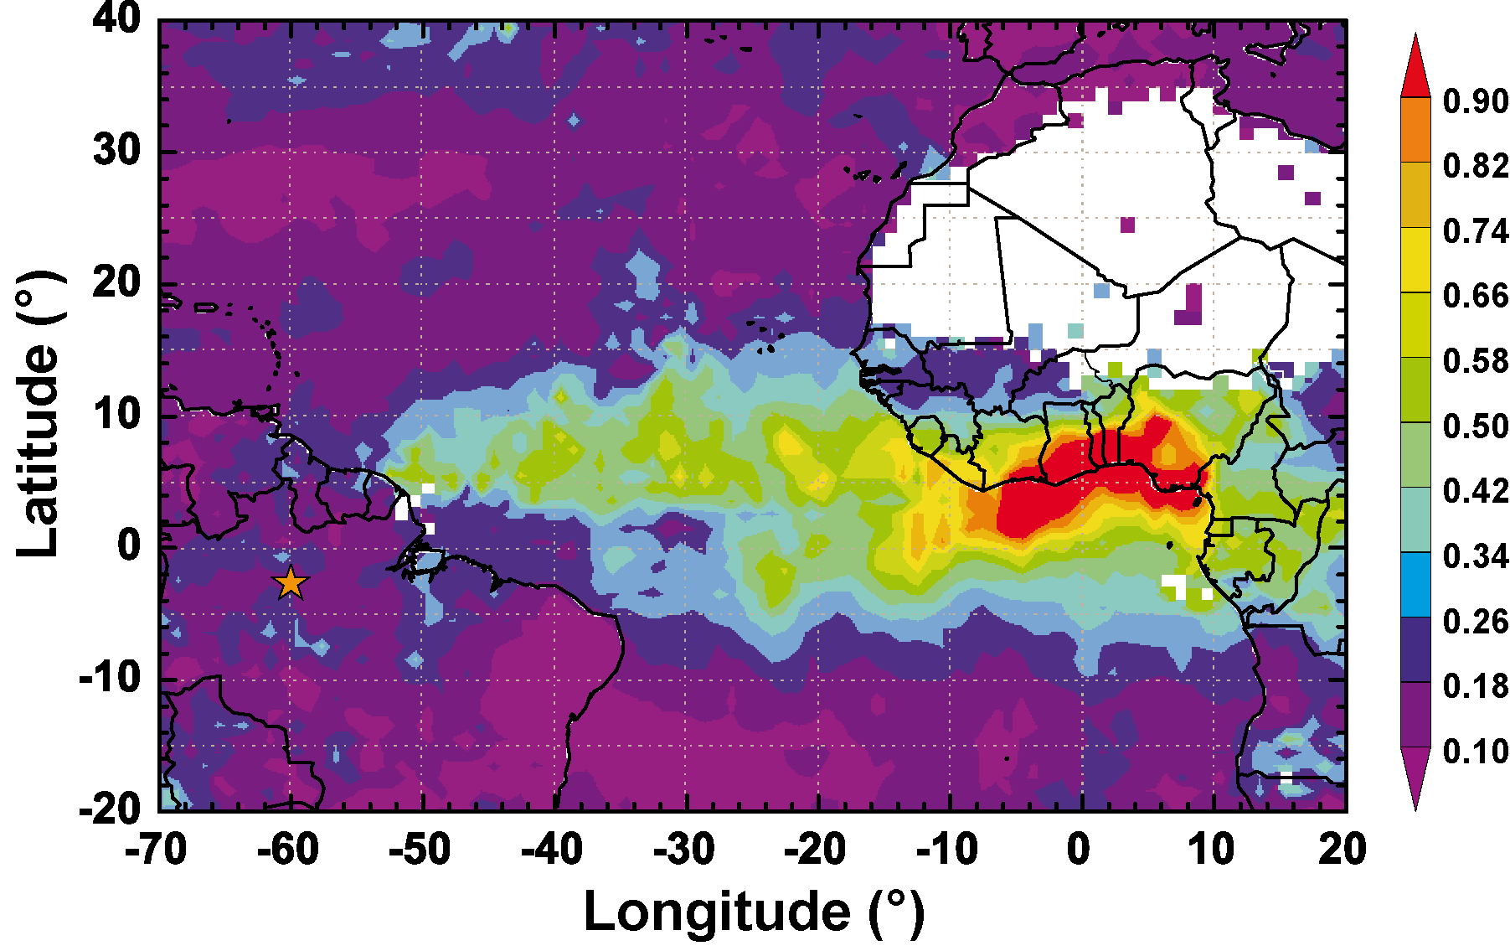
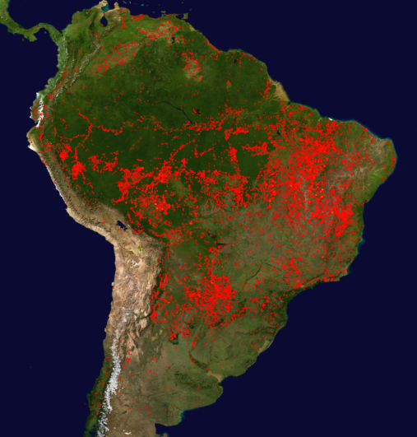
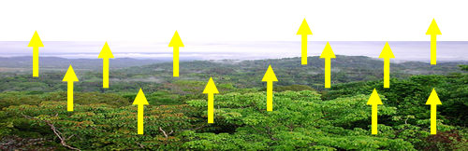
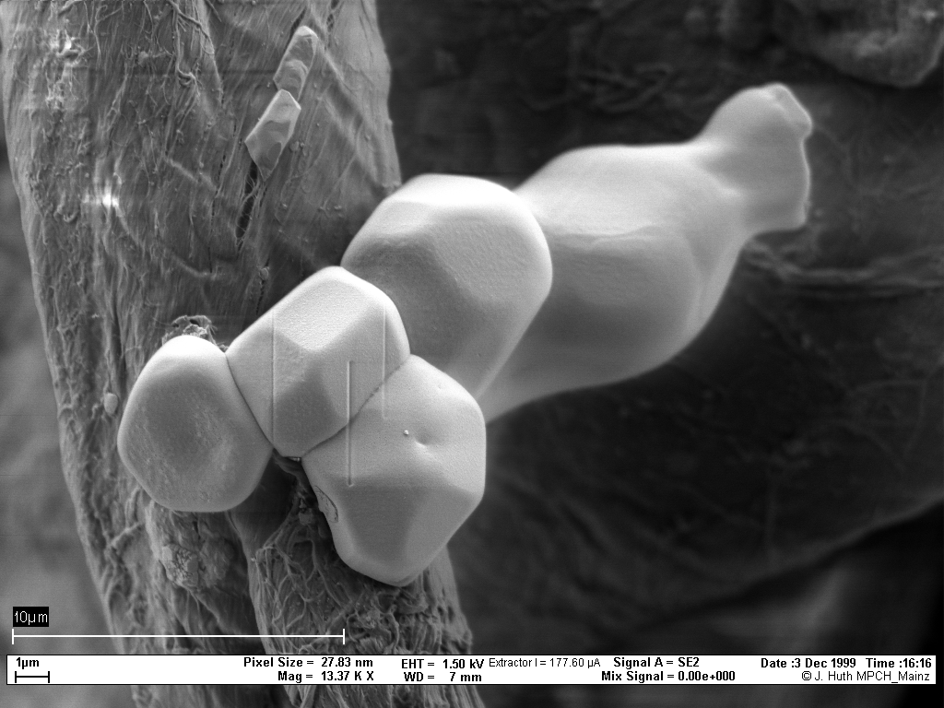
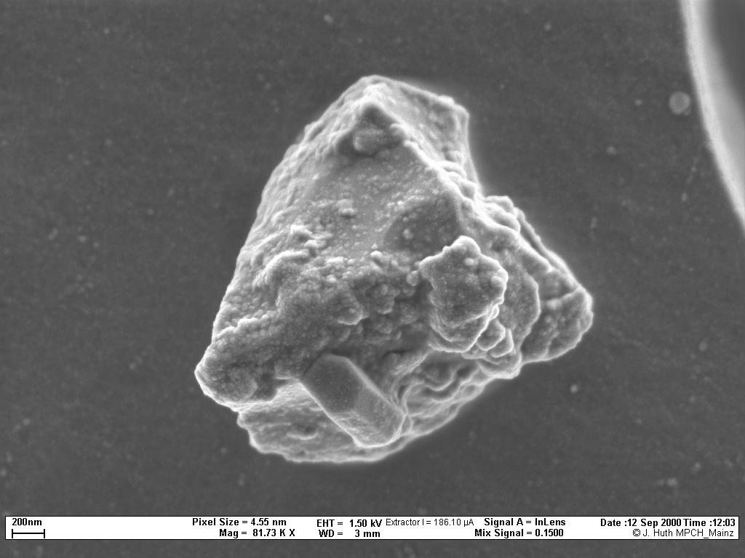
Amazonia: 3 types of aerosol particles
Biogenic (primary and SOA)
Biomass Burning
Dust from Sahara
Each with VERY different properties and impacts
Size: from 1 nanometer to 10 micrometers

Slide 14
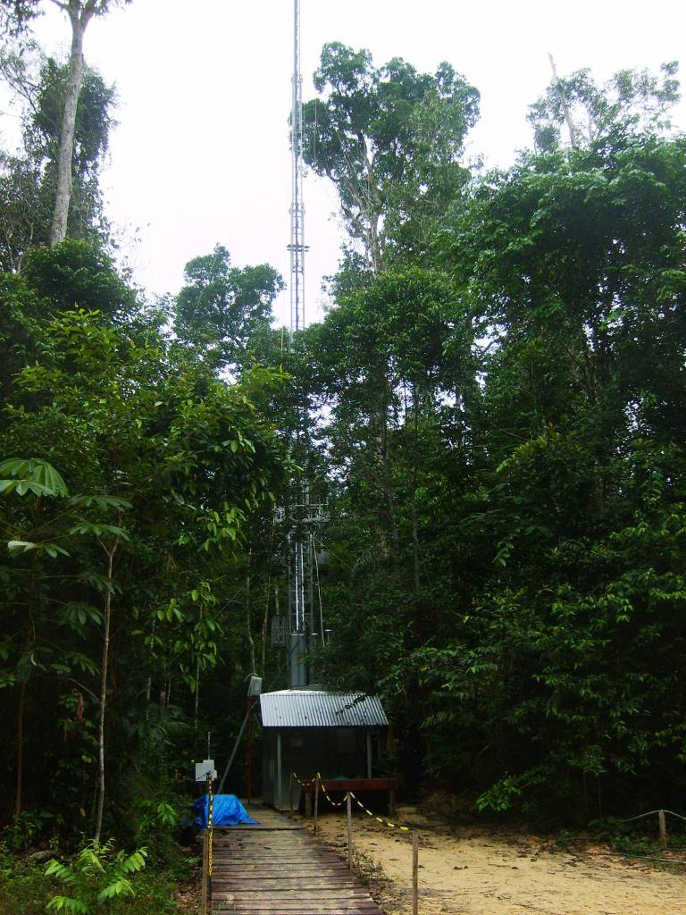
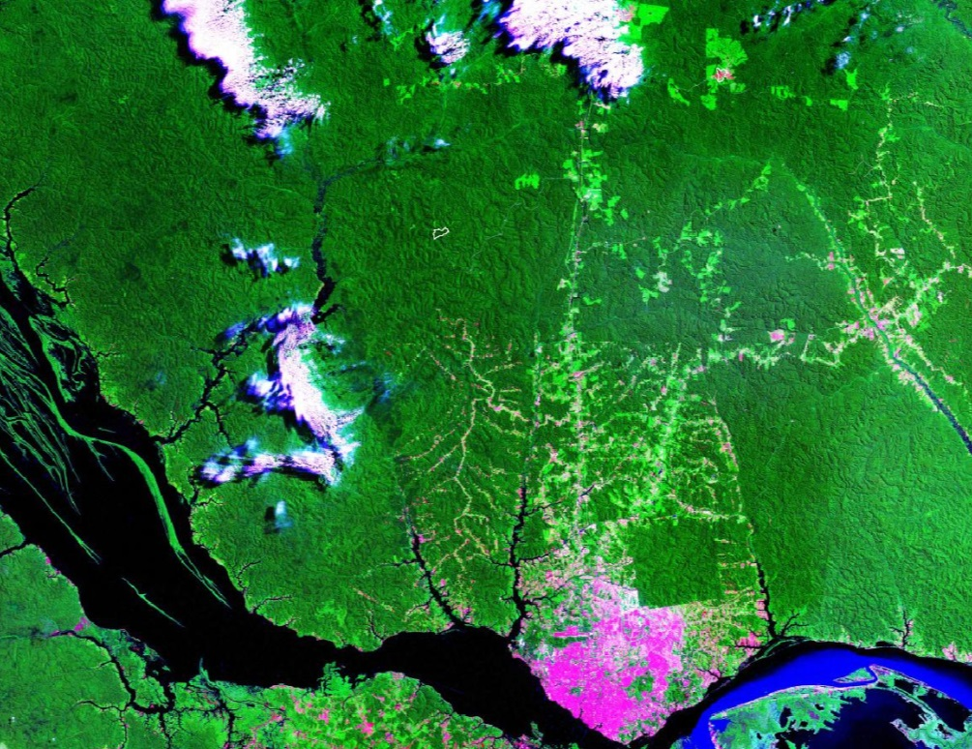
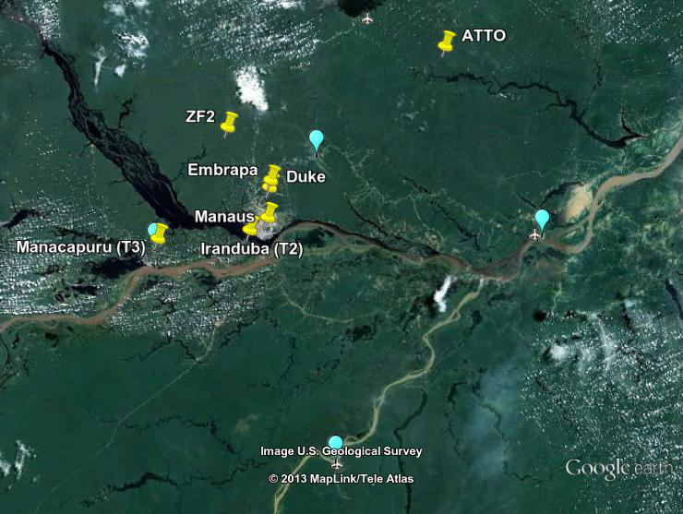
Six measurement
sites in Central Amazonia
ZF2 Rebio Cuieras site
ATTO
Rbio Cuieiras
ATTO site
Manaus

Slide 15
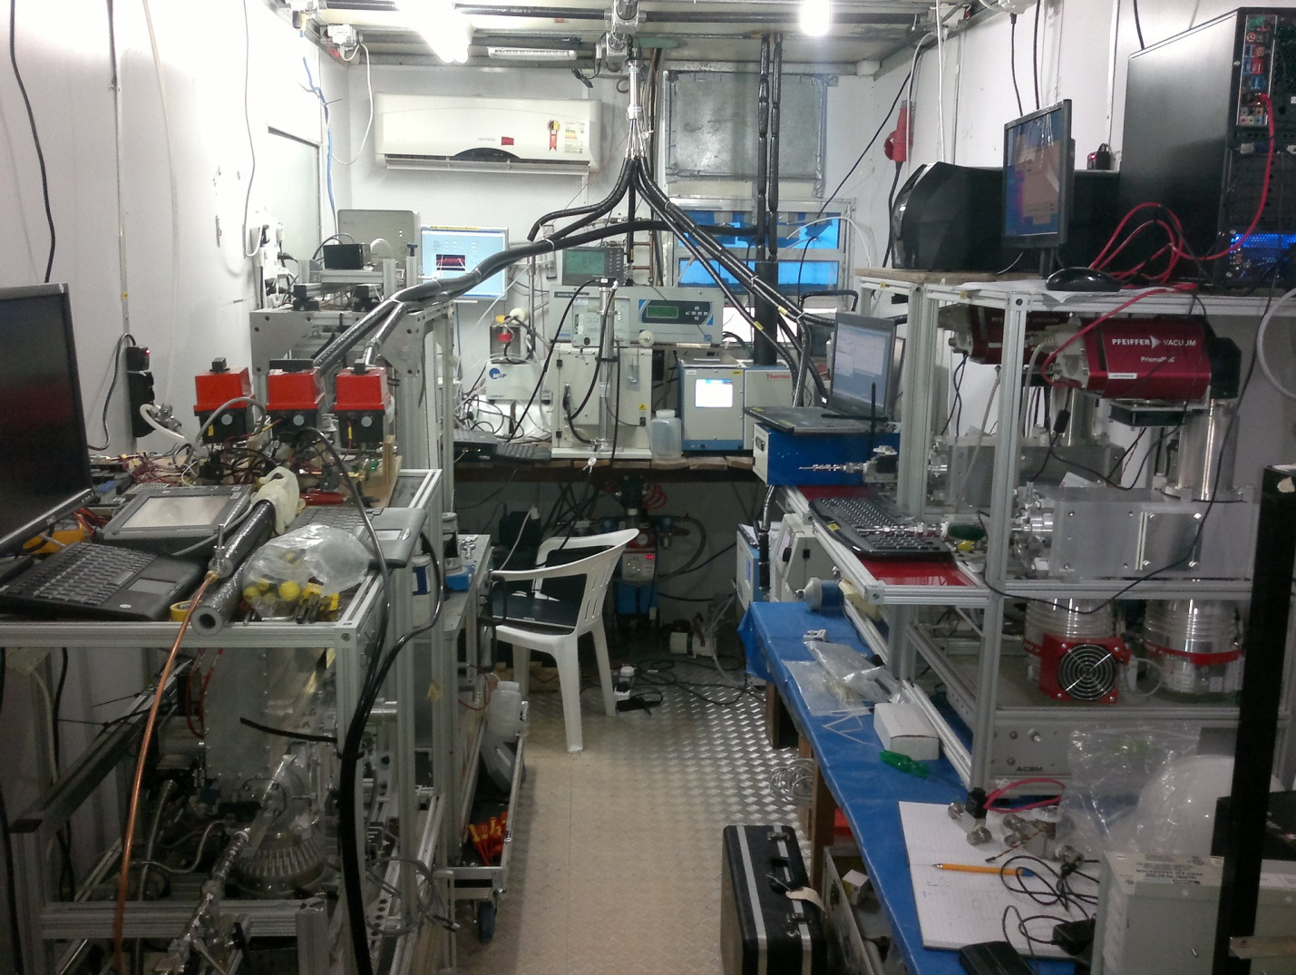
Manaus aerosol and trace gas measurements

Slide 16
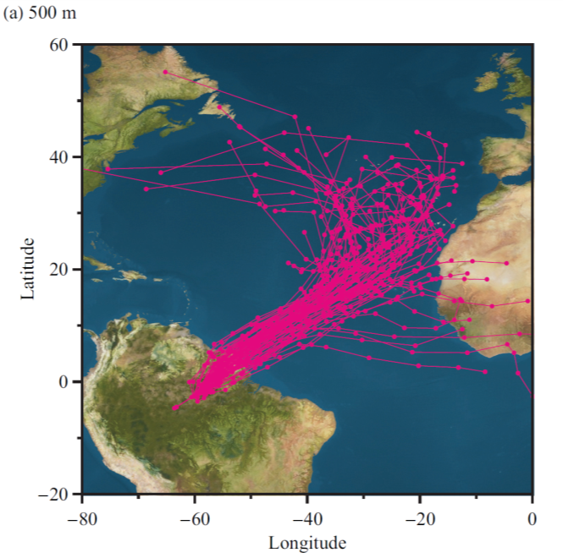
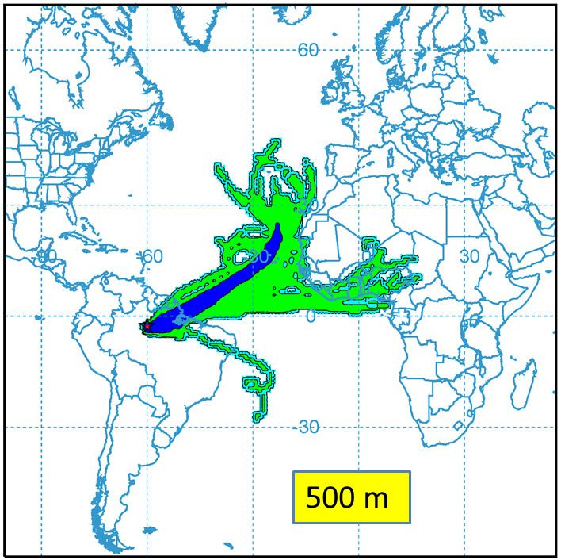
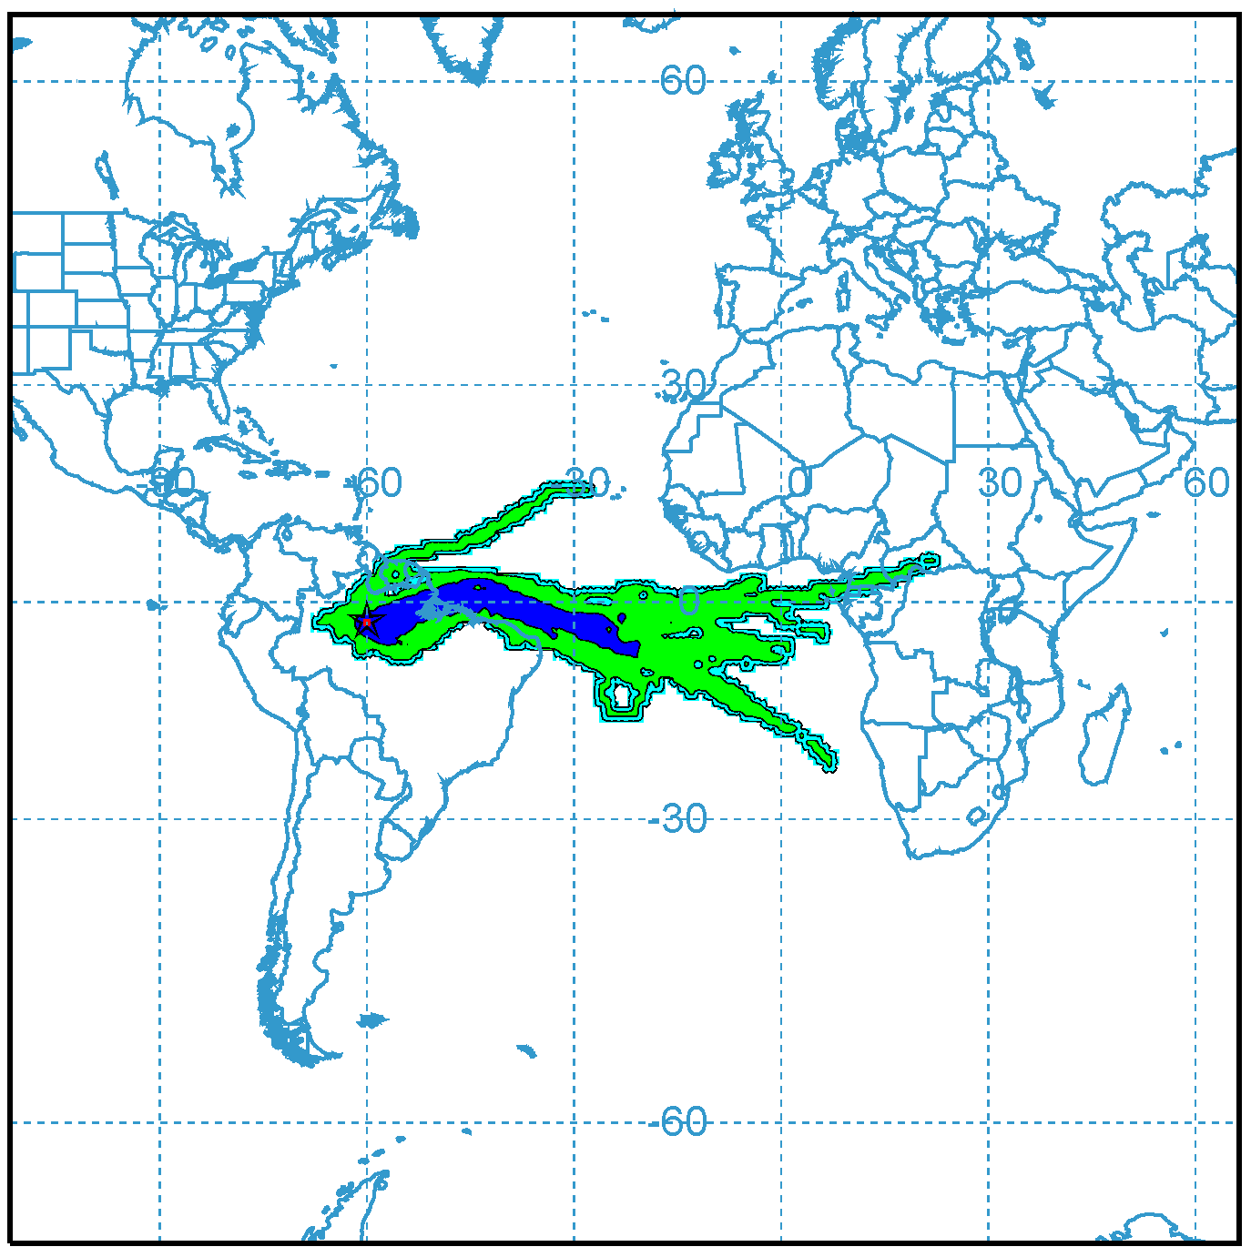
Air Mass Trajectories (10 days) and Footprint
Manaus Footprint
Manaus Footprint
500 m November
500 m - May

Slide 17
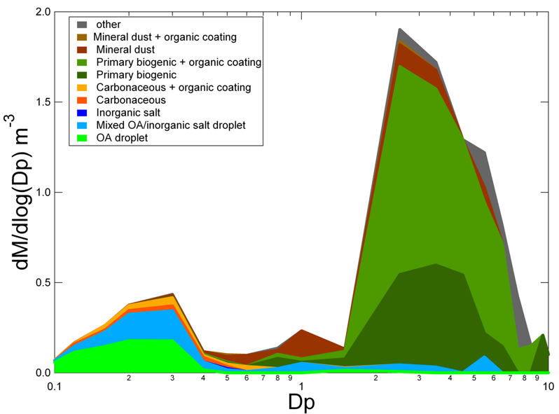
Particles in clean air over Amazon
Mass/size distribution
Biological, chemical, and physical processes over the Amazon form a closely coupled system
Martin et al., 2010, Pueschl et al., 2010

Slide 19
Ratio BC Fine and Coarse Mode to Total BC (2008-2012)

Slide 20
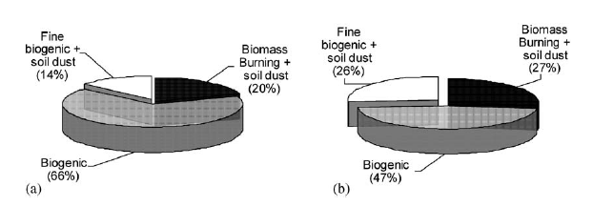
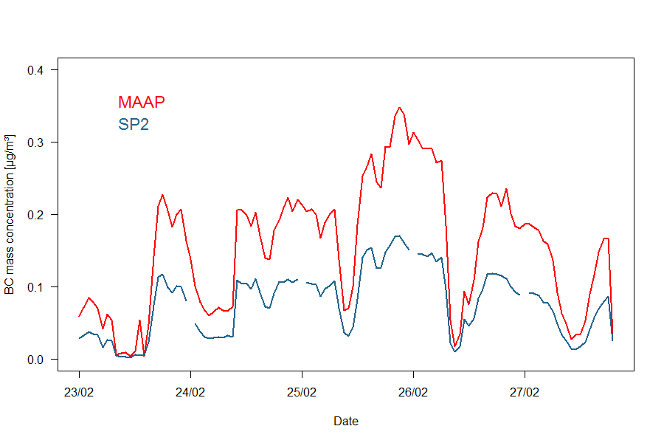
What is the light-absorbing substance over the Amazon?
Our old data suggested about 50% was related to biogenic materials
Guyon & al (2004)
Mass
Absorption
Our recent work with an SP2 indicates that only about half of absorption is due to soot carbon

Slide 21
ZF2 time series of organic and elemental carbon
Elemental Carbon is very low…

Slide 22
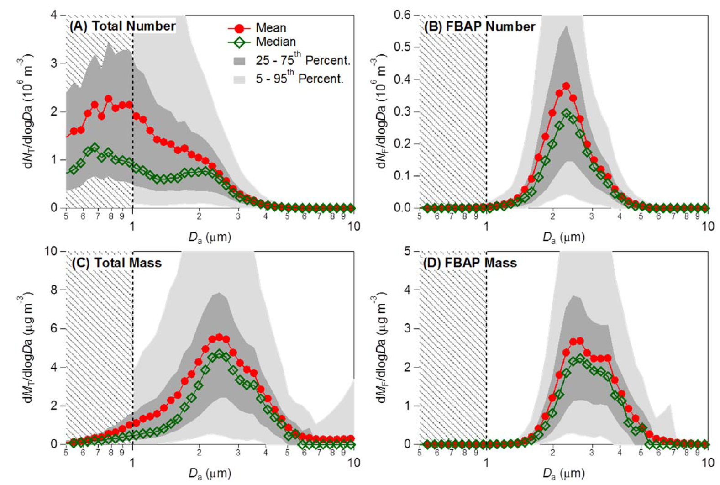
UV-APS Aerosol size distribution and UV fluorescence
Alex Huffman, ACP 2013
(A) total number (dNT/dlogDa), (B) FBAP number (dNT/dlogDa),
(C) total mass (dMT/dlogDa), (D) FBAP mass (dMF/dlogDa).

Slide 23
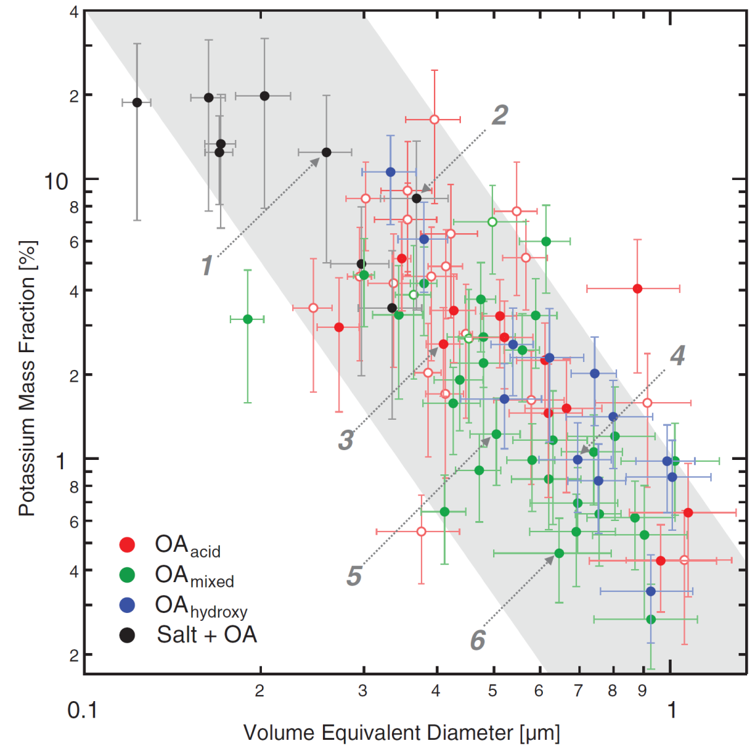
Size dependence of potassium mass fraction in Amazonian organic aerosol particles
Chris Pöhlker et al.,
Science 2012
STXM-NEXAFS shows that 95% of particles contains K, even SOA with dp 20-40 nm
The growth of organic aerosol particles can be initiated by potassium-salt–rich particles emitted by biota in the rainforest

Slide 24
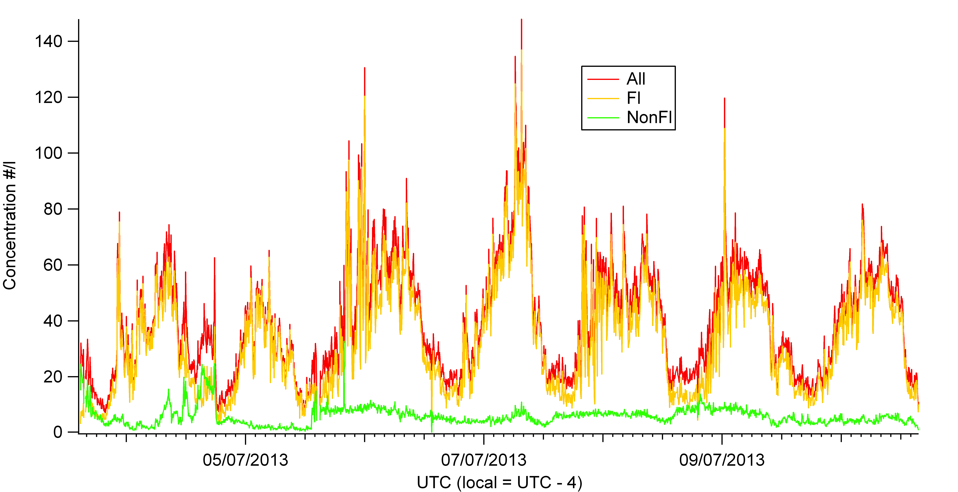
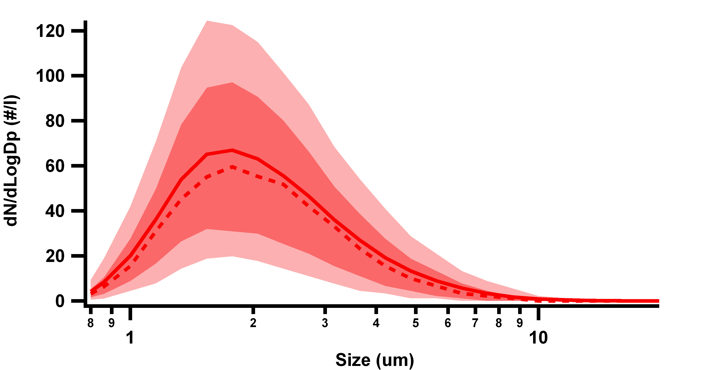
Diurnal variation in larger biological particles (WIBS)
Size range of
biological particles
BUNIAACIC - data from Jamie Whitehead

Slide 25
New particle formation? Bursts of particles 10<D_{p}<30 nm.
Aerosol size distributions measured in 2009 Apr 4th. There was a burst of ultrafine particles from 2:00 to 4:00 UTC time.
New particle formation and subsequent growth was seldom observed along two years of measurements. Nevertheless, in 70% of the days, bursts of particles with diameters in the range 10-40 nm were detected. The events usually lasted from 20 to 120min, and the subsequent growth to larger sizes was not always clearly observed.

Slide 26
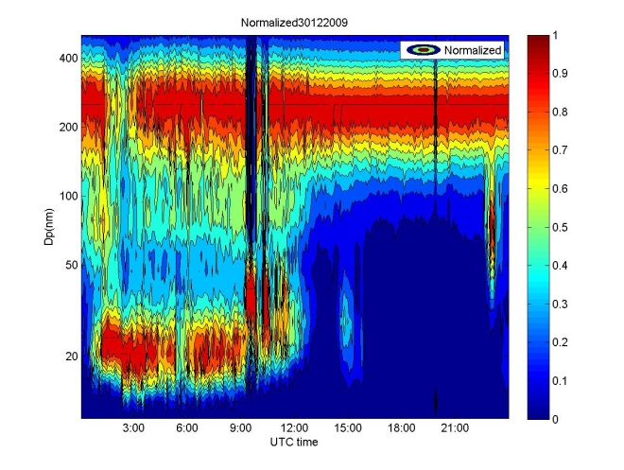
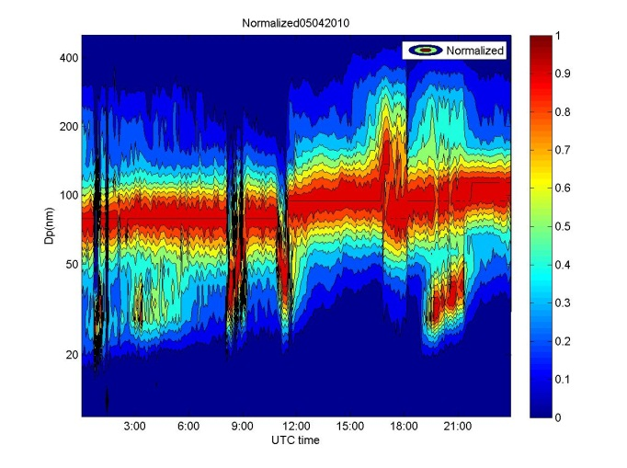
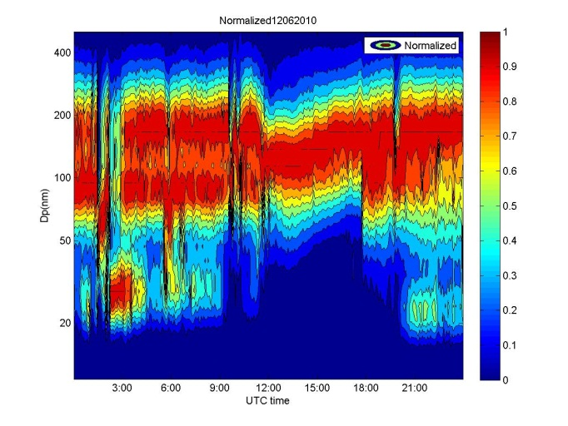
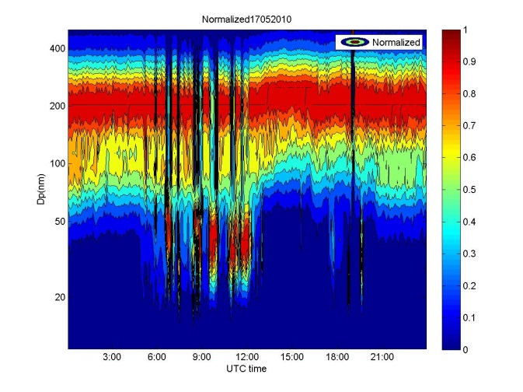
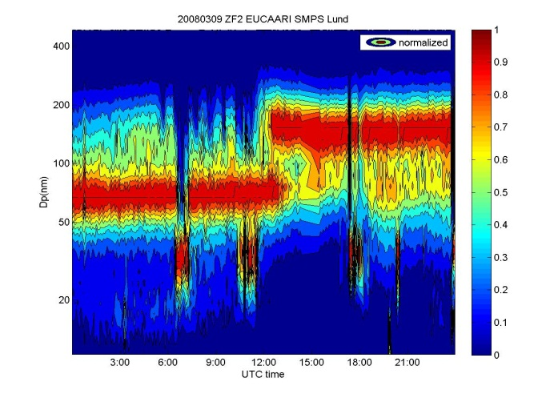
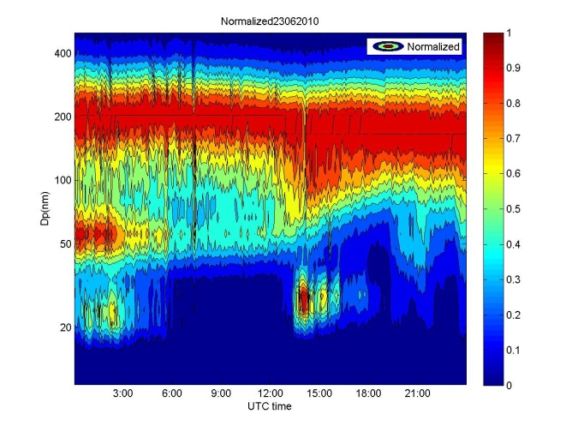
Particle bursts 20-30 nm at nighttime

Slide 27
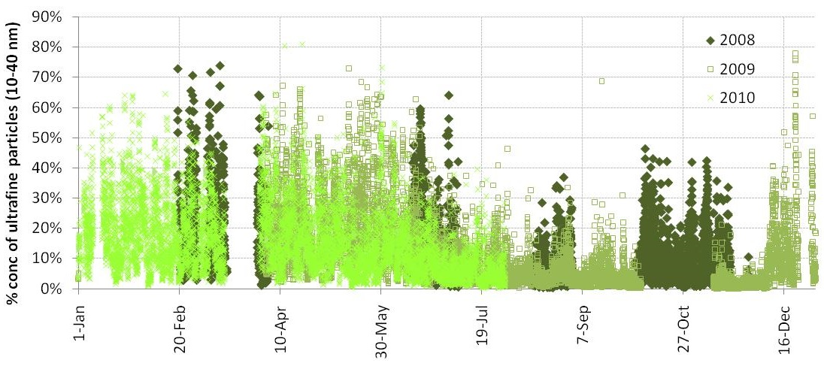
Percentage of particles with diameter from 10 to 40 nm
When this number is higher than 20%, an event of particles at 20 nm was observed.

Slide 28
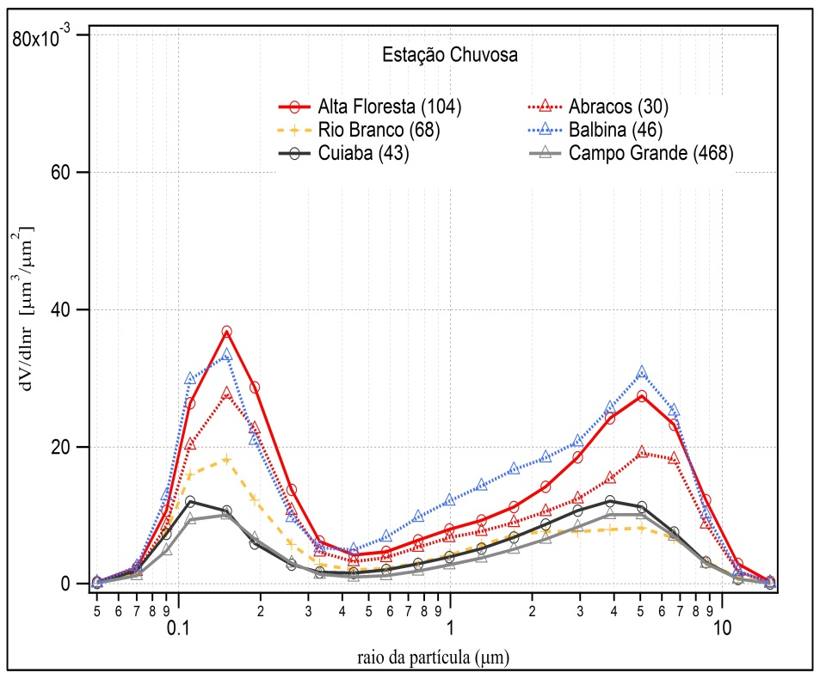
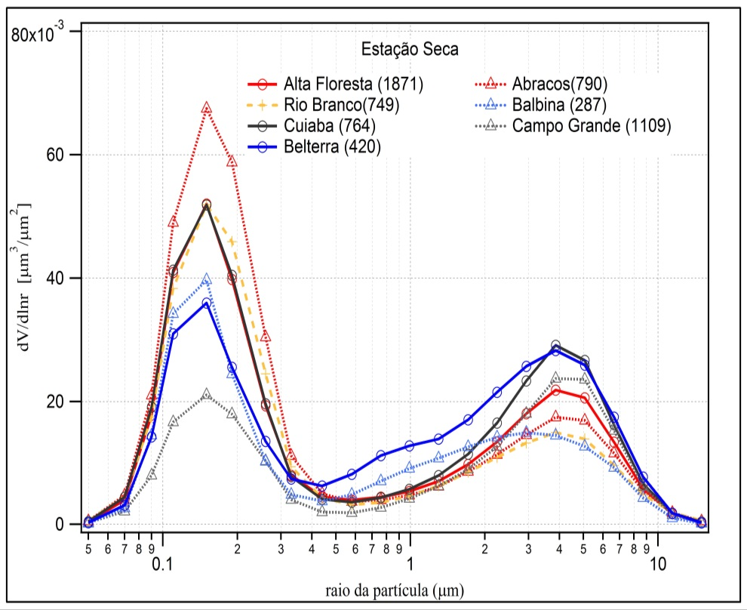
AERONET size distributions
BB/SOA
Secondary Organic Aerosol
Primary
Biological
Particles
PBP
Size distribution Wet Season
Dry Season
AERONET size distribution similar with ground based SMPS

Slide 29
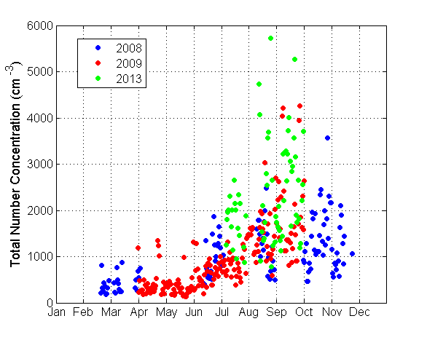
ZF2 daily medians of particle number concentrations integrated from observed size distributions (10-600 nm).
N=103,472
spectra
Rizzo et al., submitted 2014

Slide 30
Median particle number size distributions considering different periods of the day for wet and dry seasons. (Local time)
Rizzo et al., submitted 2014

Slide 31


Scattering and absorption daily median comparison (2008-2014)
All data corrected for STP (1013 mbar, 0C).
Notes:
Dry season: ATTO and TT34 are very similar (regional biomass burning emissions dominate particle optical properties).
Wet season: occasional differences between ATTO and TT34. All data corrected for STP (1013.25 mbar, 0oC). Scattering corrected for truncation error.

Slide 32

Single scattering albedo and scattering angstrom daily median (2008-2014)
Notes:
Wet season: Single Scattering Albedo and Angstrom exponent are noisier at both sites, partly due to low aerosol loadings and prevailance of coarse mode particles. All data corrected for STP (1013.25 mbar, 0oC). Scattering corrected for truncation error.

Slide 33
Joint analysis of two background sites
100 Km apart
Light scattering

Slide 34
Joint analysis of two sites 100 Km apart
Black Carbon

Slide 35

Organic compounds are major component of atmospheric aerosol, specially in Amazonia
Amazon
0.6 µg m⁻³
Adapted from Zhang et al., Geophys. Res. Lett., 2007 and Chen et al. Geophys. Res. Lett., 2009, 36, L20806.

Slide 36
Manaus organic aerosol wet season measurements
81% organics
PM1~0.61 µg/m³
Brito et al., 2013

Slide 37


Manaus organic aerosol dry season measurements (July-Dec 2013)
84% organics
4% Sulfates
Brito et al., 2013

Slide 38


A highly oxidized aerosol at ZF2 (July-Dec 2013) and ATTO (Jan-Mar 2014)
f44 = mainly CO₂^{+,} an indicator of highly oxidized species
f43 = mostly due to C₂H₃O⁺, an indicator of less oxidized species.
ZF2
ATTO

Slide 39

GoAmazon site in Manacapuru
Aug, 18 - Sept 1, 2013
f44 = mainly CO₂^{+,} an indicator of highly oxidized species
f43 = mostly due to C₂H₃O⁺, an indicator of less oxidized species.

Slide 40

ACSM at ATTO: Comparing SMPS with sum ACSM+EBC
Notes:
Comparação início da amostragem entre aetalômetro, SMPS e ACSM

Slide 41


Diurnal variability of aerosol species in Amaze
Qi Chen, submitted 2014

Slide 42
Amazonia is critically important for water vapor transport in South America

Slide 43


Ice nuclei from biogenic emissions and Sahara dust in Central Amazonia
Dust relation to ice-nucleus measurements. Dust concentrations during AMAZE-08. a, GEOS-Chem simulated dust from 2–6 March at 18 UTC. The field site, shown as a black diamond, typically fell near the edge of the plumes. Fine-dust concentrations from PIXE measurements (black rectangles; µg/m³, dp<2µm.

Slide 44


Relationships between cloud properties and aerosol loading in Amazonia
Microphysics
absorption effects
Aerosol Optical Thickness
Koren et al., Science 2008

Slide 45


Relationship between aerosols and precipitation in the La Plata Basin
AERONET (Aerossols) +
TRMM (Precipitation) + BRAMS (simulations)
Reduction in precipitation with increase in aerosols
BRAMS: Simulations with cloud microphysics confirm the measurements
Silva Dias et al., 2014

Slide 46

Regional and global energy balance

Slide 47

Average spatial distribution of the direct radiative forcing (DRF) of biomass burning aerosols in Amazonia during the dry season of 2010
CERES and MODIS
Sena et al., 2013

Slide 48

Mean Diurnal Radiative Forcing due to change in surface albedo in Rondonia:
-7.3 + 0.9 W/m²
Mean Diurnal Aerosol Forcing Efficiency:
Forest: -22.5 + 1.4 W/m²
Cerrado: -16.6 + 1.7 W/m²
Water column difference by 6-10%
Forcing of water vapor column: -0.4 to -1.2 W m⁻²
Land-use change radiative forcing. Forested areas are selected in red and deforested areas are selected in yellow.
Sena et al., 2013

Slide 49

Biospheric feedbacks through aerosol-cloud interactions in the natural atmosphere – the Amazon provides the ideal natural reactor

Slide 50

Strong effects of aerosols in Amazonia
Increase in aerosol loading

Slide 51



Effects of aerosol particles on carbon uptake by the forest: Diffuse radiation plays a major role
Rondonia
(Glauber Cirino, 2014)
Manaus

Slide 52


Biological, chemical, physical and social processes over the Amazon form a pretty complex coupled system
Still a lot to learn…
Thanks for the attention!!!

Slide 53
Scattering, absorption and SSA in Manaus and Porto Velho
Monthly statistics (2009 – 2012) for light scattering coefficient σ_{s} at 637 nm and light absorption coefficient σ_{a} at 637 nm in Mm⁻¹ for Porto Velho (PVH, in black) and central Amazonia (TT34, in red).
Single Scattering Albedo Lower at the pristine site
Artaxo et al., 2013

Slide 54


Observations and Modeling of the Green Ocean Amazon
GoAmazon2014
GoAmazon2014
Green Ocean Amazon 2014
Carbon Cycle Cloud Life Cycle Aerosol Life Cycle
Climate
Ecosystems
Atmospheric Composition

Slide 55

SAMBBA Biomass Burning f44/f43 plot ACSM
f44 = mainly CO₂^{+,} an indicator of highly oxidized species
f43 = mostly due to C₂H₃O⁺, an indicator of less oxidized species.

Slide 56

Chiral analysis of 2- methyltetraols
Gonzales et al., 2014
Chiral and isomeric analysis can be used to distinguish between atmospheric chemistry process or primary biological origin

