Slide 1
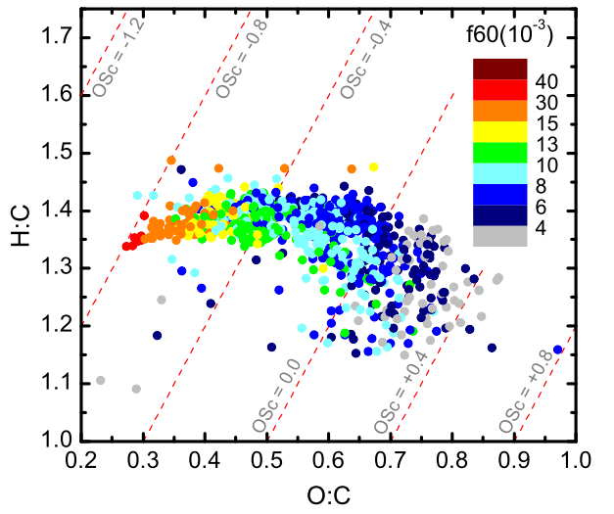
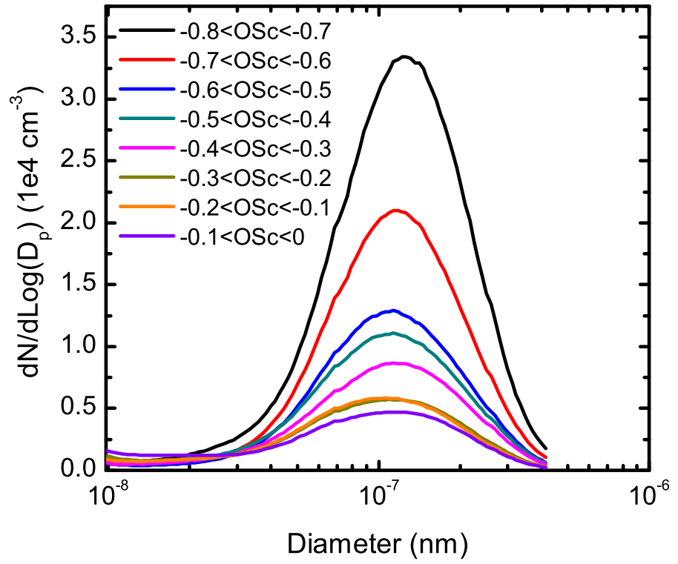
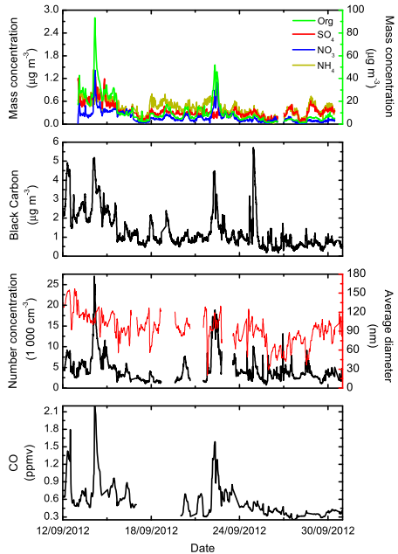
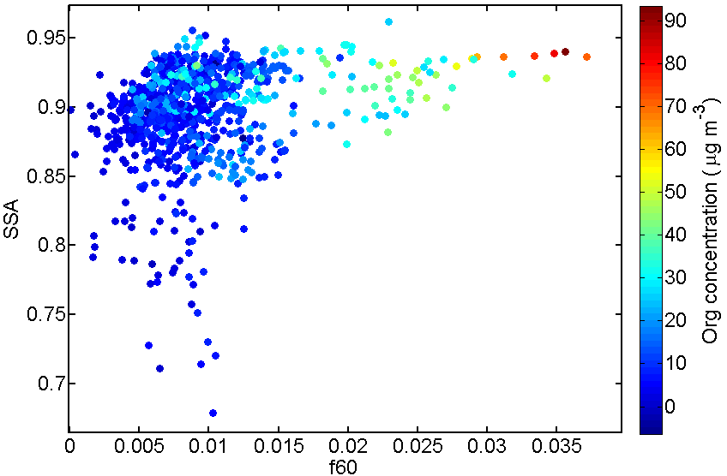
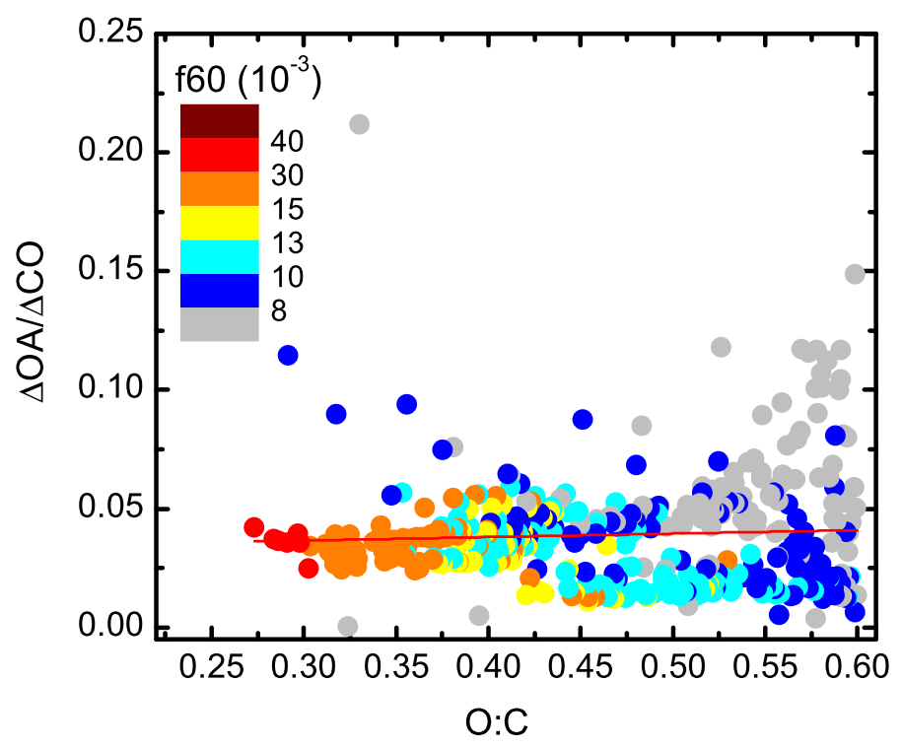
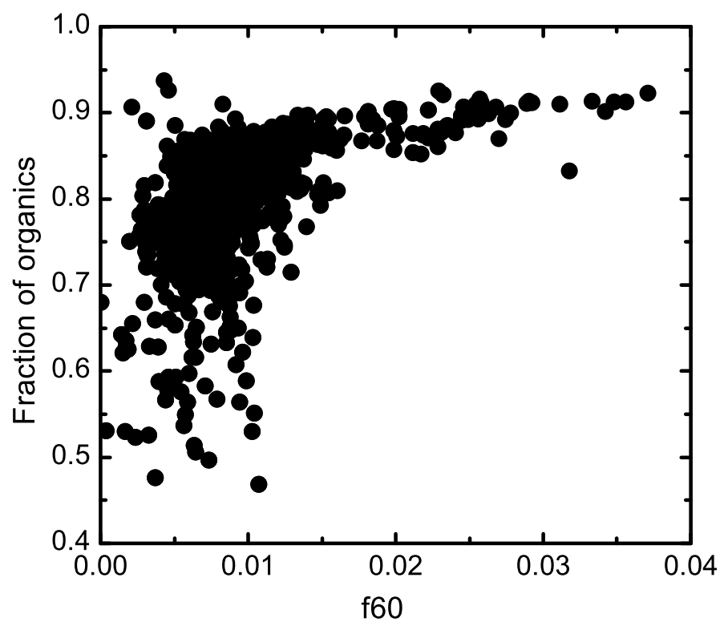
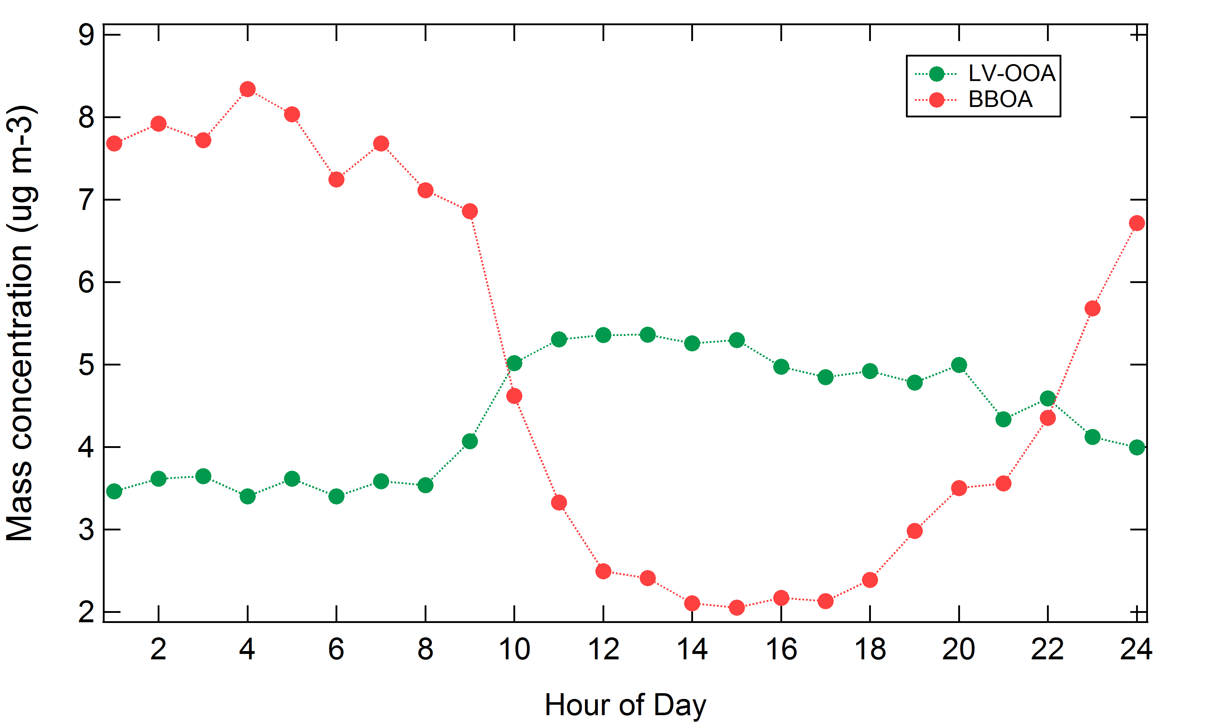
Ground based characterization of biomass burning aerosols during the South American Biomass Burning Analysis (SAMBBA) ﬁeld experiment
Joel Brito(1), Luciana V. Rizzo (2), William T. Morgan(3), Hugh Coe(3), Ben Johnson (4), Karla Longo (5), Saulo Freitas (5) and Paulo Artaxo (1)
University of Sao Paulo, Brazil (jbrito@if.usp.br), (2) Federal University of Sao Paulo, Brazil, (3) University of Manchester, United Kingdom, (4) UK Met Ofﬁce, United Kingdom, (5) National Institute for Space Research (INPE), Brazil.
Background
The biomass burning aerosol, studied using a Van Krevelen diagram, was observe to be processed by the change in the O:C ratio only, consistent with the replacement of a hydrogen with an alcohol group (-OH), for example. The parameter f60 is a biomass burning marker.
The South American Biomass Burning Analysis (SAMBBA) was an international research project investigating the impacts of biomass burning emissions on climate, air quality and numerical weather prediction over South America. The measurement program was headed by the deployment of UK’s BAe-146 research aircraft from FAAM (Facility for Airborne Atmospheric Measurements) over Brazil during the dry season of 2012. The aircraft operation was coordinated with ground-based measurements set up at Porto Velho, operated by the University of Sao Paulo.
Results and discussion
Physical processing
(a)
Despite strong chemical changes in the aerosol composition, its size distribution has not been affected during atmospheric processing, except for a scaling factor. The oxidation state (OSc) is defined as 2xO:C-H:C.
Several instruments were deployed at the sampling site, near Porto Velho, Rondônia. Here, results from an Aethalometer (Magge), SMPS (TSI), CO monitor (Picarro) and an ACSM (Aerodyne) are analyzed. The ACSM is a compact version of the widely used Aerosol Mass Spectrometer (AMS, Aerodyne). Concentration time series of: Organics, SO4, NO3 and NH4 (a), Black Carbon (b), particle number concentration and average diameter (c) and CO mixing ratio (d).
(b)
The single scattering albedo (SSA), as well as the fraction of organics, was strongly enhanced during biomass burning events, indicating highly scattering aerosol at the 637nm wavelength.
(c)
(d)
The mass ratio of Organic Aerosol (OA) relative to CO indicates very little contribution of Secondary Organic Aerosol (SOA) production with processing of the biomass burning plume.
Chemical processing
Positive Matrix Factorization analysis
During intense biomass burning events, the mass contribution of organic matter relative to SO4, NO3, NH4 and Black Carbon has strongly increased. Such organic contribution is the among the highest worldwide. The f60 is a biomass burning marker measured by the ACSM.
Two dominating factors were obtained, Low Volatility Oxygenated Organic Aerosol (LV-OOA) and Biomass Burning Organic Aerosol (BBOA). Diurnal variation of the BBOA factor indicates regional pollution following boundary layer, whereas LV-OOA (highly processed OA or SOA) seems to be from aloft.
Funding: FAPESP 2010/52658-1 and FAPESP 2012/14437-9

